Slide 1
NOURISHING
TRADITIONAL DIETS
THE KEY TO VIBRANT HEALTH
PART I
BY SALLY FALLON MORELL, PRESIDENT
THE WESTON A. PRICE FOUNDATION
POWERPOINT DESIGN BY SANDRINE LOVE
COPYRIGHT 2018 Sally Fallon Morell
Notes:
This presentation is copyrighted 2018 by Sally Fallon Morell. Others may use these slides to present this information to the public without compensation to Sally Fallon Morell; however, this presentation may not be sold or given for pay to the presenter.

Slide 2
DISCLAIMER
Title Slide
The information contained in this presentation
is not intended as a substitute for professional
medical advice, diagnosis or treatment.
It is provided for educational purposes only.
You assume full responsibility for how you choose
to use this information.

Slide 3

WHAT IS A HEALTHY DIET?
ATKINS DIET?
VEGETARIAN/VEGAN?
ZONE DIET?
ALL RAW?
MACROBIOTIC?
SOUTH BEACH DIET?
JUICING?
FOOD COMBINING?
BLOOD TYPE DIET?
METABOLIC TYPING?
EVEN LISA IS CONFUSED!
Notes:
Today we will try to answer the question: what is a healthy diet?
Today most people—even those within the conventional medical system—understand that what we eat has a bearing on our health. The problem is that there are so many conflicting claims about what constitutes a healthy diet. No wonder we are confused—even the precocious Lisa Simpson is confused!
Proponents of everything from a diet based on meat to all-raw veganism claim that theirs is the proven pathway to good health. Most of the diets listed here can be classified as “schemes,” thought up by men (sorry, guys!) who never had to put meals on the table, day after day, for a large family. When you are faced with the challenge of providing nutritious meals that everyone in your family will actually eat, and that you can afford, you cannot be bothered by preparing foods specifically for the blood type or metabolic type of individual family members!
All kidding aside, how are we to make sense of all these conflicting claims in order to choose a diet that works for ourselves and our families? And not only in this generation but in the generations to come.
Good health has to do not only with how we feel today, but the health of the future generations we produce.

Slide 4
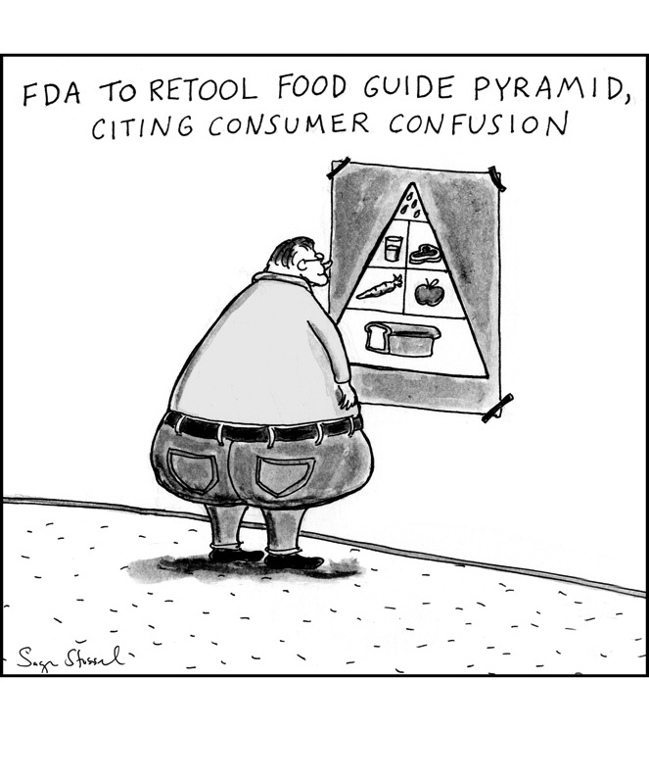
Cartoon
OR IS IT THE US GOVERNMENT OFFICIAL DIET?
FORMULATED TO PROMOTE THE PRODUCTS OF COMMODITY AGRICULTURE!
Notes:
In addition to the dietary schemes presented in the previous slide, we have the official U.S. government diet, based on carbohydrates, mostly refined carbohydrates. Make no mistake, this diet is not based on science; it was designed to promote the products of commodity agriculture—processed foods made from wheat, corn, conventional milk, sugar, soy and industrial seed oils.
First proposed in the early 1980s, the USDA Food Pyramid gave Americans the green light to eat as much refined carbohydrate food as they wanted. Since that time, consumption of protein and fat has remained about the same, while consumption of carbohydrate foods in the form of bread, pasta, crackers, desserts and snack foods has increased considerably and obesity rates have doubled, from 15 to 30 percent of the population.

Slide 5
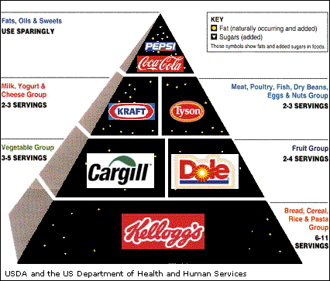
Notes:
The USDA Food Pyramid often leads to this—the junk food pyramid.

Slide 6
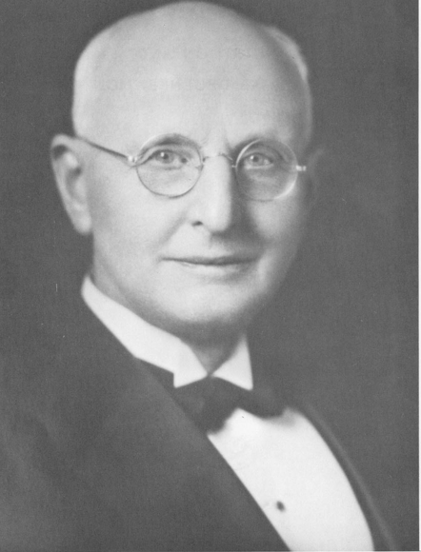
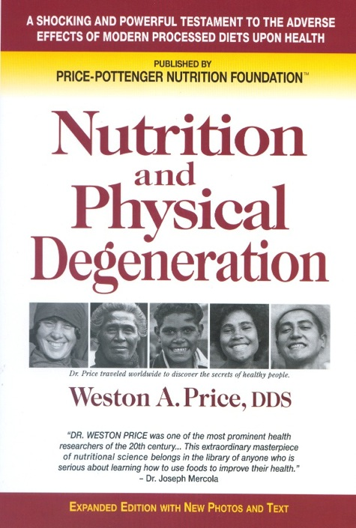
WESTON A. PRICE 1870 – 1948
Notes:
In order to answer the question, “What is a healthy diet?” we need to look at the scientific findings of Dr. Weston A. Price. Dr. Price is sometimes called the Charles Darwin of nutrition. I like to call him the Isaac Newton of nutrition because he figured out the fundamental laws of human diets, which, like the laws of physics, identify certain dietary components the body needs to be built properly and to stay healthy. It was Weston Price who put us on the path with his discovery of these basic fundamental laws.
Who was Weston Price? Weston Price was a dentist who practiced back in the 20s, 30s, and 40s in Cleveland, Ohio. He was well known and well respected in his day, widely published in peer review journals. He was the author of a textbook on dentistry used by the US Navy. He served as head of research for the National Dental Association. He had a laboratory in his dental office where he evaluated different foods for nutrient content. He wrote prolifically and did a lot of research on root canals
Dr. Price became more and more concerned about the increasing amount of dental carries he was seeing in his patients. He noted that tooth decay not only caused a lot of suffering but also that people who suffered from tooth decay invariably had other health problems. In addition, he was concerned about the children coming into his practice. More and more frequently he saw what he called “dental deformities.” We have a euphemism for this condition; we say “crooked teeth.” More and more young people were coming in with narrow jaws, narrow palates, not enough room for their teeth to come in and hence crowding, overbites, underbites, the under-development of certain areas of the face. He noted that the young people who had these problems invariably had other health problems. He concluded that the teeth were a visual indicator of what’s going on in the rest of the body.
Now Dr. Price practiced at a time when the world was opening up; adventurers and anthropologists were going to areas where there had never been any contact with civilization before. Their observations and photographs appeared in magazines like the National Geographic. They frequently observed that isolated peoples had beautiful teeth. In fact, the 19th century American painter George Caitlin described the teeth of the Native Americans as “white and straight as piano keys.” Dr. Price had a nephew who worked for the National Geographic, so this was dinner table conversation in the Price household.
These reports intrigued Dr. Price very much, and he decided to start out on a series of travels to find these people with beautiful teeth. His investigations lasted ten years and are described in his book Nutrition and Physical Degeneration. In his travels, Dr. Price sought the answers to two questions. The first question was, was it true? Were these reports of populations that did not suffer from dental carries and dental deformities actually true? Did people with excellent dental health—and by inference, excellent overall health—really exist? And if the answer to the first question was yes, then he sought the answer to the second question: what were these people eating? He was not interested in what unhealthy people were eating. He knew what unhealthy people were eating. He wanted to know what types of food the diets of healthy people contained.
That was the genius of Dr. Price--he asked the right questions and had the fortitude and persistence to determine the answers. It was the perfect time in the history of the world to seek the answers to these questions because groups of isolated peoples still existed, and he had at his disposal a new invention to record his findings—the camera.

Slide 7
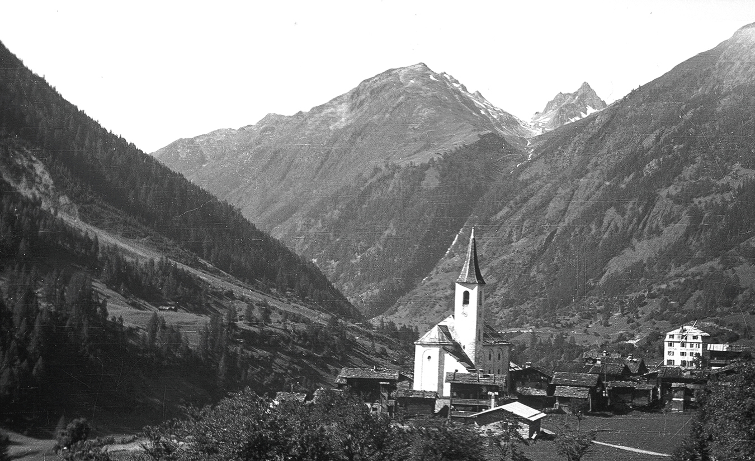
LOETSCHEN VALLEY, SWITZERLAND
Notes:
Dr. Price began his travels to remote parts of the globe in 1931. The first place he visited was the Lötschental(Loetschen Valley), a very remote valley in Switzerland. At that time the only access to some of the villages in this valley was a footpath too narrow for a wheeled cart. Thus Dr. Price could be assured that the food they consumed was food that they had grown themselves, with the exception of salt, which was carried in. Everything else was grown and prepared in the village.
Whenever Dr. Price visited a tribe or village, he first sat down with the elders and, with the help of an interpreter, he explained his research. Then when he had gained their confidence and permission, he lined everyone up in the village, meticulously counted cavities in each individual, and noted the presence of dental deformities. This part of his research was exacting and precise. He recorded his findings in notebooks and published them in peer reviewed dental journals.
He also took photographs and took more general notes on the health of the population. These notes were of course less precise, less scientific, but nevertheless very interesting.
Finally, he described the foods that they ate; he also carried samples of the foods back home to his laboratory in Cleveland for nutrient analysis.

Slide 8
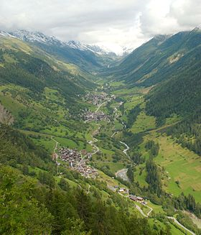
Notes:
Photo of the beautiful Lötschental

Slide 9
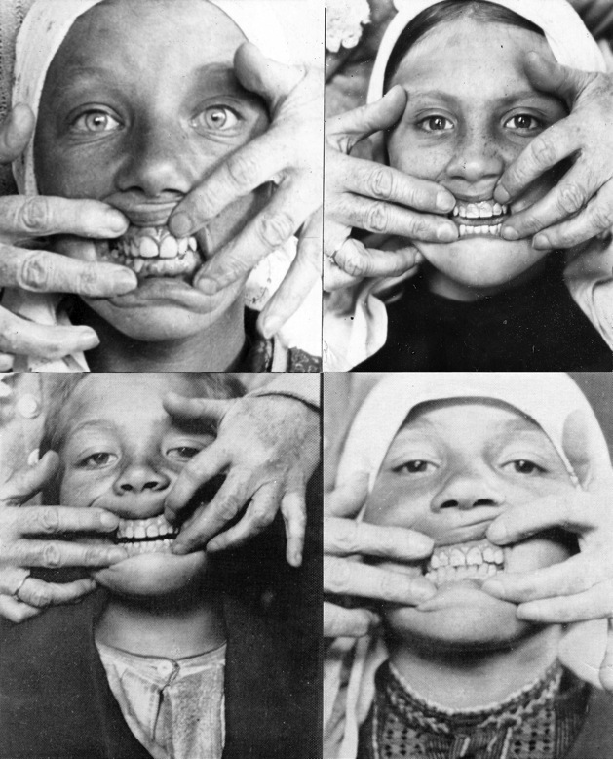
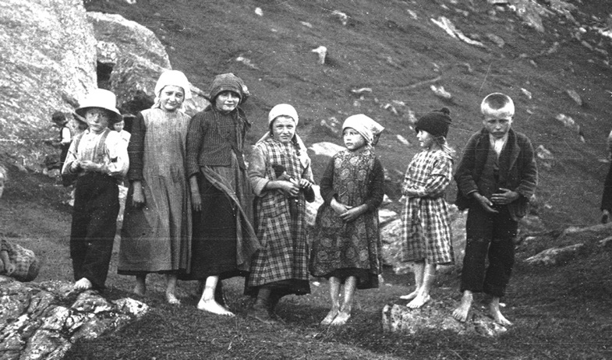
PRIMITIVE SWISS
Notes:
You can imagine the amazement of the dentist from Cleveland, lining up all the people in this village, all the children and all the adults, and discovering he had to look in three mouths before he found even one tooth that had evidence of decay. These villagers had less than 1 percent tooth decay. Furthermore, none had dental deformities. Every single child, every adult in the village, had straight teeth, they had broad faces, and the adults had all their wisdom teeth. Notice the round, fully formed faces of the children in the photo on the right.
By the way, the children never brushed their teeth, they had never seen a tooth brush. Many of the children’s teeth were covered with green slime but they had virtually no cavities. Price observed that the children were very hardy. They played in frigid streams barefoot during weather in which he and his wife had to put on heavy overcoats. The men in the villages were noted for their strength--they routinely won the athletic contests throughout Switzerland--and the women were noted for their beauty. So it was just the opposite of Lake Wobegan. . . except all the children were above average.
In talking to the health officials of Switzerland, Price learned that there had never been a case of tuberculosis in this village, and this was a time when tuberculosis was raging throughout the rest of Switzerland. They couldn’t explain this remarkable fact as a result of lack of contact because very often the young people would leave the village, work somewhere else and come back later. So they did have exposure to TB, but no one from the village had ever contracted the disease.
Thus, with his first visit, Price answered his first question with a resounding “yes.” He had found a healthy isolated population, judged by the evidence of their teeth, and by the anecdotal evidence of Swiss health authorities. So, he turned his attention to his second question. What were these healthy Swiss villagers eating?
The number one food in the diet was the very food that was blamed for causing the epidemic of tuberculosis throughout the rest of Switzerland and the world: raw milk. These people kept cattle and goats. The animals grazed on the rich lush pastures beneath the melting glaciers; the diet consisted of raw milk, raw cheese, raw cream and raw butter. They also grew rye which they made into a very dense sour dough rye bread. So the basis of the diet was dairy foods and grains—foods that are forbidden on the paleo diet, which claims that these foods are new to human beings and making us sick. Yet here was a diet based on dairy and grains and the people were superbly healthy.
The Swiss villagers also had meat about once a week, usually veal because they killed the calves to get rennet for making cheese. They ate the whole animal including the organ meats; they made soup with the bones; they also ate some vegetables during the short summer months. But the basic diet for the Swiss villagers was raw milk products and sourdough rye bread. A typical lunch for the children was a thick slice of rye bread and a thick slice of Swiss cheese. During athletic contests, the athletes drank bowls of pure cream. The diet was very rich in animal fat.
Every isolated culture that Price observed had one or more sacred foods. The sacred foods were foods considered very important for couples before conception, for pregnant women, during lactation and for growing children. Today we are very casual about how we bring children into the world—when something goes wrong we blame it on the three G’s, germs genes and God—but all primitive peoples understood that the responsibility for bringing healthy children into the world rested on their shoulders.
The sacred food in Swiss villages was the butter that came from the cows when they first went up to pasture in the spring. This butter was a deep orange color. They actually had a ceremony in which they lit a wick in a bowl of butter on their altars to honor the life-giving force in this wonderful butter.

Slide 10
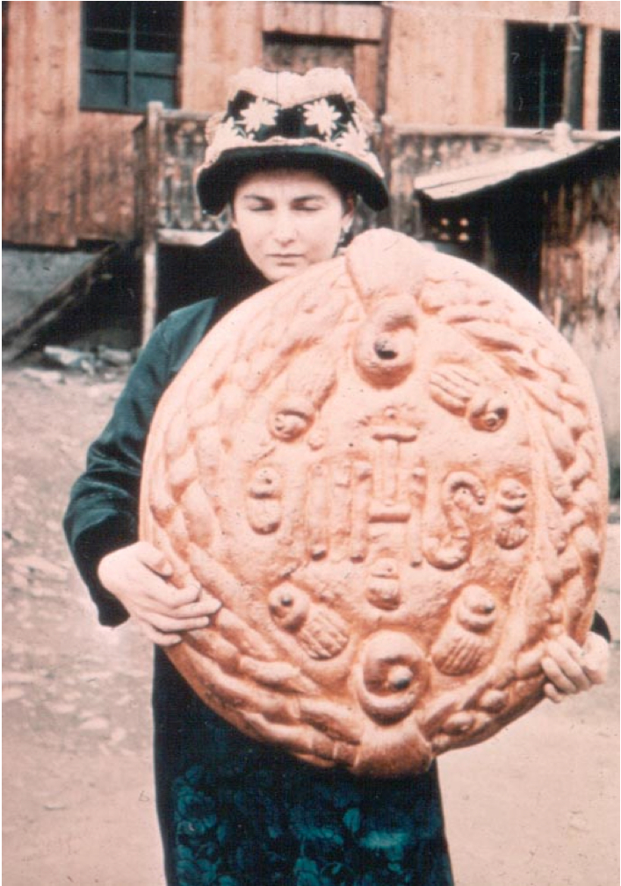
Swiss Bread Photo
Notes:
Here’s a picture of their sourdough rye bread. First notice the beautiful bone structure of the woman holding the bread, her high cheekbones. Also, she is nice and slender despite her high fat diet. (And don’t you love the hat!)
Also notice the hole near the top of the loaf of bread. This is put there so they can hang the bread up with a hook. The bread is sourdough and takes a long time to make, and then it is hung up and allowed to “cure” for an additional two weeks. The process of making the bread with the long curing is basically a fermentation process. We recently learned that breadmaking was carried out only twice a year, so the bread they ate was a slow-cured product.
This is a theme we’re going to see over and over again in these cultures – very careful preparation of grain products that allow a long fermentation period—two weeks is very typical, and often much longer. Later on we will explain why this careful preparation is so important.

Slide 11
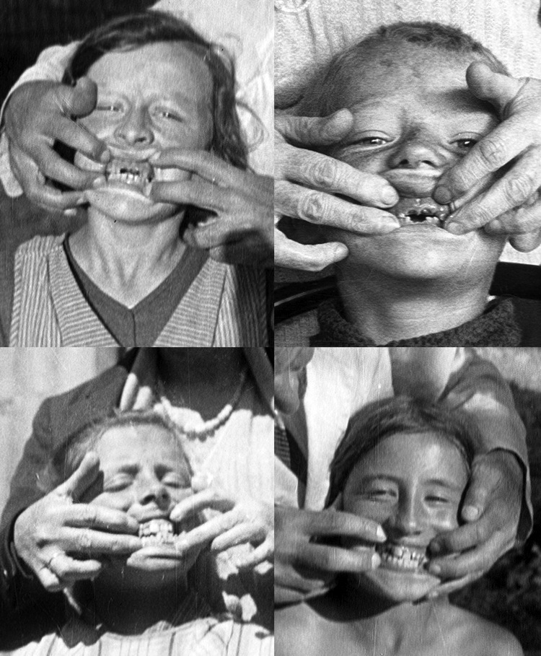
MODERNIZED SWISS
Notes:
Dr. Price also visited Swiss villages that had connection by road to so-called civilization and in these villages he found stores selling our kinds of food--sugar, white flour, pastries, candies, jams and jellies, canned condensed milk, canned foods and vegetables oils—at that time mostly cottonseed oil. People no longer drank rich, raw milk. . . The farmers were selling their milk to the chocolate factories.
Price also counted cavities and took photographs in these villages. If the store had already been there for a few years, he found one tooth in three was decayed, and if the store had been there long enough for a new generation to come along, the children born to the parents who had changed their diet had dental deformities. Their teeth were coming in overlapping, crowded and crooked. Their faces were more narrow than those of the primitive children he had seen in the Loetschen Valley. Most tragically, tuberculosis became a huge problem in these communities.

Slide 12
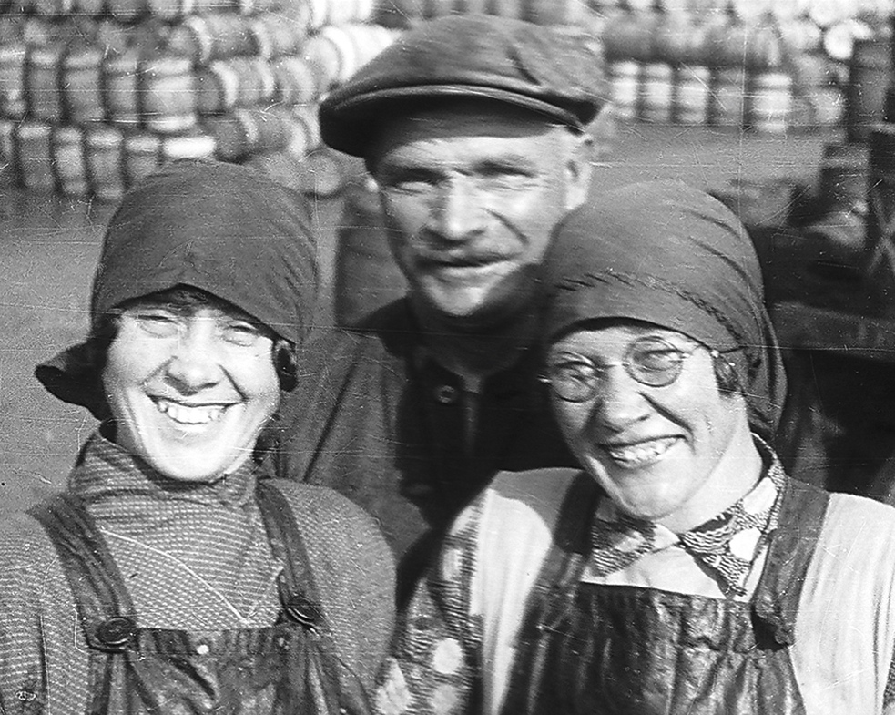
PRIMITIVE GAELIC PEOPLE
Notes:
Next Dr. Price went to a remote island off the coast of Scotland in the outer Hebrides. Here he found a very healthy population with excellent dental health – virtually no tooth decay—and free of tuberculosis. Price was very taken with the cheerfulness, optimism and spirituality of these people living on this remote, windswept, foggy island.
The diet of these people was very different than the one he had found in Switzerland. They had no dairy animals, they had no animals of any kind. They had no chickens, no pigs, no eggs, and they had no fruit and no vegetables. . . . no broccoli! How could they possibly be healthy?
So what were these hearty Gaelic people eating? They ate seafood. The diet was a based on seafood of all types, and not just skinless fish filets but the whole fish, including skin, head, liver and liver oil, and shellfish of every type. They also grew oats which they made into porridge and oat cakes. Oats and seafood, that was the diet. The only green food was seaweed, considered very important for good health.
The sacred food on this island, one that was considered important for pregnant women and growing children, was cod’s head stuffed with oats and chopped cods liver.

Slide 13
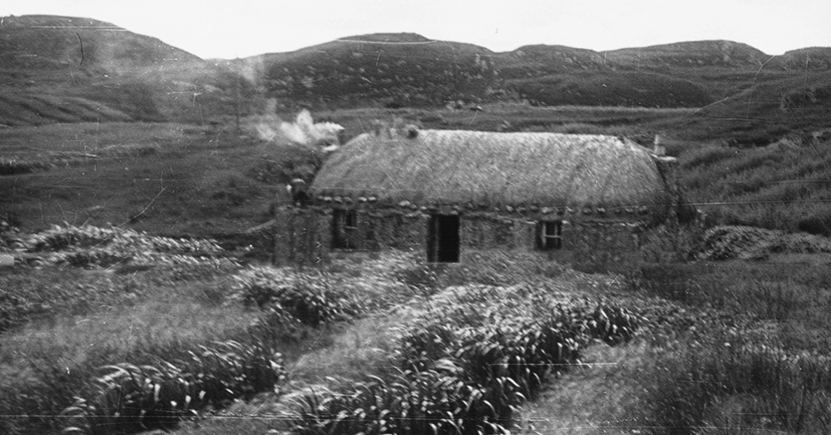
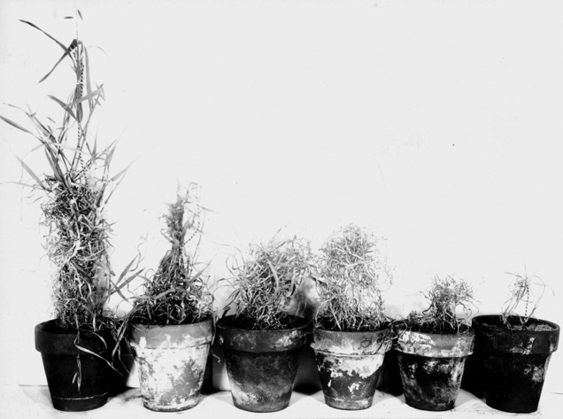
PRIMITIVE GAELIC PEOPLE
Notes:
The people in the Outer Hebrides lived in cottages that had no chimneys, and their thatch became blackened with smoke during the winter. In the spring, they removed the blackened thatch from the roof and spread it on the fields so they could get a good crop of oats. The soil was very poor on these islands but the islanders understood the principle of soil fertility.
Dr. Price did an experiment in which he took soil from the island and put it into different pots. He added different types of fertilizer and planted oats. The pot on the right contained only soil from the island, with no fertilizer. The four middle pots contained soil plus various types of commercial fertilizer. The pot on the left, the only one that grew a normal crop of oats, contained soil from the island plus the smoke-blackened thatch.
Price was able to observe the dental health and over all health of Gaelic peoples living on islands that had contact with the mainland, that had stores selling western type foods. These people suffered from rampant tooth decay and tuberculosis. The health officials told them they needed to put chimneys in their cottages because they were living in smoke-filled environments all winter long, making them susceptible to tuberculosis. So everyone had to put chimneys in and they could no longer put beautiful thatch on the fields. They were buying foods in stores anyway, not growing or catching their own. But no one stopped to ask why the primitive Gaelics never got tuberculosis living in these dank, smoky cottages all winter. They did not contract TB because the diet was so nutrient-dense that they had everything they needed, even in this stressful environment, to combat such diseases. And putting chimneys in did not prevent TB in the people eating processed food.
By the way, it is a myth that primitive people had less exposure to toxins than we do. They were exposed to smoke almost constantly from their fires inside houses, huts and teepees—and smoke is full of toxins, especially dioxins. But they had one very important protective factor in their diets—we will return to this subject later.

Slide 14
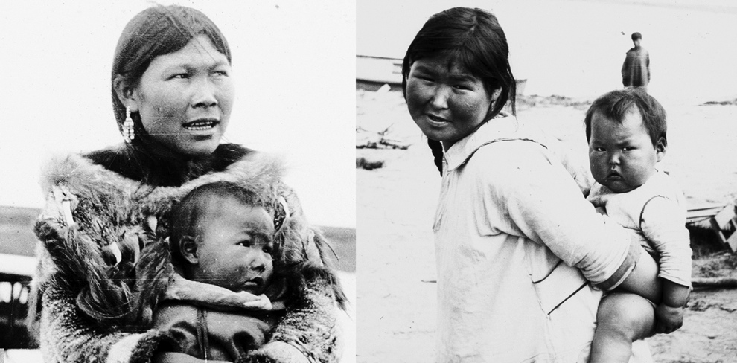
PRIMITIVE ALASKAN PEOPLE
Notes:
Dr. Price then went to Alaska, to the remote, so-called primitive villages, where he found a very high degree of health and physical perfection among the natives. He describes the teeth of the woman on the left as virtually two rows of pearls.
He noted that the babies were very strong, very sturdy. They were curious and alert. One observation he made was that in primitive cultures, the babies rarely cried--they only cried when they hurt themselves.

Slide 15
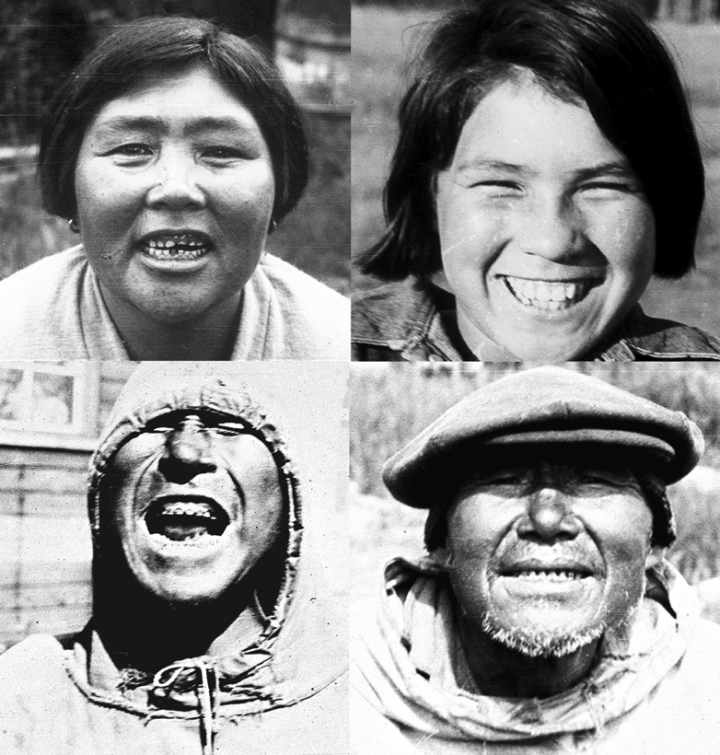
PRIMITIVE ALASKAN PEOPLE
FREE OF TOOTH DECAY AND DEGENERATIVE DISEASE.
Notes:
The photographs on this page show the faces of so-called primitive Eskimos. Price uses this word primitive in a complimentary sense, not as an insult. He was in awe of their primitive wisdom pertaining to food choices. (Most researchers in those days referred to these isolated people as “savages,” an insulting term that Price never used.)
Many Eskimos had worn down or even missing teeth, because they chewed on leather to make their clothes and often encountered grit and grains of sand. But even these worn down teeth had no cavities. And every member of these isolated villages had straight teeth, with no dental deformities.
Price was able to affirm the overall state of health of the primitive Eskimos in his conversations with one Dr. Romig, who had lived for thirty years among the Eskimos. Dr. Romig told him he had never seen a case of cancer, heart disease or any condition requiring an operation among those Eskimos who lived as their ancestors lived; while those who ate modern food contracted all the modern diseases that we suffer from. Furthermore, if he could convince an Eskimo with TB or some other serious disease to return to his ancestral village, he invariably recovered.
The primitive Eskimo women gave birth with ease—typically having her baby at night while her husband was asleep. When he woke the next morning, she introduced him to the new baby! But the women living in towns and eating modern foods had great difficulty in childbirth.

Slide 16
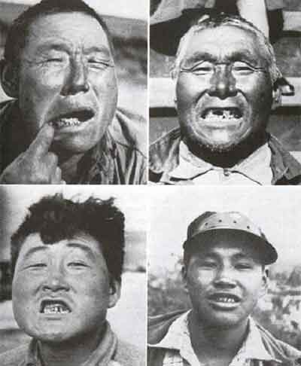
MODERNIZED ALASKANS
FIRST GENERATION SUFFERED FROM TOOTH DECAY.
Notes:
The diet of Eskimos living in towns caused rampant tooth decay and a tremendous amount of suffering. This once happy, optimistic population became prone to suicide, and the only cause of suicide was severe toothache.
Processed foods were among the first items to come in with the white man, but the technology to help them, the dentists, did not get there until later. It is important to realize that many of us would look just like this if we didn’t have dentists to repair the damage from our modern diet.
So we can be grateful to have the dentists to help repair some of this visible damage but it’s much harder to repair the damage that we don’t see, inside our bodies.

Slide 17
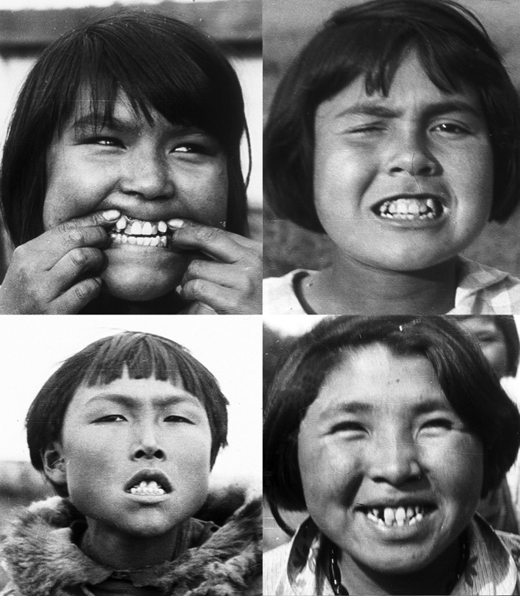
MODERNIZED ALASKANS
SECOND GENERATION HAD MORE NARROW FACES,
AND SUFFERED FROM DENTAL CROWDING AND MODERN DISEASES.
Notes:
Dr Price’s greatest concern was for the children born after the parents changed their diet. These children lost the facial characteristics of their ancestors. They had more narrow faces with crowding, overbites, underbites and facial deformities. This was the pattern that repeated itself over and over again—excellent facial structure in the parents brought up on a primitive diet, compromised facial structure in the children born after the parents changed their diets.
Price was not the only observer who noticed this change in facial structure. The accepted explanation in his day was race-mixing. Race-mixing was said to result in compromised genetics and the more narrow facial structure. But Dr. Price pointed out—quite bravely, considering the political climate of the day--that he had observed many children with perfect teeth from racially mixed marriages because they were living on traditional diets, and many children with parents of the same race who had dental deformities because they had changed their diet.

Slide 18
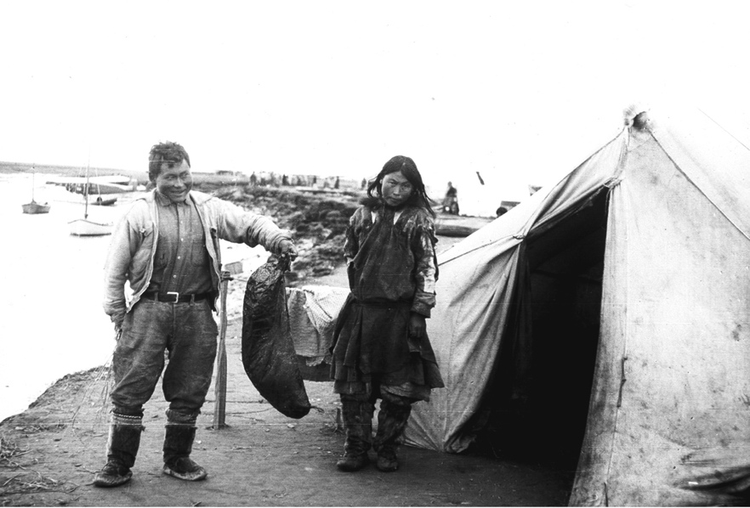
Seal Oil
SEAL OIL: A MAJOR SOURCE OF CALORIES
IN A DIET CONTAINING 80 PERCENT FAT.
Notes:
The superb health of the primitive Eskimos allowed Dr. Price to answer “yes” to his first question once again. He had found yet another group with excellent dental health and excellent overall health. So the next question is, what were these people eating?
The number one source of calories in the Eskimo diet was seal oil, animal fat from the seal, which in this photo they are carrying in a “poke” made from the seal skin. Seal oil was used for cooking, food storage, food preservation; they often dipped their food in it, using it as a kind of dressing. They made “Eskimo ice cream” by beating the seal oil until it got frothy and then adding a few berries --this was for special occasions, like birthdays. They also made fish egg ice cream by squishing fish eggs up in snow, or adding them to the whipped seal oil.
They also obviously ate lots of fish. The fish were prepared by fermentation – thrown into a hole and allowed to ferment until they became soft and slightly rancid. The softened fish bones provided them with calcium.
They also ate lots of game animals. The Alaskan natives did have one food combining rule: they never ate lean meat. The lean muscle meat from the game was smoked or dried and when they ate it they spread it with the fat from the animal. They also ate lots of nutrient-dense organ meats, particularly the liver, brain, stomach, marrow and intestines of the animal.
There were very few plant foods in this diet. Fat—mostly animal fat—supplied about 80 percent of total calories.

Slide 19
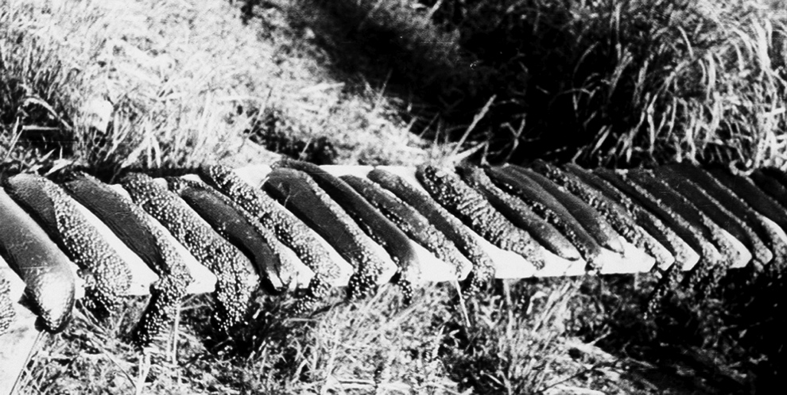
Salmon Roe
FISH EGGS: A SACRED FOOD OF THE ESKIMOS,
FOR ENSURING HEALTHY BABIES.
Notes:
The sacred food found among the Eskimos was salmon roe. Salmon roe was dried so they could have it all through the year. When Dr. Price asked them why they went to such trouble to dry the salmon roe they said: “We need this throughout the year so we can have healthy babies.”

Slide 20
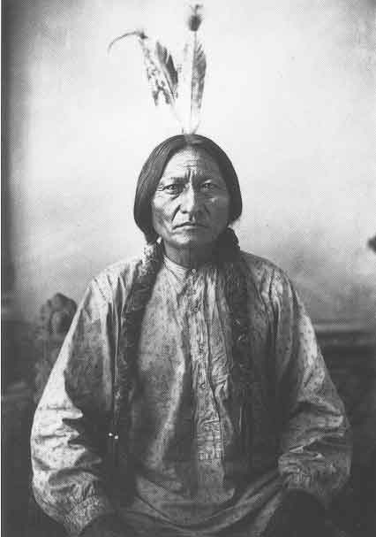

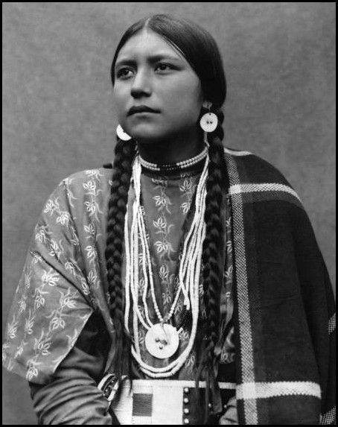
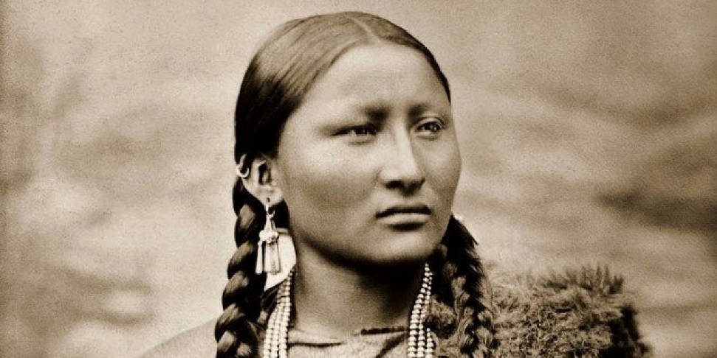
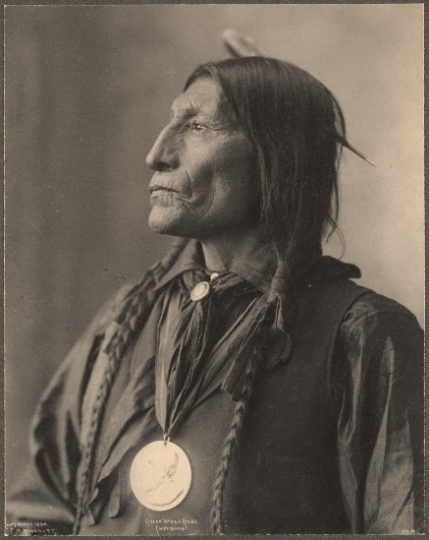
PRIMITIVE PLAINS INDIANS
Notes:
Dr. Price traveled throughout the United States and Canada to study Native Americans. He did not find very many groups living as their ancestors had done—mostly they were living in reservations on western processed foods, in a state of suffering and misery. However, old photographs show us the excellent bone structure of those who had grown up on ancestral diets.
The early explorers consistently described the native Americans as tall and well formed. Of the Indians of Texas, the explorer Cabeza de Vaca wrote, "The men could run after a deer for an entire day without resting and without apparent fatigue. . . one man near seven feet in stature. . . runs down a buffalo on foot and slays it with his knife or lance, as he runs by its side."⁷ De Vaca reports on an Indian "traversed by an arrow. . . he does not die but recovers from his wound." The Karakawas, a tribe that lived near the Gulf Coast, were tall, well-built and muscular. "The men went stark naked, the lower lip and nipple pierced, covered in alligator grease [to ward off mosquitoes], happy and generous, with amazing physical prowess. . . they go naked in the most burning sun, in winter they go out in early dawn to take a bath, breaking the ice with their body."

Slide 21
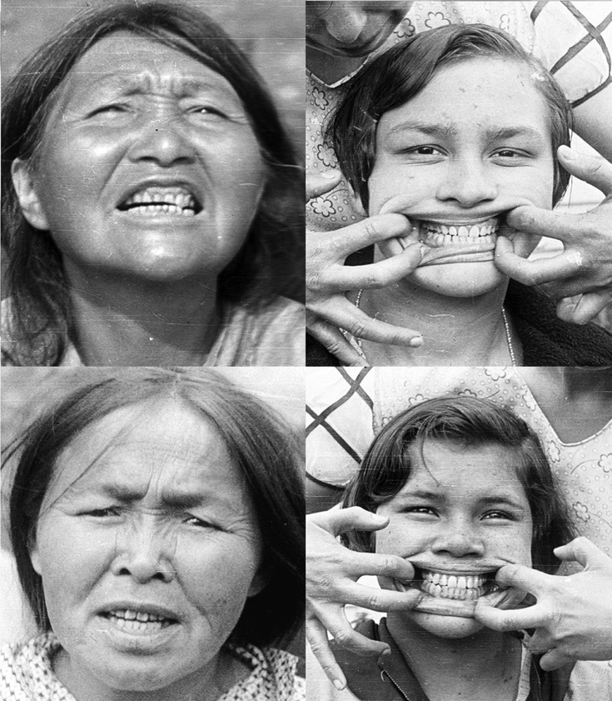
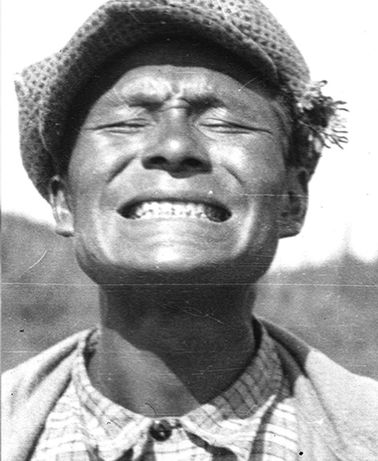
PRIMITIVE CANADIAN INDIANS
Notes:
In northern Canada, Price found some groups still living as their ancestors had lived, consuming the foods of the land, mostly game, especially the organ meats. They had uniformly excellent dentition.
The fat was prized. In fact, like the Eskimos, the native Americans would not eat lean meat, considering it dangerous. They hunted older animals because these had a buildup of fat along the back. A one thousand-pound animal would provide about ninety pounds of fat, mostly saturated fat, and this fat was saved and consumed together with the lean meat. When hunting was good, they actually threw the muscle meat away, and ate only the brain, tongue, liver and marrow (the fattiest organs) and fat.

Slide 22
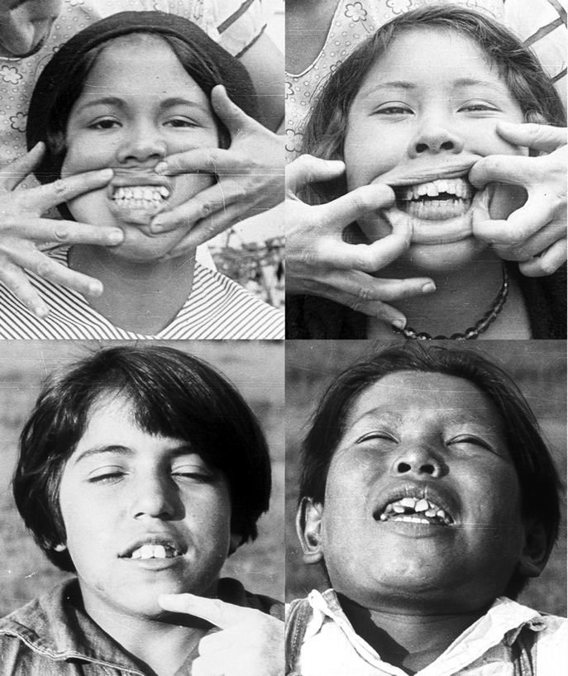
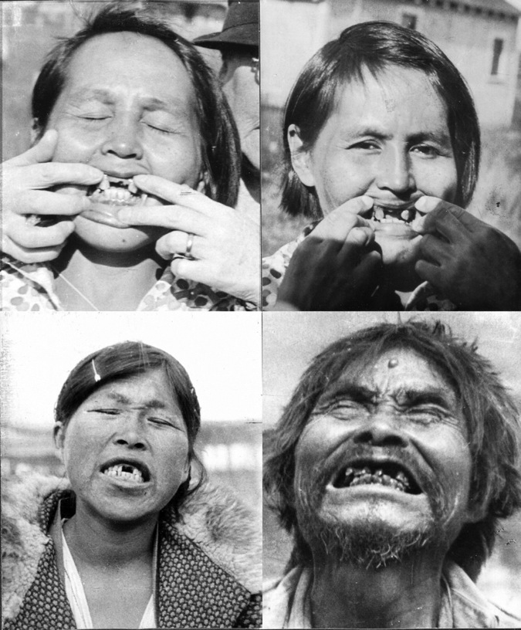
MODERNIZED CANADIAN INDIANS
Notes:
These photographs show modernized Indians living on the White man’s food. They are plagued by tooth decay and disease. Children were born with dental deformities.
Interestingly, Price did find one group of Native Americans living on a reservation who were healthy. These were Mohawks on a reservation in Canada. They did not hunt, but kept a “fine dairy herd.” In other words, they drank raw milk. Sugar and white flour were also restricted on this reservation.
It’s interesting that this so-called lactose-intolerant peoples had no problems with the whole raw milk from grass-fed cows. This kind of milk provides most of the factors that can also be obtained from “guts and grease,” the organ meats and fats that they consumed in their traditional diets. This is why it is so important for modern parents to provide their children with whole raw milk from pastured cows—because few children today will eat the kinds of foods that kept the native Americans healthy before the white man came, but most children will drink milk and eat cheese and butter.

Slide 23
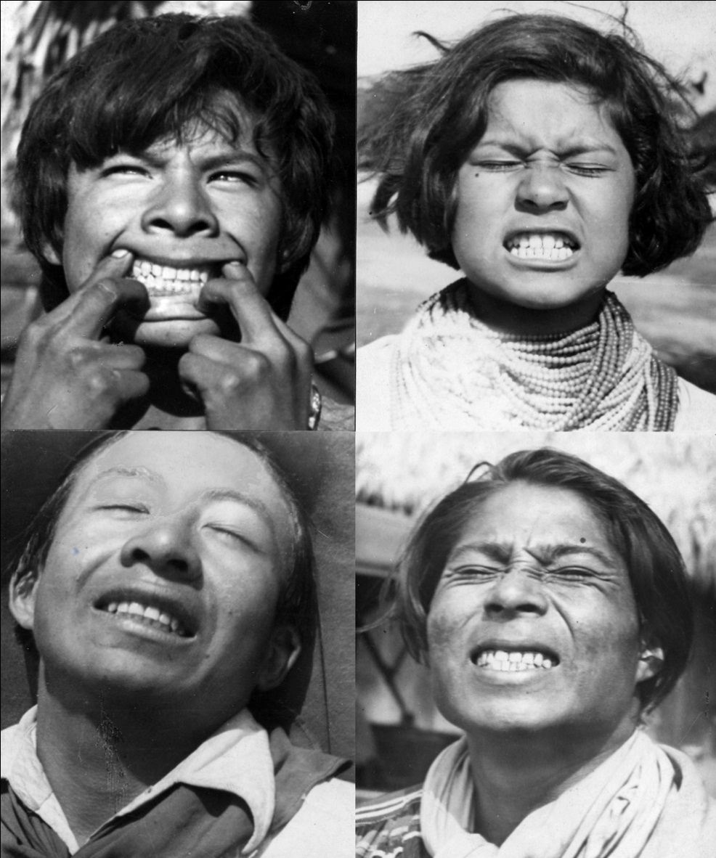
PRIMITIVE SEMINOLE INDIANS OF FLORIDA
BEAUTIFUL FACIAL DEVELOPMENT SHOWS OPTIMAL EXPRESSION OF GENETIC POTENTIAL.
Notes:
These are Seminole Indians living in the Florida Everglades. Dr. Price had to sit around and twiddle his thumbs for a couple weeks while the elders debated whether to give him permission to look into their mouths and take photographs Finally they allowed him take photographs and count cavities. Fortunately, they allowed him capture these beautiful faces. Notice the expression of nobility on each face. This is what the Creator desires for us all.
We have a blueprint for our bodies. Our bodies are like a house or a temple and the blueprint for building those bodies is our genetics. The Creator would not give us any less than a perfect blueprint for our bodies. Whether or not this house is built according to the blueprint depends on the building materials that we use. If we don’t know enough to choose good building materials, or if we are trying to save money and use sub-standard materials, the body does the best it can but it cannot build exactly according to the blueprint.
The Seminole Indians lived mostly on animal foods—fish, birds, reptiles and game. Surprisingly, the game in tropical climates contains a lot of fat.
Now let’s compare this beautiful Seminole Indian princess in the upper right hand corner. . .

Slide 24
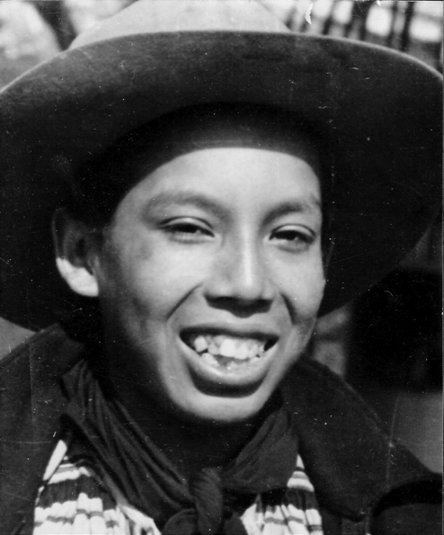
MODERNIZED SEMINOLE INDIANS OF FLORIDA
POOR DIET HAS PREVENTED OPTIMAL EXPRESSION OF THE GENETIC POTENTIAL.
Notes:
. . . with some one from her same tribe who was born after her parents changed their diet. There’s a severe narrowing of the face and crowding of the teeth. She doesn’t look like her ancestors. This is not a genetic problem. It is a nutritional problem. It shows up almost immediately in the next generation when the diet changes.
Not only is the attractive appearance lost, but she is likely to suffer from numerous health problems.

Slide 25
THE TEETH TELL THE TALE!
STRAIGHT TEETH | CROWDED, CROOKED TEETH
PLENTY OF ROOM IN HEAD FOR PITUITARY, PINEAL, HYPOTHALAMUS, SINUS CAVITIES AND EAR TUBES | COMPROMISED SPACE FOR MASTER GLANDS IN THE HEAD; INCREASED SUSCEPTIBILITY TO SINUS AND EAR INFECTION
GOOD SKELETAL DEVELOPMENT, GOOD MUSCLES | POOR DEVELOPMENT, POOR POSTURE, EASILY INJURED
KEEN EYESIGHT AND HEARING | POOR EYESIGHT AND HEARING
OPTIMAL FUNCTION OF ALL ORGANS | COMPROMISED FUNCTION OF ALL ORGANS
OPTIMISTIC OUTLOOK, LEARNS EASILY | DEPRESSION, BEHAVIOR PROBLEMS, LEARNING PROBLEMS
ROUND PELVIC OPENING, EASY CHILDBIRTH | OVAL PELVIC OPENING, DIFFICULT CHILDBIRTH
Notes:
The teeth tell the tale! When the teeth are straight, it’s a sign that the rest of the body is properly constructed, with plenty of room in the head for the master glands, the sinus cavities and the ear tubes; also with good bone structure, good musculature, keen eyesight and hearing, optimal function of all the organs, optimistic attitude and a well functioning mind. And when the teeth are straight and the facial structure broad, the pelvic opening is round, allowing for easy childbirth.
But when the teeth are crooked, it is a sign that there will be compromises in the rest of the body as well. When the face is narrow and the teeth crowded, there is less room for the important glands in the head—the pituitary, the pineal and the hypothalamus, the master gland. The hypothalamus is the seat of impulse control—and what is the defining characteristic of our young people today? Lack of impulse control!
When the teeth are crowded, the nasal passages are likely more narrow so there’s more susceptibility to infection. The ear tubes are more narrow so problems in this area are more likely.
Crooked teeth often goes with poor posture and underdeveloped muscles. The plumbing and the wiring of the body-house will be compromised as well. There will be less surface area in the lungs, fewer cells in the kidneys. The security system of your house—your immune system—will not be able to keep out all intruders.
In addition to physical problems caused by poor diet, mental and emotional problems also appear. We actually have receptors for feel-good chemicals in our brains and these receptors can’t work without the nutrients found in foods like seafood, animal fats and organ meats.
Finally, when the face is narrow, the pelvic opening is oval and childbirth becomes much more difficult, even life threatening. We should not blame the doctors for all the C-section births they are doing today—these operations are often necessary because otherwise the babies cannot get through the narrow opening of the pelvis.

Slide 26
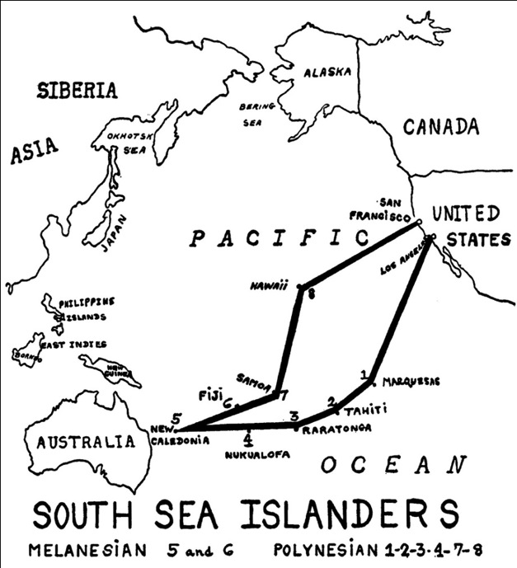
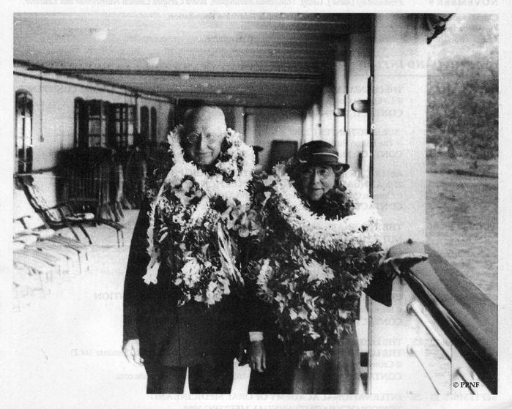
SOUTH SEA ISLANDERS
Notes:
Then Dr. Price went to the South Seas, studying the isolated Polynesians, Melanesians and the peoples of Australia.

Slide 27

Traditional South Pacific
PRIMITIVE SOUTH SEA ISLANDERS
THESE ARE HAPPY TEENAGE BOYS!
Notes:
These photographs were taken on an island that had been untouched by western civilization. Can you imagine getting off a boat and finding a population where everybody looked like this? What magnificent facial structure in these young men!
Dr. Price has been criticized as being unscientific. You can go on to quackwatch.com and read the detractors who say that he was just a quack on a whirlwind tour, who could not have discovered anything important. Or they say that his work is old and therefore no longer valid. This is like saying that Newton’s laws of physics are no longer relevant because they were discovered hundreds of years ago. We can no more afford to ignore the laws of good nutrition than we can afford to ignore the laws of physics, jumping off tall buildings assuming there will be no consequences.
Critics aside, there is no question that faces of this type have disappeared. The dentition of these boys is absolutely remarkable. And these are the faces of teenagers—look how happy and optimistic they are! Our teenagers today do not have these types of expressions on their faces.

Slide 28
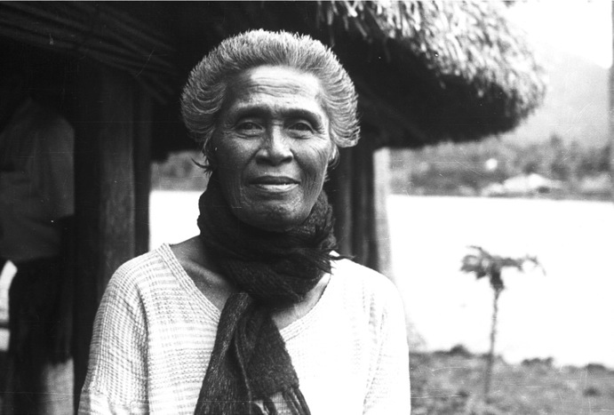
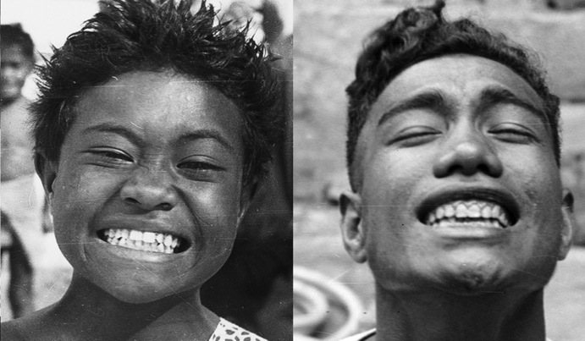
PRIMITIVE SOUTH SEA ISLANDERS
THE WOMAN IN THE UPPER SECTION IS 90 YEARS OLD!
Notes:
Price noted that all the women looked like sisters and all the men looked like brothers even though they were not related. This is because their diet was so good that it brought out the optimal expression of their genetic potential.
The lovely lady in the upper photograph is 90 years old—when you have excellent bone structure, you age very gracefully.
Now we will never know what the average life span of these people was. No one was keeping records, no one knows whether they were always telling the truth when they gave their ages. But Price commented on the fact that that he found many old people in these communities. Often they lived in special enclaves for the elderly and ate foods that were reserved for them because they were easy to hunt or gather.
Even the Eskimos, living in their harsh environment, had a tradition of longevity. Many Eskimos claimed to be over one hundred years old.
The important point is that there were many elderly peoples in these communities living useful lives and playing important roles in the community, often as sages and teachers.

Slide 29
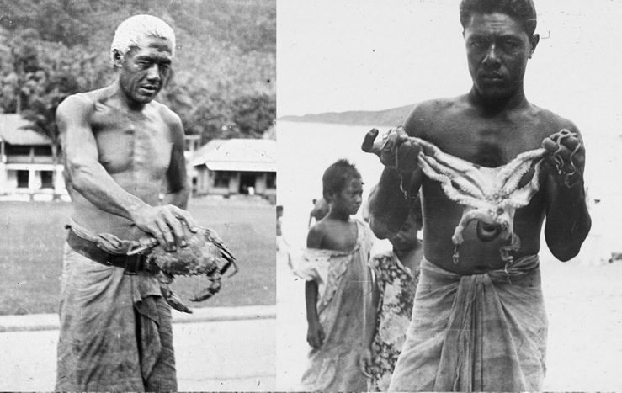
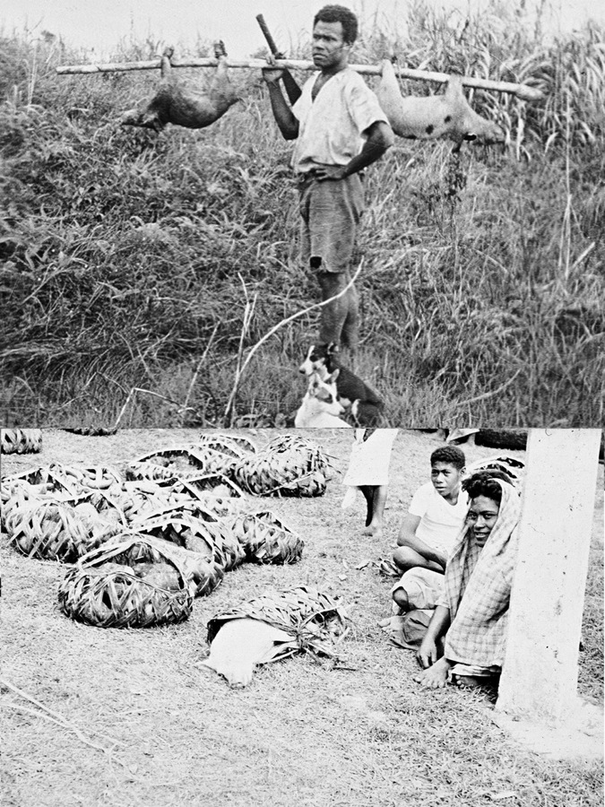

FOODS OF THE SOUTH SEA ISLANDERS
Notes:
What were the foods consumed by the healthy South Sea islanders? In this part of the globe, we see a lot more variety. They ate lot of plant food--fruits, tubers, vegetables and a very oily fruit called the coconut.
Nevertheless, the basis of the diet was seafood, like octopus, shell fish, and all different types of fish. They also had pigs on the island which were roasted in underground pits. Of course, they ate the whole pig--the organ meats, the fat and the skin—and also the blood.
They had more carbohydrates in the diet than we have seen before, in the form of the taro, pictured in back on the lower right, which was buried underground and allowed to ferment. It’s interesting that on some of these islands, heavy people were considered very beautiful, and they got heavy by eating a lot of taro root. They understood the carbohydrate principle.
The young man in the lower left is eating a snack which he did not get from a vending machine. He’s eating a delicious, fatty sea worm.
The sacred foods on these islands were usually the organ meats of certain fish and the shark. Shark livers were put inside the shark stomachs, hung in trees and allowed to ferment; the oil dripped out and served as an important sacred food. Also, the men ate the male reproductive organs and the women ate the female reproductive organs of the shark.

Slide 30
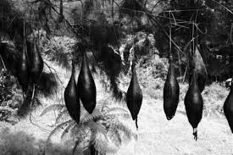
TAHITI: SHARK STOMACHS
CONTAINING FERMENTING SHARK LIVERS
Photo courtesy Kay Baxter
Notes:
This photo shows shark stomachs with the shark livers inside, hanging in the trees to ferment. About one liter of oil dripped out of each liver. This was a sacred food—very similar to the fermented cod liver oil that is available today.

Slide 31
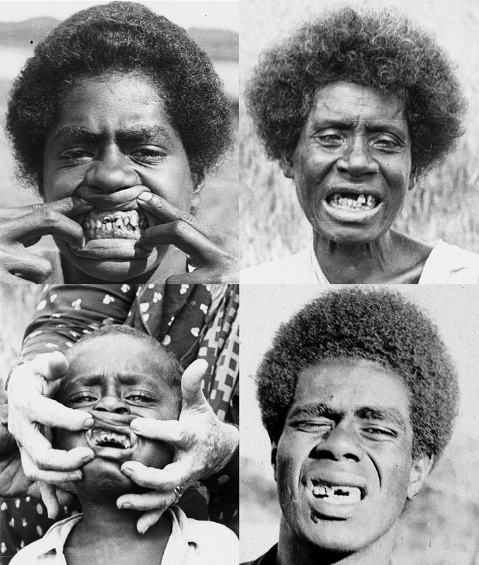
MODERNIZED SOUTH SEA ISLANDERS
FIRST GENERATION SUFFERED FROM TOOTH DECAY.
Notes:
On the islands where there were trading posts or missions, Price found a very different situation. He found an immense amount of suffering from tooth decay, as well as all of the White man’s diseases, from TB to cancer. Although a very spiritual man, Dr. Price became disillusioned with the work of the missionaries who, he observed, invariably brought in western foods.
We have an old film clip of Weston Price in which he says that he comes as a missionary from the primitive peoples to teach the civilized peoples how to be healthy. Unlike most people of his day, he believed that the primitive peoples had much more to teach to us than we had to teach them!

Slide 32
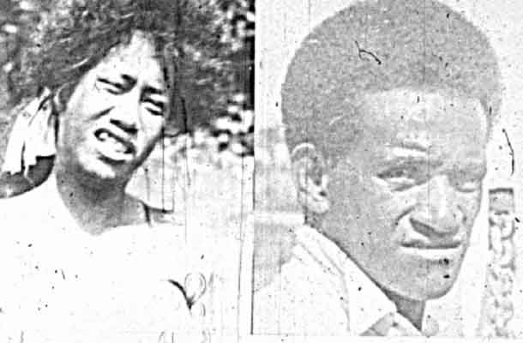
South Pacific 1st Generation
MODERNIZED SOUTH SEA ISLANDERS
Second generation had narrowed faces
and modern health problems.
Notes:
In the next generation of South Sea Islanders, the altered facial structure predictably appears. And notice that the expression of cheerful optimism is absent from these faces. These young people have a look on their faces as if to say, “I think I have been cheated, I’ve been had,” but they can’t pinpoint just how. And they have been cheated—of their birthright to physical perfection.
Havelock Ellis, a psychologist, once stated: “People have forgotten what the savage instinctively knows—that a perfect body is the supreme instrument of life.”
We received a letter recently from a woman whose father was familiar with the work of Weston Price. During the 1950s, they went to the South Seas where they observed a society in which everybody exhibited physical perfection and everybody seemed happy. She said they went back about 20 years later and the boat sat in the harbor for several hours and wouldn’t let them off. They asked the captain why they were waiting. They had to unload the Sarah Lee coffee cake first, he said, which would be sold out in two days. When they finally got off the boat, their impression could be summarized in two words: Paradise Lost. She said what really struck her was the babies who were crying. When they visited during the 1950s, they never heard a baby cry or saw children fighting or quibbling. The contentedness, the happiness had disappeared.

Slide 33
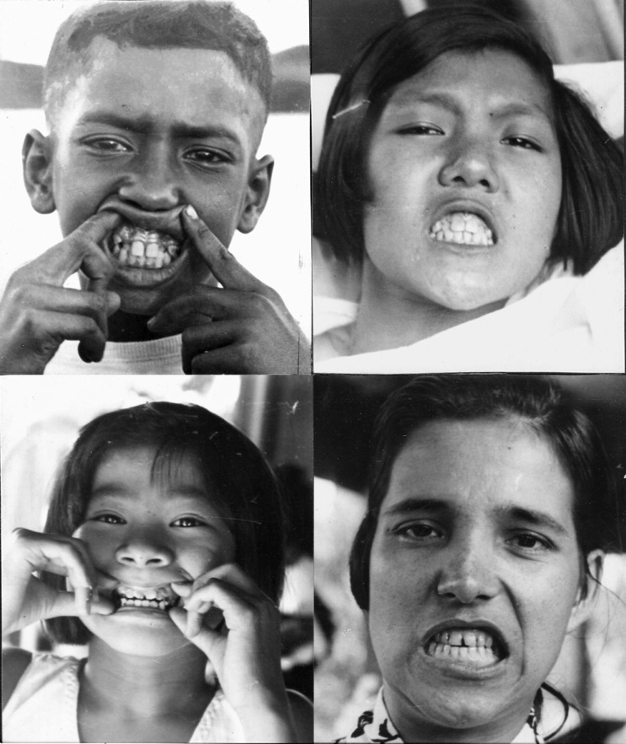
HAWAIIAN TB WARD
Notes:
These photographs were taken at a tuberculosis ward in Hawaii. Every child in the ward had dental deformities. The dental deformities were not, of course, the cause of tuberculosis, but the same deficiencies that prevented the optimal expression of their genetic potential made them very susceptible to this disease.
Price believed that TB was not caused by a pathogen, but by poor lung formation, which made the lungs very susceptible to the effects of pathogens.

Slide 34
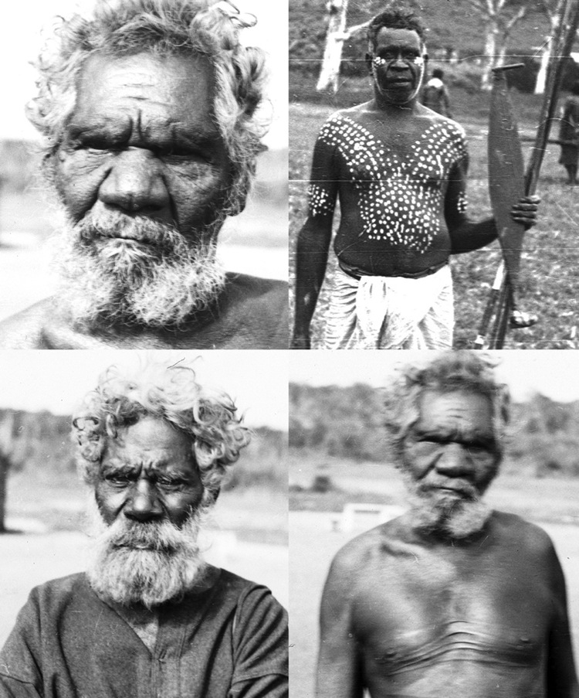
PRIMITIVE ABORIGINE MEN
Notes:
In Australia Dr. Price spent time among the Aborigines who lived as their ancestors lived. They exhibited a very high degree of physical perfection, visual acuity, strength and agility.

Slide 35
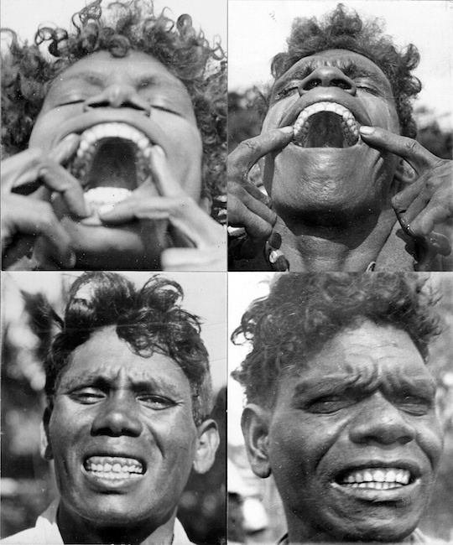
PRIMITIVE ABORIGINE WOMEN
Notes:
These are Aboriginal women. They have never been to a dentist and never brushed their teeth; yet their teeth are so perfect they look like false teeth.
The aboriginal diet was most interesting. It had a lot of variety, including fruits, vegetables, grains and legumes. The grains and legumes were prepared with great care. They were placed in leaching baskets in a running stream for two weeks and then prepared by roasting, pounding and cooking. We see this careful preparation of grains and legumes in all traditional societies.
Nevertheless, the diet was still based on animal foods. They hunted birds, they fished, they hunted game animals. Once again, we find the tradition of never eating lean meat. They hunted animals at times of the year when they would have the most fat. If a certain bush was in flower, that meant a certain animal was fat so they hunted that animal. They left fruit on the trees so that the birds would get fat, they wanted the fat. If they killed a kangaroo and it was too lean, they discarded it—they considered it “rubbish.” They also ate insects, particularly the wichiti grub, which was about six inches long and contained a lot of fat.

Slide 36
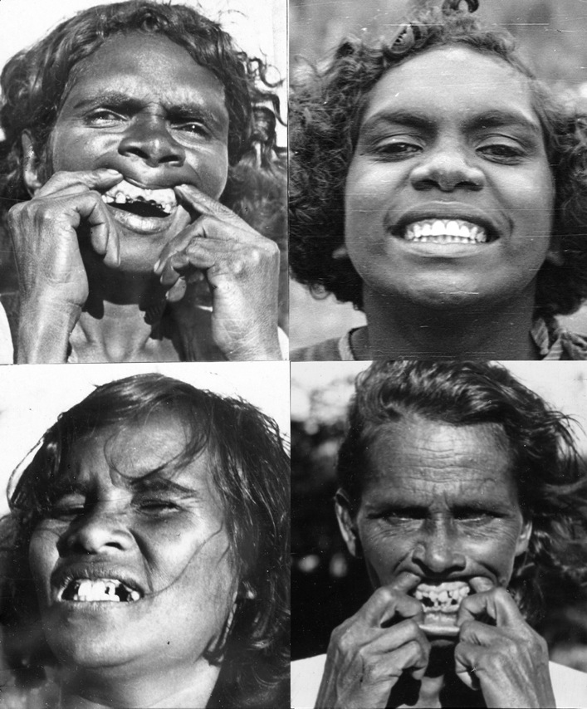
ABORIGINAL DECAY
Notes:
The photo in the upper right shows a healthy Aborigine woman on the traditional diet, compared to her compatriots who lived in the town and were eating our foods. Dr. Price called these foods “the displacing foods of modern commerce.” They were not only empty foods but they were pushing out – displacing – the nutrient-dense calories of the traditional diet.

Slide 37
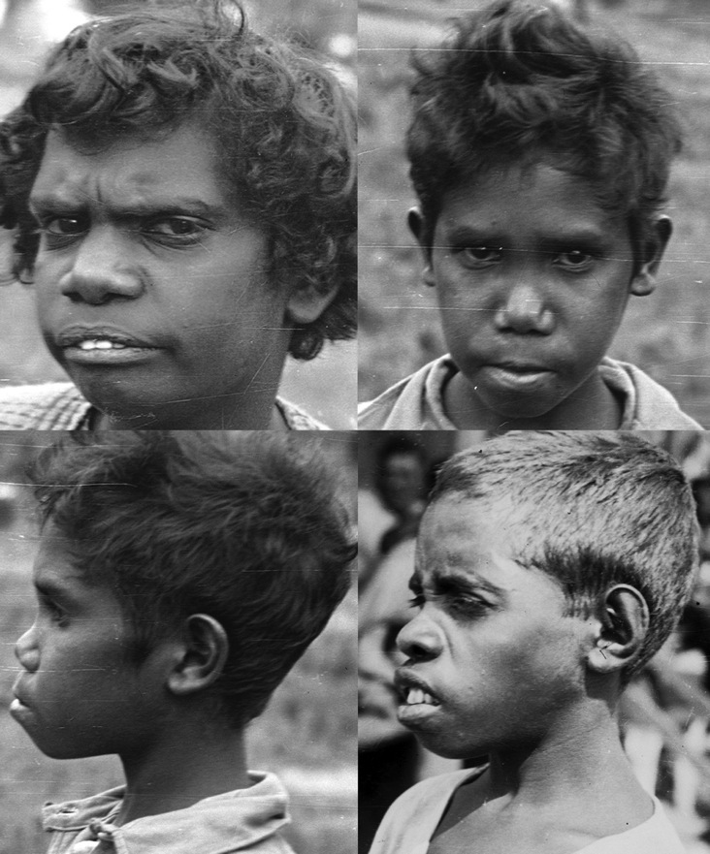
ABORIGINALS NEXT GENERATION
Notes:
Dr. Price found the same pattern wherever he went. In the next generation, there was a narrowing of the face and dental deformities. This photograph illustrates what Dr. Price called the underdevelopment of the middle third of the face.

Slide 38
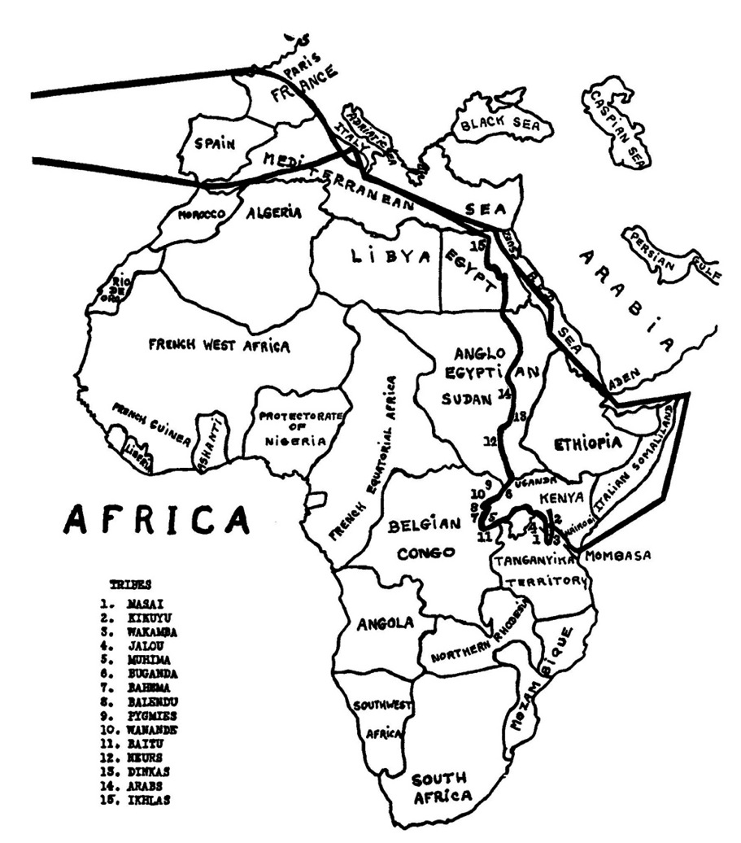
Africa Map
Notes:
In Africa Dr. Price went to areas where very few white men had been before. There he found six tribes without a single cavity, and no dental deformities.

Slide 39
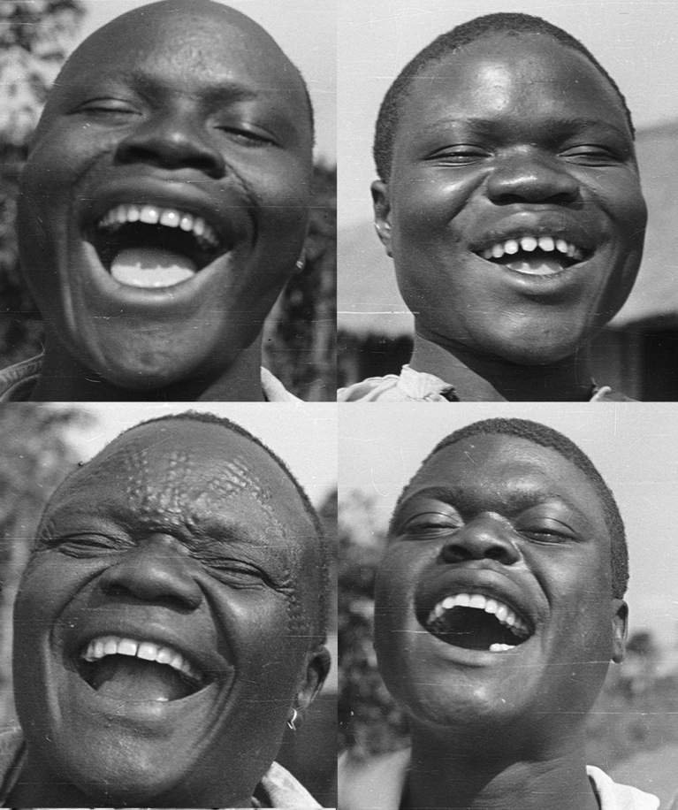
PRIMITIVE AFRICANS
Notes:
Even among those tribes where the people had the custom of filing their teeth, their teeth, as in the upper right, cavities were absent.
In Africa, Price was able to compare three different diets practiced by the same racial group.

Slide 40
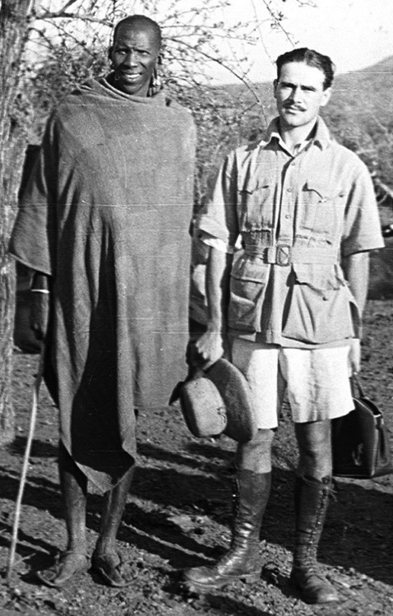
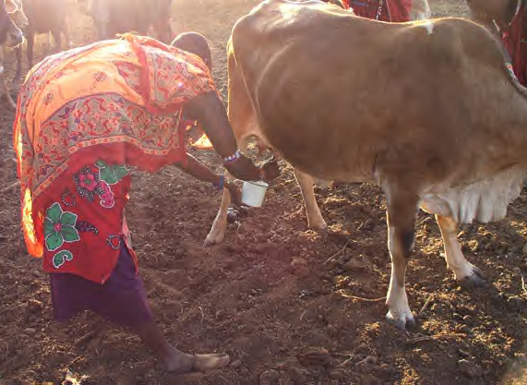
AFRICA: HERDING TRIBES
DIET: MILK, MEAT & BLOOD
A warrior in his prime consumed
one gallon or more of milk per day containing three-quarters pound butterfat.
Notes:
First, he looked at the diets of the cattle-herding people, the Samburu, Masai and related tribes. Their diet consisted of milk, meat and blood. A warrior at his prime would consume a gallon or more of milk per day. It was very rich milk that gave him the equivalent of three-quarters pound of butterfat per day—that’s three sticks of butter per day! He also got fat from the meat and the blood. Scientists have studied these people, by the way, and found that they have very low levels of cholesterol and no heart disease.
On the left is a typical Masai warrior. They were very, very tall – typically seven feet or more - slender and very good runners with a lot of stamina.

Slide 41

BURNING TO ENCOURAGE GREEN GRASS
Notes:
They often set dry grass on fire so new green grass would grow up, fertilized by the ashes of the old grass. They understood that the milk and meat of their cows would be healthier if they ate green grass. Marriages took place during periods when the grass was green.

Slide 42
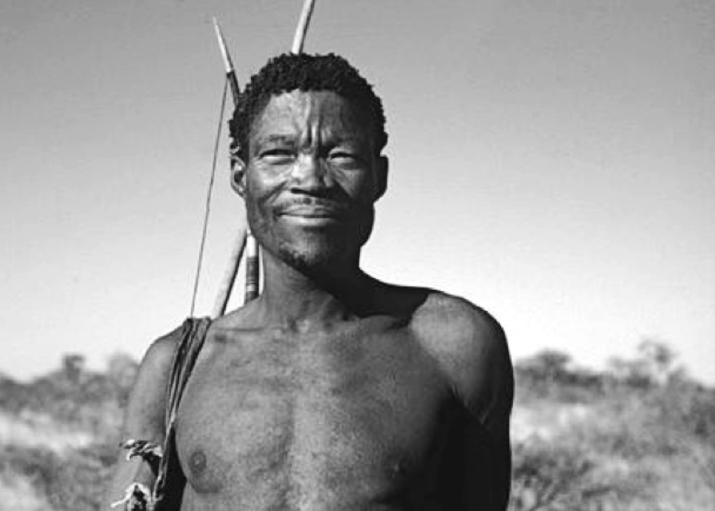
AFRICA: HUNTER-GATHERERS
DIET: ANIMAL AND PLANT FOODS
Liver was a sacred food, consumed both raw and cooked.
Notes:
Other tribes, the hunter-gatherers, hunted game, ate fish and some kept cattle or goats. They also had a lot of plant foods in their diet, such as vegetables, fruit and grain. Their sacred food was liver, which they ate both raw and cooked.

Slide 43
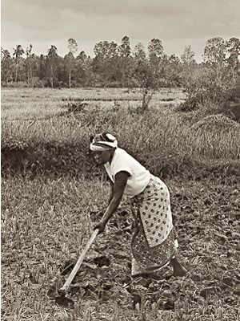


AFRICA: AGRICULTURISTS
DIET: GRAINS, LEGUMES, SQUASH, INSECTS
These cultures suffered from about 6 percent tooth decay.
Notes:
The third group was agriculturists who did not keep animals and did not hunt, but grew corn, beans, squash, and so forth. Their diet was largely based on plant foods but they were not vegans because about 10 percent of their diet consisted of insects like termites– a very important food for them.

Slide 44
COMPARISON OF AFRICAN DIETS
HERDERS | HUNTER-GATHERERS | AGRICULTURISTS
Mostly Animal Foods | Mixed Plant and Animal Foods | Mostly Plant Foods
No Tooth Decay | No Tooth Decay | Some Tooth Decay
Very Tall and Slender | Tall and Muscular | Short and Chubby
DR. PRICE’S CONCLUSION
The ideal diet avoids the extremes of
too much animal food or too much plant food.
Notes:
When Price compared the dental health of these three groups, he found that the first two groups had no cavities (these were the 6 tribes). The agriculturists suffered from about 6 percent tooth decay. They were certainly healthier than the people he was seeing back in Cleveland but they did have a certain amount of tooth decay, and some of the elderly were toothless. They were also of shorter stature, with more weight on them, a little bit heavier, and not as robust as the other two groups.
Comparing the cattle-herding people with the hunters, Price came to the conclusion that the hunters with the mixed diet were the healthiest. They had better proportions and were stronger.
So one of the conclusions of his African trip was that the optimal diet avoids the extreme of too much animal food or too much plant food. – but has a balance somewhere in the middle. I think this is good news for all of us—we don’t have to eat an extreme diet to be healthy.

Slide 45

AFRICAN DECAY
Notes:
No matter which diet the various African tribes started out on, none of these groups was immune to the ravages of the modern diet, causing tooth decay and tremendous suffering.

Slide 46
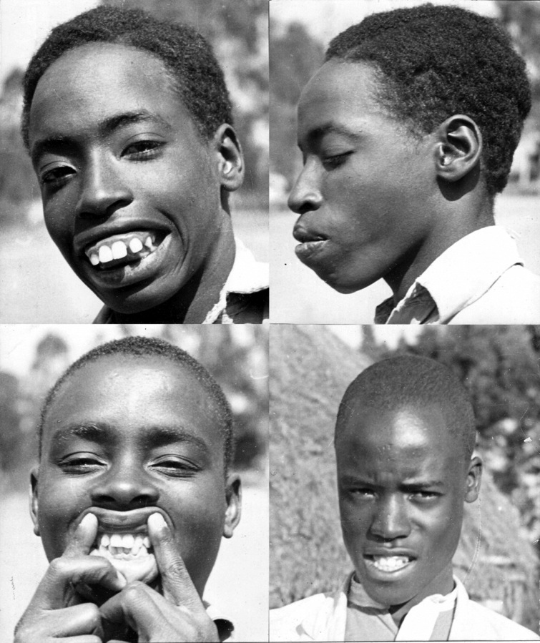
AFRICANS NEXT GENERATION
Notes:
The dental deformities showed up in just one generation with a very severe narrowing of the face. The tribal characteristics are lost and that wonderful look of happy optimism is lost as well.

Slide 47

MODERN VERSUS TRADITIONAL FACIAL STRUCTURE
Notes:
This photograph illustrates perfectly the difference between normal and compromised facial structure. Obviously these two boys belong to the same tribe and have the same genetics, but the young man on the right has excellent facial structure, a very broad face with obviously strong facial bones, while the young man on the left shows the elongation of the face and the narrowing of the palate that comes with the introduction of western foods. The body has done the best it can with the materials available, but did not have the nutrients needed to build the strong bones that are required for wide dental arches.
While the boy on the right has a bone structure that supports the entire face, it looks as though the face of the boy on the left is actually hanging from the skull.

Slide 48



DENTAL CASTS OF MODERNIZED AND PRIMITIVE INDIVIDUALS
Notes:
Here we have dental casts comparing a modern American with a healthy primitive. Do you see the difference in width? What you see in the cast on the right is beauty, strength and order. What you see in the cast on the left is weakness, chaos. . . physical degeneration.
We know from animal studies, particularly the studies of Francis Pottenger, that if you put animals like cats on a deficient diet, a diet deficient for that animal, you will start getting a narrowing of the palate and a softening of the bones in the next generation. The animals develop all sorts of modern disease, parasites and vermin, and also develop behavior problems. Generally the females become aggressive and the males become docile. By the third or fourth generation, reproduction ceases. Either the young do not reach adulthood or the adults do not breed.
We are on our third generation in this country of our deficient diet, the displacing foods of modern commerce. We’re seeing about 25 percent infertility among our couples and an incredible amount of chronic disease. It is a heart-breaking situation, but one predicted by Dr. Price. The situation is very, very serious, we are at the edge of a precipice. If we don’t figure out how to eat properly and turn this trend to physical degeneration around, we’re going to die out as a species. This is what motivates us at the Weston A Price Foundation—the critical need to get accurate nutrition information out to the public so the next generation will be healthy.
When we set up the Foundation, one of our earliest members had a dream. He saw the words “western price” instead of “Weston Price” and realized that his name meant that the price of westernization is physical degeneration. This does not have to happen if we make wise choices in our use of technology and our production and use of food The primitive people had no choice. The only foods they had to eat were good foods, but we have to make the choice between good and bad food--that is the price we pay for being modern.
The architectural diagrams in this slide are to illustrate the point that any arch—whether in the mouth or in a building—needs to be built with strong building materials.

Slide 49

POTTENGER’S CATS
Notes:
In Pottenger’s studies, cats developed dental deformities, weak bones, various diseases, behavioral problems and infertility when they were put on a diet inappropriate for cats. These studies serve as a warning of what will happen if we continue to eat the displacing foods of modern commerce—we are already seeing an epidemic of chronic disease, behavioral problems and widespread infertility.

Slide 50

TYPICAL DENTAL DEFORMITIES
Notes:
Here are typical deformities that dentists see. They tell their patients that this is due to heredity. . . Or due to thumb sucking! It’s rare these days for a child born in America to have straight teeth—unless their parents are following the Wise Traditions diet of the Weston A .Price Foundation!!

Slide 51


THE FACIAL BONES
Notes:
The bone that is first affected by poor nutrition is the maxilla, the upper jaw bone. Almost all the other bones in the face touch the maxilla. When the maxilla is well developed, the face is broad and attractive, the cheekbones are high. When the maxilla is not well developed, there is a sunken in look in the middle third of the face—this is evident even in babies.
The second bone to be affected is the mandible, the lower jaw bone, resulting in a poorly developed chin and jaw.

Slide 52

THE SPHENOID AND MAXILLA
Notes:
Here is a rear view of the maxilla. An amazing bone called the sphenoid sits atop the maxilla. This bone requires a lot of strength for optimal development, so that the “wings” can extend as far as possible.
When the maxilla is underdeveloped, various openings that allow nerve cells and blood vessels to go to and from the head will be oval rather than round, so there will be pinching and crowding. The brain will not be as well oxygenated as it could be.

Slide 53

PRE WWII AMERICAN
PRE WWII AMERICAN
HER DIET INCLUDED
WHOLE RAW JERSEY MILK
BUTTER AND CREAM
SHELLFISH
FISH EGGS
MEAT AND LIVER
BROTH
FRUITS
VEGETABLES
COD LIVER OIL
Notes:
This is a typical American beauty, the type of face we saw very frequently in my parents’ generation, the type of face you see in the old black and white movies.
This woman did not have to eat sea worms or buffalo guts or any foods that are difficult for westerners to eat, to obtain her beautiful bone structure. She ate foods that we’re all familiar with. She had raw Jersey cow milk from pastured cows, a lot of seafood including fish eggs and shell fish, meats that we’re familiar with, such as beef, pork, lamb, and chicken. Chicken broth was an important part of the diet, as well as vegetables and fruit.
She also got cod liver oil, as did almost all Americans of her generation.

Slide 54

PRE WWII AMERICAN
PRE-WWII AMERICAN
HIS DIET INCLUDED
CULTURED RAW MILK
BUTTER AND CREAM
SHELLFISH
MEAT
ORGAN MEATS
BROTH
SWEET POTATOES
GREENS
CORN BREAD
Notes:
This gentleman grew up on a farm in eastern Texas. He has a beautiful head, almost completely round. Notice the distance between the outside of the head and the outside of the eye on both sides. He grew up once again on raw whole milk (usually soured), butter, cream, fish, crawdads, organ meats like chitterlings, pigs feet and so forth. He also had sweet potatoes, corn bread, greens – a wonderful, delicious diet.

Slide 55

AGNES MCPHAIL
Notes:
This is Agnes McPhail, a great reformer in Canada. Notice her beautiful bone structure. She grew up on a dairy farm.

Slide 56

Teenager Group
FRANKIE LYMON AND THE TEENAGERS
Notes:
Does anyone recognize this group? This is Freddy Lymon and the Teenagers, famous for their song “Why Do Fools Fall in Love.” I was so struck by the dentition of these young men that I saved the photograph. You cannot go into a high school today and find five young people born in America with naturally straight teeth like this. The reason our children have straight teeth is because their parents are spending fortunes at the orthodontist, but very few children born in America today have teeth that are naturally straight.
These young man probably grew up in an environment that today we would call deprived. Almost certainly they had access to whole raw milk, game and organ meats, foods that were typical of the African American community before the second world war.

Slide 57

THE TEMPTATIONS
Notes:
Let’s compare The Teenagers with the Temptations, a generation later. They may have had their teeth straightened and whitened but the difference is obvious, the facial structure is much more narrow. And we know from animal studies that if you continue the typical American diet for two or three generations, fertility declines and reproduction ceases.

Slide 58

BILL CODY’S WILD WEST SHOW, 1910
Notes:
This is a photograph of Bill Cody’s Wild West Show, taken in 1910. Both Native Americans and whites have excellent bone structure—notice how handsome everyone is. There is only one exception, the man whose face is circled. Today the individual with good bone structure is the exception and the narrow face is the norm The Native Americans got their good bone structure by eating things like buffalo guts but the Americans almost certainly got theirs from eating raw dairy products along with eggs, liver, bacon and other familiar foods.

Slide 59

Elvis
ELVIS PRESLEY AND HIS PARENTS GLADYS AND VERNON
Notes:
Here’s a familiar American figure. Note the excellent wide facial structure of Elvis’s parents. Although handsome, Elvis has a more narrow face.

Slide 60

NORMAL FACIAL DEVELOPMENT
THE TYPICAL CENTRAL AMERICAN DIET INCLUDES
RAW GOAT MILK, SEAFOOD, ORGAN MEATS, INSECTS,
CHEESE, RICE AND BEANS.
Notes:
Central American children. All have good facial form and dentition in spite of a “poor” lifestyle. This excellent facial structure is Nature’s plan for all of us, rich or poor, civilized or primitive.

Slide 61





MODERN CHILDREN
MOST MODERN CHILDREN HAVE NARROW FACES
AND NEED BRACES TO STRAIGHTEN THEIR TEETH
Notes:
This is what our modern children look like. Almost all of them need braces to straighten their teeth. They are plagued with allergies, asthma, learning disabilities, addictions and even diseases that were formerly associated with adults, like cancer, diabetes and arthritis.

Slide 62


Thin Faces
Notes:
The narrow faces have become so common place that we’re seeing them in the magazines today.
Most of us, including myself, belong in this category. In fact, our interest in nutrition probably stems from the fact that we have suffered from numerous health problems. We cannot go back and change our bone structure, but we usually can restore our health with the same kind of diet that promotes good bone structure in the next generation.

Slide 63

Jordana
Notes:
The good news is this trend to physical degeneration is reversible. This beautiful young woman was born to a mother who had a narrow palate and other health problems. Yet, her healthy daughter was born with broad, straight teeth because during her teenage years her mother went back to a traditional diet. Actually it was a Jewish diet. In particular, she ate liver two or three times per week. She often went out with her friends but did not have as much money they did so she chose the least expensive thing on the menu, which was liver. She also had access to raw Guernsey milk and cream. So she gave birth to this beautiful healthy girl with naturally straight teeth. The trend to physical degeneration was reversed.
My experience was similar. While in college, I went to France where I discovered a new food. . . liver pate. One bite and I recognized this as a food that my body wanted. I actually made a pig of myself eating pate morning, noon and night. My own daughter, my first child, was born very healthy, and has naturally straight teeth. She did not suffer from the health problems that I had as a young adult—such as allergies and fatigue.

Slide 64






HEALTHY BABIES BORN TO PARENTS FOLLOWING WAPF PRINCIPLES
Notes:
This is our goal, healthy children, children who give joy rather than sorrow. It is possible for us to ensure that every child born today is born with his birthright of physical perfection. These children are rarely if ever sick, walk and talk early, have good dispositions, plenty of energy and sleep well, because their mothers ate a healthy diet while pregnant and breastfeeding, and fed a healthy diet to the children while they were growing.

Slide 65
NATURAL BEAUTY
"
Individual beauty is a matter of both design of the face and regularity and perfection of the teeth.
Nature always builds harmoniously if conditions are sufficiently favorable, regardless of race, color or location.
"
WESTON A. PRICE, DDS

Slide 66
GREAT VARIETY IN TRADITIONAL DIETS
Some had no plant foods
Some had few animal foods
Some had mostly cooked foods
Some had large amounts of raw foods
Some had milk products; some did not
Some had grains; some did not
Some had fruits; some did not
WHAT ARE THE UNDERLYING CHARACTERISTICS
OF THESE HEALTHY DIETS?
Notes:
After seeing the photographs of Weston Price and learning about the various diets of healthy traditional peoples, you may be more confused than ever. No two diets were alike. Some diets were almost 100 percent animal food and some had very little animal food. Some people ate dairy, some had grains, some had fruit, some did a lot of cooking, some didn’t do much cooking.
How are we going to make sense of all these different diets and put them in a form that you can implement in a modern kitchen? This is the task that lies before us—to identify the underlying characteristics of healthy traditional diets so you can implement these principles using foods that you like, that you and your family find familiar, that you can afford, and that your children will actually eat.
What we are going to do now is look at eleven underlying characteristics of healthy diets. Then we will look at eleven practical steps you can take to change your diet for the better.

Slide 67
FIRST PRINCIPLE
NO REFINED OR DENATURED FOODS
REFINED AND DENATURED FOOD COMPONENTS 1930s
Refined Sugar
White Flour
Vegetable Oils
Canned Foods
Condensed Milk
REFINED AND DENATURED FOOD COMPONENTS TODAY
Refined Sugar
High Fructose Corn Syrup/Agave Syrup
White Flour
Pasteurized Milk
Skim and Low-Fat Milk
Hydrogenated Fats
Refined Vegetable Oils
Isolated Protein Powders
Additives/Artificial Sweeteners
Notes:
The first characteristic of healthy traditional diets was that they contained no refined or denatured components. The list of such man-made items coming into the outposts during Dr. Price’s day was relatively short: refined sugar, white flour, vegetable oils (primarily cottonseed oil), canned fruits and vegetables and canned and condensed milk.
Unfortunately, the list today is considerably longer. Not only does our diet contain much refined sugar, but also high fructose corn syrup (and its evil twin, agave syrup), which animal studies have shown to be worse than sugar. (We’ll look into this in more detail later.)
The processing of grains (mostly wheat) into white flour removes most of the vitamins and minerals. White flour is the basis of the modern American diet, providing a large portion of the calories.
Pasteurized and reduced-fat milks are not whole foods, they are foods whose vital nutrients have been damaged or removed.
Refined vegetable oils and hydrogenated fats are completely new to the human diet and one of the chief causes of our health problems today. Yet most spokesmen for the various health establishments tell us that they are better for us than animal fats.
Isolated protein powders are also not whole foods, but proteins separated from the components our bodies need to assimilate them, and also denatured by high-temperature processing. We will learn later just why the consumption of protein in isolation from animal fat is so dangerous.
Finally, there are over two thousand additives in use in our food today. If we decided that we needed just a few of these additives, say four or five, for food preservation, and if the diet were otherwise good, these additives would not be such a problem. But when you feed many different additives together to rats, even though the additives are all in the “safe” dose range, you get dead rats—the effects of additives are indeed additive.

Slide 68







Modern Processed Foods
"LIFE IN ITS FULLNESS IS MOTHER NATURE OBEYED."
WESTON A. PRICE, DDS
FACTORY FOODS ARE NOT MOTHER NATURE’S FOODS!
Notes:
Here are many examples of modern processed foods. The most famous quote from Dr. Price is “Life in its fullness is Mother Nature obeyed.”
I can say without reservation, you cannot live life to the fullest eating these kinds of processed foods. They do not support good health, nor even a positive mental outlook.
Most scientists today, and in Dr. Price’s day, believe that we can “outsmart mother nature” and we do not need to learn and obey her laws. But Dr. Price was different—he knew that there were no mistakes in nature, only wisdom that man needed to honor.

Slide 69
SECOND PRINCIPLE
EVERY DIET CONTAINED ANIMAL PRODUCTS
FISH AND SHELLFISH
Including organs, oil, bones and heads.
Weston Price found the best bone structure
among those eating seafood
Chicken, ducks, geese, etc.,
including the organs, fat, skin and bones.
BIRDS
RED MEAT
Beef, goat, sheep, game, etc.,
with organ meats and fat preferred.
MILK AND MILK PRODUCTS
EGGS
REPTILES
INSECTS
Raw or cultured, not pasteurized
From birds outside in the sunlight
Notes:
The second characteristic of healthy traditional diets was all of them contained animal foods. This was Dr. Price’s greatest disappointment. He hoped to find a healthy population living entirely on plant foods but he did not find one. What he did find was that primitive peoples expended a great deal of energy and went to considerable risk to obtain animal foods.
The most important animal food, according to Dr. Price, was fish and shellfish—including the organs and roe. In his studies, he not only looked at living facial structure, but always asked to see skulls. He used calipers to measure the thickness of the skulls. He found that the populations that had access to fish from the sea had the thickest skulls—and it’s a good thing to have a thick skull!
But traditional peoples used many other animal foods including different types of birds, red meats (with the fat and organ meats preferred), milk and milk products, eggs and reptiles; and many, many cultures that he looked at valued insects. In some cultures, insects were the only animal food consumed.

Slide 70
ANIMAL FOOD NUTRIENTS
THESE NUTRIENTS ARE FOUND
ONLY IN ANIMAL PRODUCTS
THESE NUTRIENTS ARE MORE EASILY ABSORBED FROM ANIMAL PRODUCTS
CALCIUM
B6
MAGNESIUM
IRON
ZINC
COPPER
VITAMIN A
VITAMIN D
CHOLESTEROL
VITAMIN B12
VERY LONG CHAIN,
SUPERUNSATURATED FATTY ACIDS
AA, EPA AND DHA
Notes:
There are certain nutrients that are found only in animal products; first and foremost, vitamins A and D, found only in animal fats. (More on these in a moment.)
Cholesterol is actually a nutrient, especially for the growing child, who cannot make enough cholesterol to ensure the optimal development of the nervous system and the gut. Mother’s milk is very rich in cholesterol and contains an enzyme that helps the baby absorb all of that cholesterol. For humans, dietary cholesterol is important, right through the growing years. Adults can make all the cholesterol they need, but nevertheless, the cholesterol we consume is important for the health of the intestinal tract—these cells there are very rich in cholesterol and can actually directly take up the cholesterol that comes with our food.
Usable vitamin B12 is only found in animal products.
Other important dietary components found only in animal foods are the long-chain, very unsaturated fatty acids, called AA (arachidonic acid), EPA (eicosapentaenoic acid) and DHA (docosahexaenoic acid). Later we will learn how important these substances are for the brain and nervous system.
Then there are many nutrients that are present in plant foods but which are more easily absorbed from animal foods. For example, many plant foods contain calcium, and vegetarians insist that you can get all the calcium you need from plant foods; but the calcium from plant foods is bound up—the technical term is chelated--in the food and is not very available. Your body has to work very hard, using many enzymes and vitamins, to get at that calcium. The only two good sources of calcium in human diets are dairy products and bones. In cultures where they do not have dairy products, they use bones. They either grind the bones of birds and small animals into a powder to add to food, or they make bone broth. Consider the Asians who do not have dairy products. In the typical Asian diet they have a bone broth with every meal. The Eskimos got calcium from fermented fish bones.
Zinc is another nutrient that is very difficult to get in adequate amounts from plant foods. Iron, B6, magnesium and copper are also difficult to absorb from plant foods. Copper is very important for the cardiovascular system. The best source of copper is liver.

Slide 71
VITAMIN B12 DEFICIENCY
EARLY SIGNS | PSYCHIATRIC DISORDERS | CHRONIC DISEASE
FATIGUE | DEPRESSION | MULTIPLE SCLEROSIS
TINGLING IN HANDS AND FEET | OBSESSIVE COMPULSION | ANEMIA
SLEEP DISORDERS | MANIC DEPRESSION | CANCER
IRRATIONAL ANGER | DEMENTIA ALZHEIMER’S | HEART DISEASE
Notes:
Useable B12 is found only in animal products. There is a compound that looks like B12 in certain plant foods but it is actually an analog that blocks the absorption of true B12. For example, soy foods contain something that looks like B12 but which actually increases the body’s need for B12 because it blocks the absorption of true B12.
So important is vitamin B12 that you body stores a supply that can last up to ten years, and some people use B12 very efficiently while others use it up quite quickly. This is why some people can go longer on a vegan diet than others without developing serious health problems.
We associate B12 deficiency with serious diseases like multiple sclerosis, cancer, heart disease, and anemia but actually the early signs of deficiency tend to be psychological or nervous disorders, such as fatigue, tingling of hands and feet, sleep disorders and the tendency to irritability and anger. Somebody who is always flying off the handle may be lacking in B12—a condition I frequently encounter in vegans--and most of the people in our mental institutions are very deficient in B12.

Slide 72

VITAMIN B12
ONLY IN ANIMAL PRODUCTS: Usable vitamin B12 is found only in animal products. Analogs in soy foods or blue-green algae actually increase body’s need for B12.
ABSORPTION DIFFICULT: Absorbed through a complex process involving an "intrinsic factor," secreted in the stomach.
VEGETARIANS AND THE ELDERLY: Deficiencies are most likely to appear in vegetarians, who do not consume animal products, and in the elderly and those deficient in hydrochloric acid or pancreatic enzymes, who cannot produce or use the intrinsic factor.
PASTEURIZATION: B12 carrier proteins are destroyed by pasteurization.
Notes:
Even the true B12 is difficult to assimilate because it is a very large molecule that is absorbed by attaching to a protein called the intrinsic factor. The intrinsic factor is secreted by the same cells in the stomach that secrete hydrochloric acid. Thus, although B12 deficiency is common in vegetarians, it can also occur in those who eat meat if they have difficulty producing hydrochloric acid—a condition that frequently occurs in the elderly.
It is difficult to utilize vitamin B12 from pasteurized dairy products, so if you’re a vegetarian depending on milk products for most of your animal foods it’s very important to have raw milk and raw cheese. I would never tell anyone they had to eat meat if they did not believe in eating meat. I’m not here to convince you you have to go eat a steak every day. This is not what our diet is about; rather it’s about a judicious selection of high quality animal foods and if you’re a vegetarian you’ll need very very high quality raw dairy products in your diet, along with high quality eggs. Compulsory pasteurization laws actually take away the religious rights of vegetarians—and of anybody who believes that they should only put pure foods into their body.

Slide 73

African Vegetarian
Notes:
This beautiful woman comes from a tribe in Africa whose only foods are fermented goat milk and probably some insects. This combination supplies all the nutrients the body needs. In the western diet, the combination of raw milk from pastured animals, and eggs from pastured animals, also provides the gamut of nutrients—eggs contain the same kind of vitamins and special fatty acids that occur in insects. So if you are a vegetarian, you may be able to be healthy consuming raw milk and eggs as long as they are of excellent quality.
I say “may” because if your ancestors came from seacoast regions, you will probably also need seafood in your diet to be healthy. And some people have very high requirements for zinc and iron, and so need to include red meat in their diets.
But there is no particular health reason to exclude meat and other animal foods from your diet. Raised and prepared properly, these are healthy foods that supply important components to the diet.

Slide 74

Cow Products
PRODUCTS THAT COME FROM COWS
EVEN STRICT VEGANS CANNOT ESCAPE DEPENDENCE ON ANIMAL PRODUCTS.
Notes:
This illustration provided by the beef industry shows all the modern products that require compounds derived from cows—not only meat but also plastics, modern building materials, hydraulic brake fluid for airplanes, products that go into tires, cosmetics, household cleaners and even crayons!
Many of the organ meats are used to make pharmaceuticals. For example, the adrenal glands are used to make epinephrine and a part of the spinal cord is used to make chondroitin sulfate. Why not just eat beef, including the various organs, which can be used in sausage.
So even strict vegans cannot escape dependence on the products of slaughtered animals. We as humans have always been dependent on the products of slaughtered animals, more so in the past than today, when we needed to kill animals to get the hides, the furs for warmth, the bones for tools and the tendons for thread.
Human souls living in physical bodies have always depended on animal products—that is just a fact of life.

Slide 75


ORIGINS OF THE MODERN, LOW-FAT, HIGH FIBER, VEGETARIAN MOVEMENT
THE FOOD PURITANS:
SYLVESTER GRAHAM (1794-1851)
Advocated a whole grain, vegetarian diet to promote chastity and curb lust. Preached that excessive sexual desire caused disease.
JOHN HARVEY KELLOGG (1852-1943)
Seventh Day Adventist who promoted a high-fiber, vegetarian diet to combat the twin evils of constipation and "natural urges." Preached against sexual activity, even in marriage!
Notes:
It’s important to understand the origins of today’s plant-based, lowfat, high fiber diet. The American Vegetarian Society was founded by Sylvester Graham, who advocated a whole grain, vegetarian diet to promote chastity and curb lust. He preached that excessive sexual desire caused disease and urged the suppression of anything that might be interpreted as an expression of sexual desire. For example, he told mothers not to hug their little boys or show them any affection; teenage boys were to sleep on hard beds so they wouldn’t be coddled by too much comfort.
Graham was followed by John Harvey Kellogg, who promoted a high-fiber, vegetarian diet to combat the twin evils of constipation and “natural urges.” He preached against sexual activity, even in marriage! At his famous health clinic, he was fixated on bowel movements, claiming that two or three per day was normal. He bragged that his bowel movements smelled like biscuits.
These two men were nut cases! Today we have gone through the sexual revolution, and we understand that when you suppress natural urges, and teach people to feel guilty about them, they reappear in pathological ways. So we have thrown off sexual prudishness, but the dietary strictures of Graham and Kellogg are still with us, now enshrined as national policy. And we are teaching children from a very young age that it is bad to eat animal fats, with the predictable result: eating disorders. Many people have told us that they actually feel guilty to eat butter!

Slide 76

VEGETARIAN DIETS
More cancer
More allergies
More mental illness
Need more health care
Poorer quality of life
AND
More tooth decay
Nutrition and Health – The Association between Eating Behavior and Various Health Parameters: A Matched Sample Study, Nathalie T. Burkert , Johanna Muckenhuber, Franziska Großschädl, Éva Rásky, Wolfgang Freidl Published: February 7, 2014 DOI: 10.1371/journal.pone.0088278; AMCN 27 Dec 2011, 712-738.
Notes:
A recent study found that vegetarians had more cancer, more allergies, more mental illness and more tooth decay than meat eaters. They needed more health care and had a poorer quality of life.

Slide 77
What About Claims of Success by Writers Promoting Vegetarianism?
ORNISH: Forbids vegetable oils, margarine, sugar, alcohol and processed foods with more than 72 g fat.
ESSELTYN: Forbids vegetable oils, refined grains, white flour.
MCDOUGALL: Limits vegetable oils, refined grains, sugar-coated cereals, soft drinks, processed carbs, fruit juice.
BARNARD: Forbids vegetable oils, high-fructose corn syrup, caloric sweeteners, fried starches.
FUHRMAN: No vegetable oils, no sugar, no processed food
Short term studies; many dropouts
Vegans much less likely to drink and smoke than meat eaters
Notes:
What about claims of success by writers promoting vegetarianism? As you can see, these writers also forbid processed foods, especially vegetable oils and sugar. If you get off all of these at the same time as giving up animal foods, you are bound to feel better. . . . At least for a short period. But eventually the nutritional deficiencies appear.
The studies these writers refer are invariably very short term with many drop-outs. Also vegans are much less likely to drink and smoke than meat eaters.

Slide 78

THE PURITANICAL DIET
The virtuous, low-fat, low-salt, high-fiber,
impossible diet. Approved by dietitians!
Notes:
People try to consume a virtuous, low-fat, low-salt, high-fiber diet, but this is impossible to do for any length of time unless you have super human willpower (and if you do, you are probably not a very nice person to be around).

Slide 79









PORNOGRAPHIC FOOD
Notes:
So they end up bingeing and splurging on what I call the pornographic foods.
Why not just consume a good, wholesome, rich diet of natural traditional foods? Why not nourish your worthy self and your magnificent body temple by eating the foods it requires. Isn’t it better to eat butter throughout the day than pig out on a half gallon of ice cream in the evening when you can stand your lowfat diet no longer?

Slide 80

ANOTHER FORM OF FOOD PURITANISM
Notes:
Make no mistake, the paleo diet is another form of food puritanism--lean meat, no salt, no dairy, no grains. They actually allow for 20 percent of the diet to be “anything you want to eat”—which of course ends up being the pornographic foods.

Slide 81




Notes:
Our diet is neither puritanical nor pornographic, but is based on good, wholesome, satisfying foods. It’s a diet that allows fats, meat, sauces, salt, grains, pickles and even sweet things. There’s no need for renunciation and no need to rely on will power. There are delicious whole foods alternatives to all the junk foods on the market.
The only difference between eating these delicious, satisfying foods today and eating them in the past is that today we have to be much more careful about where our food comes from, because everything has been poisoned—plant foods and animal foods.

Slide 82
THIRD PRINCIPLE
NUTRIENT DENSITY
DR. PRICE’S KEY FINDING
PRIMITIVE DIETS CONTAINED 4 TIMES
THE CALCIUM AND OTHER MINERALS,
AND 10 TIMES THE FAT-SOLUBLE VITAMINS
COMPARED TO THE MODERN AMERICAN DIET.
Notes:
The third underlying characteristic of healthy traditional diets concerns the high levels of nutrients in the foods. This is the most important slide of this collection and represents the crux of Dr. Price’s research. Two words can sum up Dr. Price’s findings—Nutrient Dense.
Dr. Price analyzed the foods of healthy primitive people in his laboratory. He found that traditional diets contained high levels of minerals—at least four times the calcium and other minerals compared to the American diet of his day. This is why organic and pasture-based farming is so important, that is, farming that puts an emphasis on putting nutrients back into the soil. If the minerals are not in the soil, they will not be in the food. That is one reason sea foods are important—because they will contain all the minerals that are in the sea.
In addition, primitive peoples prepared their foods so as to make the minerals more available, more easy to assimilate. By contrast, everything we are doing in the West, starting with the way we grow our foods and ending with the way we prepare them, minimizes the nutrients in our foods and reduces availability.
The most surprising finding of Dr. Price was the very high levels of fat-soluble vitamins, in the diets of healthy primitive peoples. These diets contained ten or more times the levels of vitamins A and D than the American diet of his day. Today there would be an even greater disparity as American avoid the foods that contain these nutrients.

Slide 83



SOURCES OF VITAMINS A AND D
SEAFOODS
FISH EGGS
FISH LIVERS
FISH LIVER OIL
FISH HEADS
SHELL FISH
OILY FISH
SEA MAMMALS
LAND ANIMALS
GRASS-FED!
INSECTS
BUTTER AND CREAM
EGG YOLKS
LIVER, ORGAN MEATS
ANIMAL FAT
ESPECIALLY MONO-GASTRIC ANIMALS SUCH AS BIRDS, PIG, BEAR, GUINEA PIG
Notes:
Dr. Price looked at three fat-soluble vitamins, and we will start with the first two: A and D. These are the sources of vitamins A and D: Fish eggs, fish liver and fish liver oils (such as cod liver oil), fish, shellfish, oily fish and sea mammals, such as the seal. For example, fish eggs are extremely high in vitamin D; in a lab test carried out by the Weston A. Price Foundation, we found17,000 IU per tablespoon; according to Weston Price, fish heads and seal oil are exceptionally high in vitamin A.
From land animals, good sources of vitamins A and D include liver and other organ meats, butter and cream, the fat of birds, such as ducks and geese, and the fat of mono-gastric animals. Mono-gastric means they have one stomach such as the bear, pig or Guinea pig; cows, sheep and goats are poly-gastric animals, having more than one stomach. They store vitamins A and D in their organ meats and milk, not in their body fat.
The important point is that vitamins A and D, will not be in egg yolks, butter, cream, organ meats and fat of birds and pigs unless these animals are on pasture in the sunlight and eating green grass. As soon as animals are put in confinement, and given hay and dry feed, vitamins A and D are greatly reduced from the butterfat; and the levels begin to decline in the organ meats and eggs.
What do you notice about this list? These foods are all animal foods, and all the high-fat, high-cholesterol foods that our establishment nutritionists tell us not to eat. Traditional cultures valued most the very foods that we are afraid of today—we are not to eat butter and cream because they contain saturated fat, nor egg yolks because they are full of cholesterol. We’re told that liver will poison us and that fatty meats will carry us to an early grave. The latest victim of demonization is sea food, which many people avoid due to the mercury scare. But there has always been mercury in the sea—the chief source is volcanos—and there is one specific component of a healthy diet that is highly protective against mercury (more on this later.)
So the take home message is that to be healthy, you need to eat as many of the foods on this list as possible. Many of these foods were sacred foods in traditional cultures, given to pregnant women, nursing women and growing children. But if you’re pregnant today, doctors will advise you not to eat liver because it contains vitamin A, which they say is toxic. Just a few decades ago, pregnant women were routinely advised to take cod liver oil and eat liver a couple of times per week. And our doctors today are telling mothers that children above the age of two should be put on low-fat diets, thus depriving them of the most critical nutrients they need to grow up healthy, strong and smart.
Eggs from pastured chickens contain vitamins A and D--eggs are a sacred food in China. A nursing or pregnant woman in China will eat up to ten eggs per day, if she can afford them. The Chinese recognize that eggs are a brain food, ensuring that the child will be very intelligent if he or she gets the nutrients through her mother’s pre-natal diet or through her milk.
Bear fat was a very important food among the Native Americans. If any couple could not get pregnant, they went on a bear fat diet for about a month and ate nothing but bear fat. It always worked. Any couple trying to get pregnant today should go on the equivalent of the bear fat diet—eating lots of the foods in this list--before they spend any money on fertility treatments

Slide 84
THE FAT-SOLUBLE ACTIVATORS A AND D
"
A question arises as to the efficiency of the human body in removing all of the minerals from the ingested foods. Extensive laboratory determinations have shown that most people cannot absorb more than half of the calcium and phosphorus from the foods eaten. The amounts utilized depend directly on the presence of other substances, particularly fat-soluble vitamins.
It is at this point probably that the greatest breakdown in our modern diet takes place, namely, in the ingestion and utilization of adequate amounts of the special activating substances, including the vitamins [A and D] needed for rendering the minerals in the food available to the human system.
It is possible to starve for minerals that are abundant in the foods eaten because they cannot be utilized without an adequate quantity of the fat-soluble activators.
"
WESTON PRICE, DDS
NUTRITION AND PHYSICAL DEGENERATION
Notes:
Dr. Price referred to vitamins A and D as “activators” because they are necessary for mineral metabolism. You cannot absorb minerals without these vitamins. You may be drinking mineral drinks and green drinks, taking mineral supplements and eating organic mineral-rich food, but you cannot absorb those minerals without these special activating substances, A and D. According to Dr. Price, this is where the greatest breakdown of the modern diet takes place. “It is possible to starve for minerals abundant in the food you eat,” he said, “because they cannot be utilized without the adequate quantities of the fat soluble activators.”
This is why you need to put butter on your vegetables and cream on your soup—there’s a reason most foods taste so much better with butter and cream, because butter and cream ensure that the nutrients are absorbed.

Slide 85

BRICKS AND MORTAR
MORTAR = FAT-SOLUBLE
ACTIVATORS A AND D
BRICKS = MINERALS
THE BODY IS LIKE A HOUSE OR TEMPLE, BUILT OF BRICKS AND MORTAR
Notes:
We need the dietary equivalent of bricks and mortar to build strong bodies. The minerals are the bricks and the fat-soluble vitamins are the mortar—bricks alone and mortar alone will not build a healthy body, you need both.

Slide 86

VITAMIN A MYTH: PLANT FOODS CONTAIN VITAMIN A
TRUTH: THERE IS NO VITAMIN A IN PLANT FOODS
Notes:
Unfortunately, the public has been given a lot of misinformation about vitamin A. If you look on a can of tomatoes, the label will say the tomatoes contain a certain amount of vitamin A. I have a collection of books on nutrition that tell you to get lots of vitamin A by eating carrots and green vegetables—they are all together on what I call the Shelf of Shame.
However, when we look up vitamin A in the biochemistry textbooks, or in the Merck Manual, we learn that there is no vitamin A in plant foods. It occurs only in animal foods. Plant foods contain the precursors to vitamin A, which are called carotenes. Our government allows the food industry to call the carotenes in plant foods vitamin A because otherwise it would be obvious that the food-pyramid diet contains no vitamin A.

Slide 87

CONVERSION OF BETA-CAROTENE TO VITAMIN A
Notes:
Carotenes are converted into the true vitamin A in the intestines of animals, including humans. The carotene with the highest conversion factor, that is, the carotene that is most easily converted, is beta-carotene, pictured here. Various enzymes and vitamins are needed to split beta-carotene into molecules of true vitamin A. It takes at least 6 molecules of carotene to produce one molecule of vitamin A. In some studies, researchers found a conversion factor of 48—48 beta-carotene molecules to make one molecule of vitamin A. A recent study out of the UK found that 47 percent of women are genetically unable to make this conversion.
Vitamin A is stored in the liver, so once again, some people can go for a certain amount of time without animal foods before serious problems show up.

Slide 88
CONVERSION PROBLEMS
NEEDED TO CONVERT CAROTENE TO VITAMIN A:
Fats in the diet
Thyroid hormones
Enzymes – as yet unknown
Vitamin E
CONVERSION AND STORAGE IS DIFFICULT OR IMPOSSIBLE FOR
BABIES AND CHILDREN
DIABETICS
Individuals with poor thyroid function
Individuals with poor liver function
Individuals with poor intestinal absorption
Individuals with high intake of sodium nitrites and nitrates
Individuals exposed to pesticides and other toxins
Individuals who consume lots of carotene
EVEN UNDER OPTIMAL CONDITIONS, PLANT SOURCES OF CAROTENE CANNOT SUPPLY SUFFICIENT VITAMIN A FOR OPTIMUM HEALTH.
Notes:
The body requires many nutrients in order to convert carotenes into vitamin A. First of all you need fats in the diet because this conversion takes place in the presence of bile. If you don’t eat fat, you don’t secrete bile. So you may eat a whole bunch of carrots but unless you have some fat with them, you are not going to convert them into vitamin A. Again, that’s why we put butter on our carrots or cream in our carrot soup or carrot juice—carrots also taste a lot better that way.
You need enzymes to make this conversion, many of which are still unknown, and you also need thyroid hormones and vitamin E. This conversion is a very difficult process, one that is not very well understood. One of the great services that animals like cows perform for us is to convert the carotenes in grass (which humans cannot digest) and put them into the butterfat they produce or store them in their livers. When we eat these foods, we should be very thankful for this “step-up” conversion that animals do for us.
While some humans can convert some of the carotenes in their food into vitamin A, many conditions interfere with this conversion. And babies and children do not make this conversion at all. You can give the baby carrot juice until he turns orange--and he will turn orange—but he will not make this conversion. This is why babies and growing children right up to age eighteen need MORE vitamin A in their diet as a function of body weight than adults do. Books on infant feeding back in the 1930s and 1940s recommended 2 teaspoons of cod liver oil per day for infants over three months old. You also want to make sure that babies are getting lots of vitamin A-rich foods, such as pureed liver, egg yolks and butter.
Diabetics represent another group that cannot convert carotenes in plant foods into vitamin A. Diabetes is much more than a disease of sugar metabolism. It is a disease in which the pancreas is unable to produce a lot of important enzymes. A diabetic does not make this conversion, yet what type of diet do we put diabetics on in this country? A high-carb, lowfat diet. This is the worse kind of diet for a diabetic. Diabetics need fats to stabilize their blood sugar and they also need a lot more vitamin A than most of us do. Even diabetics who need to take insulin can prevent most or all of the symptoms and terrible side effects of diabetes by taking cod liver oil and consuming high-fat foods rich in vitamin A. The side effects of diabetes are retina problems, kidney problems and healing problems—all signs of vitamin A deficiency.
Individuals with poor thyroid function do not make this conversion. That is a large portion of the adult population in the US—thyroid problems are very common here. And there are other conditions that will interfere with these conversions, including the consumption of too much carotene. When you flood the bloodstream with carotenes, the conversion mechanism shuts down. Pesticides and chemicals interfere with vitamin A conversion—that is their main vector of toxicity. If you work in a hair salon, print shop or cleaners, where you are exposed to a lot of chemicals, you need more vitamin A to protect yourself; and if wind blows the pesticides from your neighboring farmer onto your farm, be sure to take extra cod liver oil!
But let’s assume you are one of those rare people who is an efficient converter of carotene into vitamin A. You would need to eat carrots and broccoli all day long to obtain adequate amounts of vitamin A. And these conversion processes will consume an enormous amount of nutrients and energy that could be used for making the world a better place. Animals gladly provide us with the vitamin A we need so that we are properly nourished and have the energy and good health to enlarge the borders of God’s kingdom. This is why we consume animal products with humility and thanks.

Slide 89

VITAMIN A
NEEDED FOR NUMEROUS PROCESSES IN THE BODY
PROTEIN ASSIMILATION
CALCIUM ASSIMILATION
PROPER GROWTH
PREVENTION OF BIRTH DEFECTS
PROPER FUNCTION OF THE ENDOCRINE SYSTEM
THYROID FUNCTION
IMMUNE SYSTEM FUNCTION
PRODUCTION OF STRESS AND SEX HORMONES
EYES, SKIN, BONES
ABILITY TO PLAN AND COMPLETE TASKS
Notes:
Vitamin A is crucial for numerous processes in the body.
You need vitamin A for protein assimilation. What happens when you consume lean meat, skinless chicken breasts, egg whites without the yolks, skim milk or a protein powder? There’s no fat, there’s no vitamin A so your body goes to the liver to get the vitamin A stored there and pretty soon you run out of vitamin A. A high-protein, low-fat diet is the quickest way to become depleted of vitamin A, and that’s when you start to see these strange auto-immune diseases and chronic fatigue, the kind of problems that the medical professionals just do not know what to do about. Remember that the traditional cultures never ate lean meat. It is not hard to get adequate protein in the Western diet. You do need some good quality animal protein but that’s the easy part, especially in the West where we are not lacking for protein. What we lack are the fat-soluble activators. So there’s no need to overload on protein, by taking a protein powder for example, and it is very dangerous to eat lowfat foods. Traditional cultures understood this instinctively—they never ate lean meat!
Vitamin A is also needed for mineral metabolism, for calcium assimilation in particular. When you consume skim milk, your body cannot use the calcium effectively and may end up putting it in the arteries, kidneys or joints, where it does not belong. Remember what makes the arteries hard in atherosclerosis. . . It’s not cholesterol but calcium, calcium that has built up in the wrong place.
Vitamin A is critical for fetal development. The embryo begins as a collection of stem cells. After conception, the stem cells begin to get signals to become the differentiated cells of various organs, starting with the heart, which starts to form on day 6. The stem cells then get signals to become bone cells, pancreas cells, skin cells, etc. What gives the signal to the stem cells? It is vitamin A! The heart in the fetus begins to form many days before the woman knows she is pregnant. If she has good vitamin A stores, the heart will form properly. If she is depleted of vitamin A, if she has not prepared for pregnancy with nutrient-dense foods, the heart will not form properly or not at all, and there will be a miscarriage. So we see the wisdom of traditional peoples with their period of special feeding before conception.
Iron deficiency anemia is very common in the Third World even though they have a lot of iron in their foods. Often the people are very poor and cannot afford any animal foods. The way to treat the anemia is not by giving more iron, but by giving vitamin A, preferably from cod liver oil, and that cures the anemia because with vitamin A, the iron can be absorbed.
The entire endocrine system is dependent upon vitamin A, particularly the thyroid gland. The thyroid gland needs more vitamin A than any other organ in the body except the eyes. The eyes are absolutely dependent on vitamin A—vitamin A deficiency can lead to blindness. The immune system cannot function without vitamin A. We cannot make stress hormones or sex hormones without vitamin A. It is also necessary for healthy eyes, skin and bones.

Slide 90
CHOLESTEROL THE MOTHER OF ALL HORMONES
ACTH
CHOLESTEROL
Pregnenolone
Corticosterone
Aldosterone
Corticosterone
Progesterone
Pregnenolone
Progesterone
11 Deoxycortisol
Cortisol
REGULATE
MINERAL METABOLISM, GLUCOSE LEVELS,
BLOOD PRESSURE,
HEALING AND STRESS
DHEA
Androstenedione
Estrogen
Testosterone
SEX HORMONES
VITAMIN A IS NEEDED FOR EACH CONVERSION.
TRANS FATS INHIBIT ENZYMES THAT MAKE THESE CONVERSIONS.
Notes:
The left hand side of this chart shows the conversion of cholesterol into all the sex hormones—that’s right, estrogen, progesterone and testosterone are all made from cholesterol and vitamin A is needed to make this conversion. We often see dramatic improvements in hormonal problems, like fibroids, endometriosis, difficult menstrual cycle and infertility, with high doses of cod liver oil.
This right hand side of the chart shows the conversion of cholesterol into all the adrenal cortex hormones. These hormones regulate mineral metabolism, blood pressure and glucose levels in the body. Cortisol is the hormone the body uses for healing and dealing with stress—it’s what I call the ‘chill out’ hormone. An important point is that vitamin A found in foods like butter, cod liver oil and liver--all the nutritious foods our government is telling us not to eat--is necessary for every step of these conversions. Vitamin A is very important when you’re under a lot of stress or when you’ve injured yourself because then your body can make these healing hormones without it. Why do so many people need to take prednisone today? Because they are not making cortisol (the natural form of prednisone) themselves--they do not have the raw materials--vitamin A and cholesterol--to make their own stress hormones.
Trans fats found in partially hydrogenated vegetable oils (used in margarines, spreads and most processed foods) inhibit the enzymes needed to make this conversion. Mary Enig’s PhD thesis showed that the trans fats interfere with the Cytochrome P450 family of enzymes, which the body uses to make all these conversions. So when you’re substituting margarine for butter and eating lots of processed foods you end up with all sorts of problems with stress, healing, inflammation, hormone production and reproduction.

Slide 91

Pig Study
Notes:
A Dr. Hale from Texas carried out some interesting studies during the 1940s. He took normal pigs and during the pregnancy of the sows, he removed vitamin A from the diet. All the piglets were born blind, with petrified optic nerves. Then he took the blind pigs and mated them. Some of the sows got pregnant; he then gave them cod liver oil rich in vitamin A. All the pigs were born with normal sight. Thus, this so-called genetic defect can be turned off and on simply by adding or removing vitamin A from the diet.

Slide 92
VITAMIN A IS DEPLETED BY
STRESS
EXCESS DIETARY PROTEIN
COLD WEATHER
FEVER AND ILLNESS
PHYSICAL EXERTION
EXPOSURE TO TOXINS
Notes:
Vitamin A stores are rapidly depleted under conditions of stress. Actually when you have good nutritional status, including plentiful vitamin A, stress is exhilarating. The healthy individual thrives on stress, it is what gets us up in the morning, it is what makes life worth living--we’d be absolutely bored without stress and challenges. But when vitamin A is inadequate, when the diet is inadequate, the smallest little thing that happens to us can be stressful.
Excess dietary protein uses up vitamin A very quickly, as we have explained. Yet, health officials advise us to eat lean meat, skinless chicken breasts, egg whites without the yolks and skim milk. And many health coaches recommend protein powders.
Cold weather depletes vitamin A, as does fever and illness. The reason children with measles go blind is because the fever uses up vitamin A. It is important for children to have a fever, a fever is what the body uses to get the immune system going. It is important to let your children have a fever occasionally but at the same time you want to make sure they are getting their cod liver oil and foods containing vitamin A, such as smoothies made with egg yolks and cream.
Physical exertion uses up vitamin A. Athletes need extra amounts in their diets but often don’t get it, which explains why so many of them experience sudden “burn out.”
Pesticides and other environmental toxins work by interfering with vitamin A pathways so if you’re in a situation where you are exposed to a lot of toxins (such as working in a hair dresser, print shop or cleaners), you want to be sure your vitamin A intake is increased..

Slide 93

DIOXINS AND VITAMIN A
DIOXINS DEPLETE vitamin A stores in the liver. Vitamin A protects against dioxins - almost 80 scientific papers on the interaction of dioxins and vitamin A - take your cod liver oil!
FISH EATERS in Japan do not have high levels of dioxin in the blood, meaning that there are protective factors in the diet.
EXPOSURE UNAVOIDABLE: Dioxins have always been in our environment so the body has a system for taking care of them; that system is dependent on vitamin A.
Notes:
Vegetarians argue that we shouldn’t eat animal foods because they contain dioxins. Actually, many plant foods contain dioxins as well. These toxins are everywhere and it is inappropriate to single out animal foods as the only source.
Vitamin A is highly protective against dioxins, so when we avoid animal foods, we are missing out on the factors that can neutralize dioxins.
By the way, we have always had dioxins in the environment—smoke is filled with dioxins. Think of the Gaelic Islanders living in smoke-filled cottages. Traditional cultures were exposed to a lot more smoke than modern people. Since dioxins have always been in our environment, the body has a whole system for taking care of them. . . and this system is dependent on vitamin A.

Slide 94


VITAMIN D MYTH
MYTH - To get adequate vitamin D, just expose your face and hands to sunlight for 10 minutes every day.
TRUTH - The body makes vitamin D out of cholesterol by the action of UV-B sunlight on the skin. However, except in the Tropics, UV-B is available only at mid-day during the summer months.
Notes:
As with vitamin A, the public has been given a lot of misinformation about vitamin D. The establishment says all you need to do to obtain adequate vitamin D is to be in the sunlight for ten minutes every day. This statement is absolutely wrong. You can only make vitamin D when there is UV-B light, which in most parts of the country only occurs in mid summer at midday, and you need to go out completely naked during that time for about a half hour to get adequate amounts of vitamin D. There’s nothing wrong with this practice, but it’s highly impractical for most of us—and even traditional cultures spent midday in the shade. The fact is, all these traditional cultures had good sources of vitamin D in the diet, even those who lived in tropical regions.

Slide 95




VITAMIN D FOOD SOURCES
All healthy primitive groups, including those living in the tropics, had rich dietary sources of vitamin D.
FISH LIVER OILS
FISH EGGS
SHELL FISH
OILY FISH
INSECTS
BUTTER
EGG YOLKS
ORGAN MEATS
FAT OF BIRDS AND PIGS
BLOOD
Notes:
The other vitamin D myth is that you can’t get vitamin D from food—that you have to add it to milk or take a vitamin D pill. But traditional peoples had lots of food sources of vitamin D—only these foods are the very foods we are told to avoid.

Slide 96

ROLES OF VITAMIN D
HEALTHY BONES
PROPER GROWTH
MINERAL METABOLISM
MUSCLE TONE
REPRODUCTION
HEALTHY SKIN
INSULIN PRODUCTION IMMUNE SYSTEM
NERVOUS SYSTEM
CELL FUNCTION
FEEL-GOOD CHEMICALS
LONGEVITY
Notes:
Vitamin D, like vitamin A, is needed for mineral metabolism and is involved in many processes—bone health, immune system, nervous system and reproduction. There are vitamin D receptors found in almost every cell in the body.
The body needs vitamin D to make insulin. This is another reason animal foods, particularly cod liver oil, are so important for diabetics.
In a recent study from Scandinavia, one group of babies was given cod liver oil for the first year of life; a control group did not get cod liver oil. Neither group was given dietary advice. The children were then followed into adulthood. Those who got cod liver oil were immune from diabetes, there was hardly a case in that group, while those who did not get cod liver oil developed diabetes at the same rate as the general population.

Slide 97
SYNTHETIC VITAMIN D₂
MADE FROM VEGETARIAN SOURCES
Less well used in the body
OPPOSITE EFFECT TO ANIMAL SOURCE D3
OR NATURAL VITAMIN D2 IN SEAFOOD
More likely to cause softening of the hard tissues (bones) and hardening of the soft tissues (organs, arteries).
ADDED TO PROCESSED VEGETARIAN FOODS
Soy Milk
Rice Milk
Oat Milk
Almond Milk
Notes:
The vegetarian type of vitamin D (vitamin D2) is difficult to absorb and more likely to cause softening of the hard tissues and hardening of the soft tissues of the body. The dairy industry used to add D2 to milk, but quietly dropped the practice when they learned how toxic D2 is. Today the animal form, vitamin D3 is added to milk—the industry needs to do this because the cows are no longer outside making vitamin D from sunlight.
Unfortunately, D2 is still added to some foods, namely imitation milks made from soy, rice, almonds or oats aimed at the vegetarian consumer.
But even with D3, you are only getting one form of vitamin D—and there are over 1000 forms! When you eat vitamin D-rich foods, you get all those forms.

Slide 98
VITAMIN A AND D TOXICITY?
BALANCE: When vitamin D is low, vitamin A can be toxic, even at low doses; when A is low, vitamin D can be toxic.
ADEQUATE VITAMIN D: With adequate vitamin D - about 1000 IU per day - vitamin A is not toxic even at very high doses.
VITAMIN A FORTIFICATION: Fortification of low-fat milk, cereals, etc. with vitamin A in northern countries, such as Sweden, where vitamin D intakes are inadequate, has led to osteoporosis.
BEST RATIO: The ratio of A to D in cod liver oil should be no more than 10 IU vitamin A to 1 IU vitamin D. Many brands of cod liver oil contain almost no vitamin D, because it is removed during processing.
HIGH-VITAMIN COD LIVER OIL: Available through our recommended suppliers, has good A/D ratios, and high amounts of vitamins A and D in small amounts of cod liver oil.
Notes:
We hear a lot about the presumed toxicity of vitamin A and vitamin D, so the Weston A. Price Foundation has explored this subject very carefully. What we discovered is that these two vitamins need to work together. Vitamin A without vitamin D can be toxic; and vitamin D without vitamin A can be toxic. That is why we should eat a variety of foods that supply these vitamins.
It is important to take a brand of cod liver oil that has both A and D, with a good ratio of A to D, no more than 10 to 1.
Consult the Shopping Guide put out by the Weston A. Price Foundation for recommended brands of cod liver oil, or visit westonaprice.org for more information on this most important superfood.

Slide 99

Africans in Washington, D.C.
Notes:
We have a lot of Africans in Washington, DC, and you can always tell which people who grew up in Africa because they have such beautiful teeth. This picture was taken in Angola. Notice the excellent bone structure and wide palates of these two individuals.

Slide 100


TYPICAL AFRICAN FOODS
Notes:
These two jars contain foods that are very typical in the African diet. The one on the left is palm oil which is solid at room temperature in our part of the world but liquid in the tropics. Palm oil is used in cooking, for food storage and as an addition to many dishes in Africa. This is one plant food that actually tests positive for vitamin D. This is because vitamin D will be formed in any oil exposed to the sun. The palm fruit sweats a little oil and in the hot sun, vitamin D is formed.
Palm oil is also extremely rich in carotenes, and since the carotenes are in an oil, they are likely to be easily converted to vitamin A. I suspect that people from Africa are relatively good converters of carotenes to vitamin A.
The jar on the right contains fermented shrimp paste. It is very salty and spicy, and fishy in taste—definitely an acquired taste. The paste is made with dried shrimp, which are very rich in vitamin D. When I ask people from Africa what kind of food they ate they always tell me about shrimp paste. It is eaten as a condiment, like ketchup. All throughout Asia and Africa you find shrimp used in this way as a very nutrient-dense condiment eaten in small amounts.

Slide 101


SOURCES OF FAT-SOLUBLE ACTIVATORS IN THE TRADITIONAL AFRICAN DIET
DRIED INSECTS
DRIED WHOLE FISH
Notes:
These photographs were taken in a general store in Zimbabwe—they show dried insects and little dried fish. These are added to soups and stews and once again may be the only animal foods in the diet. Yet these animal foods are adequate to produce that beautiful bone structure and facial structure we see in peoples brought up on traditional diets in Africa. When the quality of animal foods is very high and the foods are very rich in A and D, as are insects and whole fish, you actually do not need a lot of animal protein in your diet.
In Japan these little salted, dried fish are a snack for children. The children carry their dried fish snack to school in a special little case--what a wonderful snack for children! In the US we give children an imitation—something that is shaped like a fish but made with white flour and partially hydrogenated vegetable oil.

Slide 102

SOURCES OF VITAMINS A AND D IN THE TRADITIONAL AMERICAN DIET
ALSO, LIVER AND OTHER ORGAN MEATS
AS IN SAUSAGE, PATE, LIVERWURST, SCRAPPLE, ETC.
Notes:
In the traditional American diet, the chief source of vitamin A was dairy products--milk, butter, cream, cheese and eggs--from animals on pasture. Actually the vitamin A in butter is the easiest to absorb of any food.
These foods are also good sources of vitamin D. One interesting study found that unless the chickens are out in the bright sunlight, there will be no vitamin D in the egg yolks.
Also in the West, we traditionally ate liver once a week. Many western cultures consume liver in the form of pate, scrapple, liverwurst and sausage. These are ways of making offal taste good. We need to return these foods to the American diet.
Until late 1940s, most Americans took cod liver oil and it was routinely given to growing children. Cod liver oil is such a rich source of vitamins A and D that it acts as an insurance policy for diets that will invariably contain some denatured and devitalized foods.
Our mantra is “cod liver oil plus butter from grass-fed cows.” These two foods work synergistically and should be part of everyone’s diet, especially that of growing children.

Slide 103

SKINLESS CHICKEN BREASTS?
CHICKEN | VITAMIN A PER 100 GRAMS
SKINLESS BREAST | 21 IU
BREAST WITH SKIN | 83 IU
SKINLESS DARK MEAT | 72 IU
DARK MEAT WITH SKIN | 201 IU
CHICKEN LIVERS | 13,328 IU
Notes:
Instead we are told to eat skinless chicken breasts—which are dry and inedible, and practically devoid of vitamin A. Look at how much richer the dark meat with skin is than the skinless breast. And look at all the vitamin A in the liver.
By the way, the amino acids in chicken skin provide a perfect balance to the amino acids in the muscle meats. Skin and meat should always be eaten together.

Slide 104

Lard
AMERICANS COOKED IN LARD!
Notes:
And Americans traditionally cooked in lard, which is a stable, healthy fat, very rich in vitamin D. Like humans, pigs make vitamin D and store it in their fat. We need to use lard and fatty pork products from animals that have been raised on pasture and exposed to sunlight.
Lard was the first fat in the American diet to be replaced by partially hydrogenated vegetable oil, specifically by Crisco and other vegetable shortenings made from partially hydrogenated cottonseed oil.

Slide 105

THE STORY OF CRISCO
In 1913, Procter and Gamble, the makers of Crisco, published The Story of Crisco, in which they claimed that women who used Crisco rather than lard
were more modern,
were more enlightened,
had cleaner houses,
had children of better character
The industry has created the impression that it is somehow vulgar to eat lard.
AN ILLUSTRATION FROM THE STORY OF CRISCO: THE YOUNG TEACH THE OLD ABOUT A MODERN IMITATION FOOD.
Notes:
In 1913, Proctor and Gamble, the makers of Crisco, published a Crisco cookbook in which they claimed that women who used Crisco rather than lard were more modern, more enlightened, had cleaner houses and children of better character than women who used lard.
The industry has created the impression that it is somehow vulgar to eat lard.

Slide 106

Lard Poster
VITAMIN D IN LARD HELPS THE BODY MAKE NEUROCHEMICALS
THAT PROTECT AGAINST DEPRESSION.
Notes:
This old advertisement for lard always gets a lot of laughs, but it’s true. Lard is a good source of vitamin D, which is very important for mental health.
The question needs to be asked: which fat, Crisco or lard, will produce children of better character?

Slide 107

Notes:
Our lard bumper sticker—available from the Weston A. Price Foundation. (Read the center shield carefully!)

Slide 108
PRICE FACTOR OR ACTIVATOR X
CATALYST: Discovered by Weston Price, a potent catalyst for vitamin and mineral absorption.
GROWTH: Important factor in the growth of children; has potent curative powers.
SACRED FOODS: Found in foods considered sacred by primitive populations--liver and other organ meats from grazing cattle; marine oils, fish eggs and shellfish; and butter from cows eating rapidly growing green grass.
BASIS: Green growing plants which have an unknown factor that animals transform and store in certain fatty tissues.
PRIMITIVE DIETS: All healthy primitive groups had a source of the Price Factor in their diets.
Notes:
There is a third fat-soluble vitamin that Dr. Price described, which we call Activator X or the Price Factor. Activator X is a more potent catalyst for vitamin and mineral absorption than vitamins A and D. It is found in sacred foods, particularly sea foods, organ meats and the butter of cows eating very rapidly growing grass in spring and fall. There are two times during the year when the grass is very lush and grows fast and that is when the cows produce the X Factor. The principle seems to be that animals transform some unknown factor in green growing plants (grass or plankton) into the X Factor and store it in their fat.

Slide 109
ACTIVATOR X = VITAMIN K₂
ANIMAL FORM: K2 is the animal form of vitamin K, made from K1, the plant form.
GROWTH: Plays important role, especially in facial development. Sign of deficiency: Underdevelopment of middle third of the face.
BONES AND TEETH: Needed for deposition of phosphorus and calcium in bones and teeth
HEART DISEASE: Prevents calcification and inflammation of the arteries.
BRAIN: Involved in synthesis of myelin sheath; supports learning capacity.
REPRODUCTION: Vital for normal reproduction.
Notes:
Recently we figured out that Activator X is vitamin K2, the animal form of vitamin K, which animals make out of vitamin K1, in green growing plants. Vitamin K2 plays an important role in growth of the skeletal structure; a sign of deficiency is underdevelopment of the middle third of the face—a sunken-in look around the cheekbones and the nose.
Vitamin K2 is needed for deposition of phosphorus and calcium in the bones and teeth. When you have a lot of vitamin K2 in your saliva, you don’t get cavities.
Recent research has shown that vitamin K2 prevents calcification and inflammation of the arteries, and Dutch researchers are predicting that within twenty years, we will define heart disease as a deficiency in vitamin K2—ironic because the sources of K2 are the foods accused of causing heart disease.
Finally, vitamin K2 is involved in the synthesis of myelin and supports learning capacity; it is also vital to reproduction.

Slide 110
THE SYNERGY OF VITAMINS A, D and K₂
k
K2
A
D
VITAMINS A AND D TELL CELLS TO MAKE CERTAIN PROTEINS.
VITAMIN K2 ACTIVATES PROTEINS AFTER SIGNALING BY VITAMINS A AND D.
Notes:
Vitamins A, D and K2 all work together. Vitamins A and D tell cells to make certain proteins and vitamin K2 activates these proteins after the signaling. Taking any of these vitamins alone will rapidly cause a deficiency in the other two. We need to get these vitamins together in nutrient-dense animal foods and fats.

Slide 111


Vitamin K2, supported by vitamins A and D, prevents the growth plates from closing prematurely, including the growth plates in the maxilla.
Notes:
Vitamin K2 helps children grow tall, by preventing the closure of the growth plates at the end of the long bones prematurely.
There is also a growth plate on either side of the maxilla, we theorize that vitamin K can prevent the closure of this plate until adulthood, so that the facial bones grow wide.

Slide 112








FOOD SOURCES OF VITAMIN K₂
BEAR FAT
NATTO (FERMENTED SOY)
EMU OIL/HIGH VITAMIN BUTTER OIL
GOOSE LIVER/DUCK LIVER
GOOSE FAT/DUCK FAT
AGED CHEESES
EGG YOLK
BUTTER, LARD
CHICKEN LIVER
FATTY MEATS
SAUERKRAUT
Notes:
Once again, the best sources of vitamin K are mostly the sacred foods. The vitamin is created by fermentation so you also find it in fermented foods such as natto (a fermented soybean paste) and sauerkraut
Again, the best sources of this vital nutrient are animal foods like poultry liver and aged cheeses.
By the way, we tested bear fat and it was off the charts. Bear fat was a sacred food among the American Indians, considered very important for reproduction. And emu oil can be another rich source.

Slide 113

PERUVIAN GIRL
PERUVIAN GIRL WITH
DRIED FISH EGGS
"FOR HEALTHY BABIES"
ACTIVATOR X
VITAMIN A
VITAMIN D
ZINC
IODINE
SPECIAL FATTY ACIDS
ALL ESSENTIAL TO
HEALTHY REPRODUCTION.
Notes:
This was one of Dr. Price’s favorite photos. This lovely Peruvian girl with her round face lived high up in the Andes Mountains at twelve thousand feet. She is holding some dried fish roe. He found that these cultures valued dried fish eggs, which they carried from the seashore to the high altitudes in their back backs. He asked the people why they went to such trouble to bring fish eggs high up in the mountains. The answer: “We need these fish eggs so we can have healthy babies.” It was the same reply he got in Alaska from the Eskimos when he asked them about their salmon roe.
Indigenous peoples knew instinctively what science has taught us—fish eggs contain many nutrients necessary for optimum reproduction, including vitamins A, D and K2, minerals like zinc and iodine, and certain fats called DHA and EPA, which are important for normal reproduction, especially the development of the brain and nervous system in babies. According to Dr. Price, fish roe is also an excellent source of the X Factor.
So how did they know? How did populations separated by thousands of miles know that consumption of fish eggs ensured healthy babies? Dr. Price was in awe at the instinctual wisdom of so-called primitive peoples throughout the world. We do not have any answer to the question of how they knew. We’ve lost that instinctual knowledge. We need science to get us back to where these people were. Our mission statement at the Weston A. Price Foundation is the scientific validation of these traditional foodways. Unfortunately, science has been perverted; it has been bought up by the food industry and is not being used to validate the ways of nature.

Slide 114


HIGH-VITAMIN COD LIVER OIL AND HIGH-VITAMIN BUTTER OIL
Dr. Weston Price found that
high-vitamin cod liver oil
(source of vitamins A and D)
given with
high-vitamin butter oil
(source of vitamin K2)
was a very powerful combination for mineral absorption. He used this combination to treat tooth decay, bone and growth problems, arthritis and many other disease conditions.
IF BUTTER OIL IS NOT AVAILABLE, INCLUDE OTHER SOURCES OF VITAMIN K2
IN THE DIET WHEN TAKING COD LIVER OIL.
Notes:
Dr. Price gave a combination of high-vitamin cod liver oil and high-vitamin butter oil as a very successful treatment for tooth decay, growth problems in children, arthritis, and many other health conditions. In fact, he brought several people, including his own nephew, back from the brink of death by placing alternating drops of cod liver oil and butter oil under their tongues. He found that they were synergistic—neither one worked very well on its own, but they had a powerful effect when put together.
When we started the Foundation, neither of these products was available. We read about high-vitamin butter oil in Price’s book Nutrition and Physical Degeneration, but we did not know what he meant by high-vitamin cod liver oil.
Then a farmer in Nebraska figured out how to make the butter oil using a low-temperature centrifuge process. This same farmer figured out how to make high-vitamin cod liver oil through a low-temperature fermentation process. This cod liver oil has double the levels of A and D compared to conventional brands, all of which come from Scandinavia and are highly processed.
We have had excellent feedback on this combination, including teeth that have remineralized, arthritis clearing up and digestive problems resolving. This combination should be used for any health recovery program.

Slide 115
HOW MUCH COD LIVER OIL?
 | VITAMIN A | VITAMIN D
MAINTENANCE DOSE | 10,000 IU* | 1,000 IU
PREGNANCY AND LACTATION | 20,000 IU | 2,000 IU
ILLNESS OR RECOVERY FROM SURGERY | UP TO 90,000 IU FOR SHORT PERIOD | 9,000 IU
BABIES AND CHILDREN | 5,000 IU | 500 IU
* From 1 teaspoon high-vitamin cod liver oil, now available as a fermented cod liver oil, or 2 teaspoons regular cod liver oil. Use only WAPF-recommended brands.
Notes:
A good maintenance dose of cod liver oil for adults is 10,000 IU per day, provided by 2 teaspoons regular cod liver oil or 1 teaspoon high-vitamin cod liver oil (which should also provide about 1000 IU vitamin D)
Those recovering from illness or surgery, exposed to environmental toxins, or under a lot of stress, can take higher amounts—even up to 90,000 IU per day for a short period of time. We have heard of miracle cures using high doses of cod liver oil.
Babies after weaning and children should receive 5,000 IU vitamin A per day from cod liver oil (along with 500 IU vitamin D). It can be given with an eye dropper or mixed with water or a small amount of fresh orange juice.
Cod liver oil works synergistically with saturated fat. The best combination is cod liver oil in a diet containing butter from grass-fed cows. Those suffering from arthritis, bone problems, digestive disorders, cancer, fatigue or recovering from chemotherapy or surgery should take ½ teaspoon high-vitamin butter oil in addition to cod liver oil. High-vitamin butter oil is also recommended for pregnant women and nursing mothers.

Slide 116
TAKING COD LIVER OIL
MIX WITH WATER, FRESH JUICE OR CREAM: Much easier than taking CLO on a spoon! Give to babies with syringe or eye dropper.
BOOKS ON INFANT FEEDING: Before 1950, recommended 2 teaspoons cod liver oil for babies 3 months and older.
SYNERGY: Cod liver oil works synergistically with saturated fat. The best combination is cod liver oil in a diet containing butter from grass-fed cows.
HIGH-VITAMIN BUTTER OIL: Recommended in addition to CLO for pregnant or nursing women and those with health problems.
Notes:
So how do you take this awful stuff? Never on a spoon! Better to mix with a little water, fresh juice or cream and then swallow quickly, bypassing the tastebuds!
Note that prior to 1950, the recommendation for babies three months and older was 2 teaspoons cod liver oil per day!

Slide 117

TAKING COD LIVER OIL
It’s all about balance!
Vitamins A & D
Highly Unsaturated
EPA & DHA
Vitamin K
Saturated Fats
Arachidonic Acid
Take cod liver oil in the context of a diet that includes
butter, animal fats, egg yolks and organ meats.
Notes:
Cod liver oil contains vitamins A and D, and highly unsaturated omega-3 fatty acids EPA and DHA. It needs to be balanced in the diet with foods containing Vitamin K2, saturated fats and omega-6 arachidonic acid (more on this later).

Slide 118



Notes:
It’s easy to give cod liver oil to children!

Slide 119

French Cod Liver Oil Poster
Notes:
Here are a few ads for cod liver oil from yester year. Translated from French: Guaranteed to be natural without any preparation, without any mixture.

Slide 120

United Kingdom Public Ad
1946
MINISTRY OF FOOD IN THE UNITED KINGDOM PUBLIC AD CAMPAIGN
FOR COD LIVER OIL
Notes:
From 1946 ... The Ministry of Food in the United Kingdom had a public ad campaign for cod liver oil!

Slide 121

Squabb’s Cod Liver Oil
"
Your baby. . .
give him the help he needs to build a well-shaped head ...
a straight, strong back. . .
sound, even teeth ...
Daily use is important!
"
Notes:
The ad states, "A well shaped head ... a fine, full chest, a strong back, straight legs ... sound, even teeth ... give your baby the help he needs to build them!" ... and goes on to explain that: "Daily use is important!
Cod liver oil was given to protect children against measles and other infectious diseases, but people also recognized its role in supporting optimal growth and development.

Slide 122

Scott’s Emulsion
"
He used to get honor grades at school …
Now his school grades are barely passing …
He tires too easily to enjoy strenuous outdoor play … In short, he’s not his "old" self and you are worried. This change In your little boy is no fault of his. His growing young body is crying aloud for essentials in which his diet is deficient
-- vitamins that are necessary for correct development and mental alertness. You can help him get some of these essentials easily and surely with the aid of Scott’s Emulsion of Cod Liver Oil.
This famous product, for sixty years, has supplied children with the purest Norwegian cod liver oil. They need this for its wealth of Vitamins A and D … the former for correct growth and resistance to common childhood diseases, the latter for the development of strong bones and teeth.
"
Notes:
This ad is from 1932.
“He used to get honor grades at school … He used to be a leader of out-of-doors with this “gang.” …. At home, he was always happy, sunny, active. But–something has happened to him … something that you could have prevented and that you should correct immediately.
“Now his school grades are barely passing … He tires too easily to enjoy strenuous outdoor play … In short, he’s not his “old” self-and you are worried. This change In your little boy is no fault of his. His growing young body is crying aloud for essentials in which his diet is deficient- vitamins that are necessary for correct development and mental alertness. You can help him get some of these essentials easily and surely with the aid of Scott’s Emulsion of Cod Liver Oil.
“This famous product, for sixty years, has supplied children with the purest Norwegian cod liver oil. They need this for its wealth of Vitamins A and D … the former for correct growth and resistance to common child-diseases, the latter for the development of strong bones and teeth.”

Slide 123

Cod Liver Oil Nursery School Photo
1938
NURSERY SCHOOL AT U.S. MARYSVILLE CAMP FOR DUST BOWL REFUGEES IN CALIFORNIA
Notes:
Cod liver oil was given as a nation-wide public health campaign.

Slide 124

Cadets Receiving Cod Liver Oil and Milk
1933
UNDERWEIGHT CADETS AT VALLEY FORGE MILITARY ACADEMY GIVEN COD LIVER OIL AND MILK TO GAIN WEIGHT
Notes:
Cadets Receiving Cod Liver Oil and Milk—and in 1933, that would be raw milk.
Cadets Receiving Cod Liver Oil and Milk
Original caption: Sixty-four cadets at the Valley Forge Military Academy, Wayne, Pa., were found to be underweight. Twice a day they were given a special diet of 1/2 pint milk and 1/2 grams of cod liver oil. Over a period of 12 weeks the average gain was four pounds. The greatest gain was 13 pounds. Four cadets did not gain, none lost weight. Nurse Mary Alice Gibson is shown with a section of the special diet squad.
Date Photographed
1933
Location
Wayne, Pennsylvania, USA

Slide 125







KEY NUTRIENTS FOR BRAIN DEVELOPMENT
VITAMIN A: Cod liver oil; liver, butter and egg yolks from grass-fed animals
VITAMIN D: Cod liver oil; lard, butter and egg yolks from grass-fed animals
VITAMIN K2: Butter, egg yolks and organ meats from grass-fed animals
CHOLINE: Liver, egg yolks
DHA: Cod liver oil, liver, butter, egg yolks
AA: Butter, animal fats, organ meats
ZINC: Red meat, shell fish
CHOLESTEROL: Seafood; dairy foods, eggs and meat fats
Notes:
The brain is an organ of the body and needs to be nourished, just like all the other organs in the body. Foods that nourish the brain are the same nutrient-dense sacred foods so highly prized by primitive peoples.
Choline is particularly important. The body goes through windows of opportunity when the brain makes connections, and this cannot happen without adequate choline—after this window has passed, the connections can’t be made. This is one reason we recommend liver and egg yolks as baby’s first foods.
So many people today—on lowfat diets or on the standard American diet—have starving brains!

Slide 126
LIVER: NO FOOD HIGHER IN NUTRIENTS
PER 100 G | APPLE | CARROTS | RED MEAT | LIVER
PHOSPHORUS | 6 MG | 31 MG | 140 MG | 476 MG
IRON | .1 MG | .6 MG | 3.3 MG | 8.8 MG
ZINC | .05 MG | .3 MG | 4.4 MG | 4.0 MG
COPPER | .04 MG | .08 MG | .2 MG | 12 MG
VITAMIN B2 | .02 MG | .05 MG | .2 MG | 4.2 MG
VITAMIN A | 0 | 0 | 40 IU | 53,400 IU
VITAMIN C | 7 MG | 6 MG | 0 | 27 MG
VITAMIN B6 | .03 MG | .1 MG | .07 MG | .73 MG
VITAMIN B12 | 0 | 0 | 1.84 MG | 111.3 MG
EAT LIVER FRIED OR GRILLED WITH BACON,
IN SAUSAGE, PATE AND LIVERWURST.
Notes:
No food is more nutrient dense than liver, which is a sacred food in many cultures. Plant foods like apples and carrots actually contain very low levels of nutrients. Liver even contains more vitamin C than carrots or apples!
Only zinc is higher in another food than in liver, and that food is red meat. This is an important reason to eat red meat.
But liver is much higher than meat in vitamins B6 and B12. If your finances are limited, you can get as much B6 and B12 by eating liver once week as by eating red meat with every meal.

Slide 127
CALCIUM
PRIMITIVE DIETS: AT LEAST 1,500 MG PER DAY
US GOV’T RECOMMENDATION: 800-1,200 MG PER DAY
AMOUNT | 1,500 MG CALCIUM IS IN: | CALORIES
5 | CUPS OF WHOLE MILK | 805
7-8 | OUNCES OF CHEESE | 900
40 | CARROTS | 1,680
5 | CUPS OF VANILLA ICE CREAM | 2,300
32 | CHOCOLATE CUPCAKES | 4,117
4.5 | CUPS OF ALMONDS | 4,077
78 | SLICES OF WHOLE WHEAT BREAD | 4,305
Notes:
Price found that primitive peoples consumed at least 1500 mg calcium per day (often much more).
You can get this much calcium from 5 cups of whole milk or 7-8 ounces cheese and consume 800-900 calories.
To get that much calcium from other foods, you will take in anywhere from 1680 to 4305 calories.
When we don’t eat nutrient-dense foods, we have to take in a lot more calories to satisfy the body’s nutritional requirements, resulting in weight gain.

Slide 128
FOURTH PRINCIPLE
ALL CULTURES COOKED SOME OR
MOST OF THEIR FOOD… BUT THEY ALWAYS ATE SOME
OF THEIR ANIMAL FOODS RAW
Notes:
Now we come to the fourth characteristic of healthy traditional diets. The first three were formulated by Dr. Price; the rest of them have been gleaned from other research.
The fourth underlying characteristic of healthy traditional diets is that all of them included some animal foods that were raw. None of these cultures ate an all-raw diet. Even in the tropics, where fires are not needed for warmth, the people built a fire every day to cook their food. And the Eskimos also cooked some of their food, although much of it was raw.
By contrast, in traditional cultures, plant foods (grains, legumes and vegetables) were usually eaten cooked, because these foods actually contain a lot of toxins that are neutralized by cooking.
So we do not advocate an all-raw diet—one of the distinguishing characteristics of the human race is that mankind cooks his food. However, in all cultures, some of the animal foods were eaten raw.

Slide 129


EXAMPLES OF RAW ANIMAL FOODS
RAW MILK, BUTTER AND CREAM
RAW CHEESE
RAW AND MARINATED FISH
RAW SHELLFISH (such as OYSTERS, ETC.)
TRADITIONAL ETHNIC RAW MEAT DISHES
(such as STEAK TARTARE, CARPACCIO, KIBBEH, ETC.)
Notes:
Examples of raw animal foods include: raw milk, butter and cream; raw cheese; raw and marinated fish, raw shellfish, and traditional ethnic raw meat dishes, such as steak tartar, carpaccio, kibbeh (raw lamb, in the Middle East), and so forth. It’s interesting that every European culture has one or more traditional raw meat dishes that are eaten occasionally.
In Russia, a dish for the sick is ground raw beef mixed with raw egg yolk and raw onion.

Slide 130

VITAMIN B6 DEFICIENCY LINKED TO
DIABETES
HEART DISEASE
NERVOUS DISORDERS
CANCER
KIDNEY FAILURE
ASTHMA
PMS
MORNING SICKNESS
TOXEMIA OF PREGNANCY
ALCOHOLISM
SICKLE CELL ANEMIA
CARPAL TUNNEL SYNDROME
Notes:
We do not know all of the factors in animal foods that are destroyed by heat but one of them is B6. Animal foods are our best source of B6. B6 is very fragile, easily destroyed by heat.
Vitamin B6 protects us against heart disease, cancer and many other health problems. Diabetics, for example, need high levels of B6 and should eat a lot of raw animal foods.
By the way, while cooking destroys many nutrients in food, it actually makes the proteins in meat more available, by unfolding the tough meat proteins so that digestive enzymes can attach more easily. We should eat our meat both raw and cooked.
In the American tradition, we don’t tend to eat raw meat, but before the second world war, most Americans drank raw milk.

Slide 131

Raw Cheeses
RAW CHEESE FROM PASTURED ANIMALS
A COMPLETE FOOD!
BEST SOURCE OF K2 IN THE WESTERN DIET.
Notes:
We will talk about raw milk later on. Raw milk is not always available, but raw cheese is legal everywhere and even if you cannot buy raw milk cheeses where you live, it is easy to have them shipped. Raw cheese is a great storage food, very concentrated, easily digested and worth the price. Raw milk from grass fed cows contains every nutrient we need—vitamins A and D, calcium and other minerals, and all the water-soluble vitamins, including vitamin C. It’s the best source of vitamin K2 in the American diet. It is also a probiotic food, with more good microorganisms than yogurt.

Slide 132

FIFTH PRINCIPLE
HIGH LEVELS OF ENZYMES
AND BENEFICIAL BACTERIA
Notes:
The fifth underlying characteristic of healthy traditional diets is that they had a high food enzyme content and were also high in beneficial bacteria—these go together in certain types of foods.
What are enzymes? They are specialized proteins that act as catalysts in the body. We need enzymes for everything we do, whether it is moving an arm or a leg, thinking, digesting or repairing.
I like to think of enzymes as tall characters wearing turbans—they do the magic alchemical transformations in our cells.

Slide 133
TYPES OF ENZYMES
METABOLIC | DIGESTIVE | FOOD
1,000S DISCOVERED | ABOUT 22 | 3 TYPES
DELTA DESATURASE | PANCREATIN | AMYLASES
SUPEROXIDE DISMUTASE | PEPSIN | LIPASES
GLUTATHIONE PEROXIDASE | TRYPSIN | PROTEASES
CATALASE | LACTASE
LYSYL OXIDASE | GALACTASE
 | PHOSPHATASE
When the diet contains food enzymes, the body is spared from making some digestive enzymes and therefore has more energy.
Food enzymes are destroyed at 118º F wet heat, 150º F dry heat.
Notes:
Scientists have grouped the enzymes into three categories. First is the metabolic enzymes, of which there are thousands. These serve as catalysts for all the processes in the body. A sub-category of the metabolic enzymes helps the body detoxify and get rid of poisons. We cannot completely escape exposure to environmental toxins. As we point out, smoke contains many potent carcinogens and primitive peoples were exposed to smoke a lot more than we are. But the healthy body can deal with these toxins through the actions of the detoxifying metabolic enzymes.
The second category of enzymes is the digestive enzymes, of which there are about 22. These are produced mostly in the pancreas, a few in the salivary glands, and work to digest our foods.
The food enzymes include amalyses (which help digest carbohydrates), lipases (which help digest fats) and proteases (which help digest proteins). They are found in raw and fermented foods—they are destroyed by heat—118 degrees F wet heat and 150 degrees F dry heat (in an oven, for example). When we take in a lot of food enzymes, they help in the digestive process and the body is spared from making all the enzymes needed for digestion. Typically 70 percent of our energy goes to digestion, so anything we can do to spare that energy will give us more energy for other things.
The presence of enzymes is one reason why raw milk is such a strengthening food, because the body does not need to make any enzymes to digest it—the enzymes are already in the milk, waiting to be activated by the special conditions in the gut.
Scientists have found that when animals (specifically dogs) are put on diets composed entirely of cooked food, that is, diets containing no food enzymes, their pancreas and salivary glands enlarge. This makes sense because these organs need to work harder to produce more digestive enzymes. However, when these two organs enlarge, other organs shrink. The first organ to shrink is the brain, and the second organs to shrink are the reproductive organs.
A very important step for anyone suffering from fatigue is to consume more foods containing food enzymes.

Slide 134



EXAMPLES OF ENZYME-RICH FOODS
RAW DAIRY PRODUCTS
RAW MEAT AND FISH
RAW HONEY
TROPICAL FRUITS
COLD PRESSED OILS (EXTRA VIRGIN OLIVE OIL)
WINE AND UNPASTEURIZED BEER
LACTO-FERMENTED
VEGETABLES such as SAUERKRAUT, PICKLES
MEATS such as SALAMI
DAIRY PRODUCTS such as YOGURT, KEFIR
FRUITS such as CHUTNEY, Asian plum sauce
FISH such as GRAVLAX
BEVERAGES such as KOMBUCHA
Notes:
Here is a list of foods that provide food enzymes, thereby facilitating digestion. One misconception is that any food that is raw will provide food enzymes. Actually, most of the raw foods we tend to eat, such as salads, raw juices and fruits from the temperate regions (apples, pears, peaches, berries, etc.) are poor sources of enzymes. However, fruits from tropical regions (bananas, papaya, pineapple, etc.) contain a lot of food enzymes, especially enzymes that help us digest meat. One Amazon tribe that Price described had a custom of always eating meat with bananas.
So the list of foods that provide food enzymes includes raw dairy products, raw meat and fish (especially meat and fish that has been marinated or allowed to become gamey), raw honey (which is rich in amylase for digesting carbohydrates), tropical fruits, cold pressed oils, wine and unpasteurized beer and, most especially, foods that have been preserved by a process called lacto-fermentation.
Lacto-fermentation is a process that preserves various foods while increasing the levels of vitamins, beneficial bacteria and lactic acid (which is a digestive aid). I like to refer to lacto-fermented foods as super-raw foods. Familiar lacto-fermented foods include sauerkraut , salami and yogurt but almost any food can be preserved using this method, including vegetables, fruits, dairy products, meats, fish and beverages.

Slide 135

BENEFICIAL BACTERIA
OLD PARADIGM: Healthy human body is sterile and microbes attack it, making us sick.
NEW PARADIGM: Healthy human body lives in symbiotic relationship with microorganisms.
SIX POUNDS OF HEALTHY BACTERIA IN OUR DIGESTIVE TRACT:
DIGEST OUR FOOD
ASSIST IN ASSIMILATION
CREATE NUTRIENTS
PROTECT US AGAINST TOXINS
HELP US FEEL GOOD
WITHOUT GOOD BACTERIA, WE ARE DEAD!
Notes:
We’ve seen a real paradigm sift in the past twenty years. We now know that we need beneficial bacteria in our digestive tracts to enjoy good health. These bacteria even produce feel-good chemicals.
Good bacteria form a biofilm lining the entire small intestine. This biofilm constitutes 85 percent of our immune system, keeping out toxins and heavy metals like mercury. If we have a good biofilm, we will not absorb the mercury in fish.

Slide 136

Healthy Bacteria Article
Notes:
The concept of healthy bacteria is now accepted science—a real paradigm shift from the days when scientists believed that the only good bacterium was a dead bacterium.

Slide 137

LACTO-FERMENTED CONDIMENTS PROVIDE ENZYMES AND GOOD BACTERIA
SAUERKRAUT, CORTIDO (SPICY SOUTH AMERICAN SAUERKRAUT),
PICKLED RELISH, PICKLED BEETS, PEACH CHUTNEY, APPLE BUTTER
Notes:
Here are some lacto-fermented foods from the cookbook, Nourishing Traditions. Typically these are eaten as condiments, in small amounts, with cooked foods. Lacto-fermented foods are “super raw,” containing much greater levels of enzymes and vitamins than the original ingredients. Thus, they compensate for any enzymes that are lost in the cooking of foods with which they are eaten.

Slide 138





LACTO-FERMENTED BEVERAGES
COMMERCIALLY AVAILABLE
KVASS
SOUR GRAIN
DRINK
KOMBUCHA
Notes:
These are lacto-fermented beverages being made commercially—kombucha, kvass and a fermented grain drink manufactured in Australia.
We look forward to the day when every town in America will produce its own lacto-fermented beverage locally. This will bring true prosperity to all areas of the country and provide Americans with a healthy alternative to both soft drinks and alcoholic beverages.

Slide 139



Fermented Beverages in Africa
Made from maize, sorghum, bananas, etc.
Rich sources of enzymes, protective bacteria, vitamin K, B vitamins.
Notes:
Lacto-fermented beers, especially made from grains, are a fixture in traditional Africa. A farmer working in the hot sun will consume up to a gallon of these beers per day—they are valued for giving energy and stamina. The are also given to babies as young as 1 day old to protect them against diseases like malaria.
I would like to see these beers tested for vitamin K content—I believe they are one thing that contributes to the wide faces in traditional Africans.
By the way, these beers are definitely an acquired taste—they smell like vomit and are quite sour.

Slide 140
SIXTH PRINCIPLE
SEEDS, GRAINS, LEGUMES AND NUTS
ARE SOAKED, SPROUTED, FERMENTED OR NATURALLY LEAVENED
PROPER PREPARATION MAKES SEED FOODS MORE DIGESTIBLE
AND THEIR NUTRIENTS MORE AVAILABLE.
BENEFITS | REASON
DEACTIVATES ENZYME INHIBITORS | BLOCK DIGESTION
NEUTRALIZES PHYTIC ACID | BLOCKS MINERAL ABSORPTION
NEUTRALIZES TANNINS AND LECTINS | IRRITANTS
PRE-DIGESTS COMPLEX STARCHES & SUGARS | HARD TO DIGEST
BEGINS BREAKDOWN OF GLUTEN | HARD TO DIGEST; CAN BE TOXIC
BEGINS BREAKDOWN OF CELLULOSE | IMPOSSIBLE TO DIGEST
Notes:
The sixth underlying characteristic of healthy traditional diets involves foods that are seeds—grains, nuts and legumes. Traditional peoples did consume many varieties of these foods but not without very careful preparation involving soaking, sprouting, fermenting or natural leavening.
These processes get rid of or neutralize the various toxins or “anti-nutrients” that are present in all seed foods. Enzyme inhibitors in seeds can block digestion, leading to fatigue and problems with assimilation. We have just learned how important food enzymes are for giving us energy and stamina—we don’t want to eat foods that have the effect of blocking enzyme function, they will definitely make us tired.
Phytic acid is an organic substance present in grains and legumes that blocks mineral absorption. Tannins and lectins can be very irritating to the digestive tract. Traditional preparation processes break down the complex sugars, starches and proteins in seed foods that are difficult for humans to digest, and also begin the breakdown of cellulose, which is impossible for humans to digest.
Thus, proper preparation makes grains, legumes, nuts, etc. more digestible and their nutrients more available.

Slide 141

HERBIVORE STOMACHS
Notes:
Animals that are herbivores, animals that eat only plant foods like grasses and seeds, all have complex stomachs, containing from two to four chambers, where this soaking-fermentation process takes place.

Slide 142

HUMAN STOMACHS
Notes:
But the human stomach, although subject to variations in size and shape, is a simple, one-chambered stomach. We do not have a fermentation vat inside our bodies. Furthermore, the human intestine is much shorter, as a function of body weight, than the intestines of plant-eating animals. Thus, humans are simply not equipped to digest a lot of plant foods, especially foods that are seeds, without first subjecting these foods to careful preparation outside the body.

Slide 143

Gorilla vs. Man Illustration
Notes:
As you can see, a gorilla that has the same height as a man has a much greater digestive capacity. The gorilla’s digestive apparatus can take care of the large amount of plant foods that he eats without prior preparation. That is why the gorilla can eat shoots and leaves.
Man must do much of his food preparation outside of the body. Unlike the gorilla, he would starve in the jungle surrounded by green plants.

Slide 144
PROPER PREPARATION OF SEED FOODS
IMITATES NATURAL FACTORS THAT
NEUTRALIZE THE SEED’S "PRESERVATIVES"
AND ALLOW IT TO SPROUT:
MOISTURE
WARMTH
SLIGHT ACIDITY
TIME
Notes:
The various “anti-nutrient” components in seeds actually comprise a marvelous system of preservation. They are the seed’s natural preservatives, which keep all the components of the seed fresh and viable until the seed begins to sprout. But humans should not eat preservatives, even natural preservatives, so we need to prepare these foods properly to get rid of them.
The four factors needed to neutralize the seed’s natural preservatives and allow the seed to sprout are moisture, warmth, slight acidity and time.

Slide 145

Cherokee Bread Photo
Notes:
This slide illustrates the preparation of traditional “Cherokee bread.” Ground corn is soaked in a solution of lime or wood ashes (to activate niacin), then cooked and wrapped in a dried corn husk. The “bread” is then put aside for two weeks. Only after this fermentation process is the corn considered ready to eat. This is the original, traditional tamale. The fermented corn can then be patted into a round and cooked on hot rocks—this is the original tortilla. Both tamales and tortillas were originally fermented foods!
A similar food called “pozole” is made in the jungles of southern Mexico. Cooked corn meal is wrapped in banana leaves and allowed to ferment for two weeks. The leaves become covered in mold and the entire concoction is eaten. Pozole is said to be a complete food, able to sustain great strength and energy.
Later on, we will see how these principles of soaking and fermentation can be used to prepare foods that you and your children might actually like to eat, such as pancakes, pastry dough, etc.
By the way, Native Americans also prepared a sour corn drink by mixing the fermented corn with water. This was a special drink served to guests, especially on hot days.

Slide 146
PROBLEMS WITH SOY FOODS
PHYTIC ACID: Blocks absorption of calcium, magnesium, iron, copper and especially zinc.
PROTEASE INHIBITORS: Block protein digestion, cause swelling of pancreas.
ISOFLAVONES: Block thyroid function and cause endocrine disruption. Lower cholesterol.
LECTINS: Irritating to the gastrointestinal tract.
OXALATES: High levels can cause kidney stones.
MANGANESE: High levels can cause brain damage in infants.
Notes:
This brings us to the subject of soy, because the soybean is a seed, specifically a legume, and like all legumes it contains many toxins. The problem with soy is that the toxins are there in very high levels and are resistant to the normal ways of getting rid of them, such as overnight soaking and cooking.
Long, slow fermentation (as in the production of miso, tempeh and soy sauce) gets rid of the phytic acid and protease inhibitors but not the phytoestrogens—which explains why in Asia soy is not eaten in large amounts.
Other problems with soy include high levels of lectins, which can damage the gastrointestinal tract; high levels of oxalates, which can contribute to kidney stones; and high levels of manganese, which can cause brain damage in infants. For this reason, mother’s milk is very low in manganese. Symptoms of manganese toxicity are very similar to the symptoms of autism.

Slide 147





TRADITIONAL VERSUS MODERN SOY FOODS
TRADITIONALLY PREPARED
INDUSTRIALLY PREPARED
MISO
SOY SAUCE
TEMPEH
NATTO
TOFU
SOYMILK
SOYMILK
SOY YOGURT
SOY BURGERS
SOY HOT DOGS
SOY CHEESE
SOY ICE CREAM
PROTEIN DRINKS
DIET DRINKS
BAC O BITS
HAMBURGERS
HAMBURGER HELPER
BREAD
ISOFLAVONE SUPPLEMENTS
TOFU IN CHEESECAKE, DIPS, ETC.
"HEALTH" BARS –
ZONE, BALANCE, ATKINS
CONSUMED IN SMALL AMOUNTS
Notes:
It is important to distinguish between traditional and modern soy foods. In Asia, traditional soy foods were consumed in small amounts, usually as a fermented condiment. Traditional fermented soy foods include miso, soy sauce, tempeh and natto. Tofu was prepared by a precipitation process that gets rid of some of the anti-nutrients, and tofu was often then fermented. Tofu was usually consumed in small amounts in fish broth, which provided lots of compensating minerals and compounds that support thyroid function. Soy milk underwent a very long preparation process to get rid of anti-nutrients and it was consumed with shrimp or egg yolk, ingredients that helped compensate for the many anti-nutrients that remained. Mostly a food for the elderly, it was sometimes given to nursing mothers but never to growing children.
Modern soy foods are very different. Most are made with soy protein isolate (SPI), and they are consumed in much higher amounts than traditional soy foods in Asia. The early foods made with SPI included Bac O Bits and Hamburger Helper, imitation foods for the budget-conscious. The industry soon realized that the market for these foods was very limited. So they began to promote soy as a health food to the health-conscious consumer. These foods—imitation milk, cheese, yogurt, ice cream and meat—are actually made with the same ingredients as Bac O Bits and Hamburger Helper—soy protein isolate and lots of artificial flavorings. Soy protein isolate is now routinely added to fast food hamburgers and soy flour is added to most breads. Tofu is used in inappropriate ways, as in tofu cheesecake and tofu casseroles, and isoflavone supplements are touted as beneficial for everything from menopausal problems to osteoporosis.
Typically 30 percent of the hamburger mix for school children is soy.

Slide 148




Soy Meat Products Imitation Foods
SOY MEAT PRODUCTS: IMITATION FOODS
Notes:
Here are examples of imitation foods made with soy. Remember, these products cannot be made in your kitchen, but only in large factories using lots of chemicals and industrial machinery.

Slide 149

Soy And Milk Dairy Products Side By Side
SOY MILK AND COWS MILK SOLD SIDE BY SIDE
Notes:
You may ask, why doesn‘t the dairy industry fight back against these products, and warn the public of their dangers? The answer is that the soy industry and the dairy industry are the same. Most large dairy companies also sell soy products. For example, Dean Foods, the nation’s largest dairy company, owns White Wave, manufacturers of soy milk. They actually make a larger profit on soy milk than on fluid milk.
Note that the imitation soy milk is packaged like cows milk and displayed in the same cases. What the dairy industry controls is shelf space in supermarkets, and they want to fill this space with the product that makes the most money for the manufacturers.

Slide 150


Soy And Milk Dairy Products Side By Side
SOY AND DAIRY PRODUCTS SOLD SIDE BY SIDE
Notes:
Soy milk, soy ice cream and soy yogurt. These product are sold alongside the milk-based products they imitate. It can’t be emphasized enough that these are imitation foods.

Slide 151
SOY FOODS IN ASIAN DIETS
JAPAN: Average soy consumption is about 30 g per day (2 tablespoons). 65% of calories in the Japanese diet come from fish.
CHINA: Average soy consumption is about 10 g per day (2 teaspoons). 65% of calories in the Chinese diet come from pork (meat and fat).
Notes:
Proponents often refer to soy as a “staple” in the Asian diet. A staple is a food item that contributes a large portion of calories. Soy is typical to Asian diets but it is not a staple. The staple in the Japanese diet is fish and the staple in the traditional Chinese diet is pork. Until recently the Chinese used pork fat (lard) for cooking.

Slide 152
Soy Problems In Animals
SOY PROBLEMS IN ANIMALS
Reproductive problems, infertility, thyroid disease and liver disease due to dietary intake of isoflavones have been observed for several species of animals¹ including:
PIGS
MICE
RATS
CHEETAH
SHEEP
STURGEON
QUAIL
MARMOSET MONKEYS
1 http://www.westonaprice.org/soy-alert/soy-isoflavones-panacea-or-poison.
Notes:
The isoflavones in soy have been shown to cause reproductive problems, infertility, thyroid disease and liver disease in mice, rats, cheetahs, sturgeon, quail, sheep, pigs and marmoset monkeys. Shouldn’t we assume that soy has the same effect in humans and exercise the cautionary principle?
The marmoset monkey study has profound implications on the use of soy infant formula. Male monkeys were given either soy formula or milk-based formula. Those on soy formula had testosterone levels reduced as much as 70 percent.
Like monkeys, male human infants undergo a “testosterone surge” during the first few months of life, during which the infant has testosterone levels as high as those of an adult male. This testosterone programs the infant to express male characteristics during adolescence and adulthood—including characteristic thinking patterns in the brain. What this study found was that soy formula inhibited this testosterone surge, making the expression of male characteristics at puberty more problematic. This study also provides evidence that soy may disrupt the development of the brain in boys, contributing to learning disabilities.

Slide 153

SOY MILK OR REAL MILK?
SYNTHETIC VITAMIN D, EMULSIFIERS, REFINED SWEETENERS
PHYTOESTROGENS IN SOY MILK: 45 MG PER CUP - A TOXIC DOSE!
TWICE DAILY AVERAGE OF JAPANESE
OTHER ANTI-NUTRIENTS IN SOY MILK: PHYTIC ACID AND ENZYME INHIBITORS
Notes:
In contrast to real, whole raw milk, which is a perfect food, soy milk contains synthetic vitamin D2, emulsifiers and high levels of sweeteners—because soybeans are very bitter. Plus, soy is loaded isoflavones, and with phytic acid and enzyme inhibitors.

Slide 154





Soy–based Infant Formula
SOY–BASED INFANT FORMULA
A RECIPE FOR DISASTER
BABY RECEIVES DAILY DOSE OF ESTROGENS ten times greater, as a function of body weight, than the level found in Asian diets.
PLUS ANTI-NUTRIENTS and high levels of manganese, aluminum and fluoride.
Notes:
A baby on soy-based infant formula receives daily dose of estrogens TEN times greater (as a function of body weight) than the level found in Asian diets, at a very vulnerable time in his or her development. The Swiss government estimated that a baby on soy formula was getting the equivalent of 5-10 birth control pills per day.
Plus, the formula is full of anti-nutrients and high levels of manganese, aluminum and fluoride.
A society that thinks this is a good idea for babies is a society that has completely lost its way.

Slide 155


Resources
RESOURCES
THE WHOLE SOY STORY BY KAAYLA DANIEL, PHD, CCN
SOY ALERT! SECTION OF WESTONAPRICE.ORG
SOY ALERT! FLYER FROM THE WESTON A. PRICE FOUNDATION
Notes:
Resources for the dangers of soy foods include The Whole Soy Story by Kaayla Daniel, the Soy Alert! section of our website westonaprice.org and our Soy Alert! Flyer, which is an easy, non-confrontational way to educate people about the dangers of soy foods.

Slide 156
SEVENTH PRINCIPLE
TOTAL FAT CONTENT OF TRADITIONAL DIETS VARIES FROM 30% TO 80% OF CALORIES,
BUT ONLY ABOUT 4% OF CALORIES
COME FROM POLYUNSATURATED FATTY ACIDS.
Notes:
People often ask us, “How much fat should I eat?”
We cannot give a precise answer because there was a lot of variation in the amount of fat contained in traditional diets—from about 80 percent in the Eskimo diet to only about 30 percent in some African diets.
Some people need a lot of fat in their diets—especially those who tend to be hypoglycemic. Other find that a high-fat diet causes nausea.
However, for all traditional diets, the amount of polyunsaturated fatty acids was low—only about 4 percent of total calories.
To fully understand this seventh principle, we need to explain what we mean by a “polyunsaturated fatty acid?”

Slide 157

LONGER-CHAIN FATTY ACIDS
PALMITIC 16:0
STEARIC 18:0
OLEIC 18:1 n-9
LINOLEIC 18:2 n-6
LINOLENIC 18:3 n-3
ARACHIDONIC 20:4 n-6
Notes:
The chemistry of fats is actually very simple compared to the chemistry of carbohydrates and proteins. Fats are simply chains of carbon atoms linked to hydrogen. They range in length from 4 to 26 carbons. There is a carboxyl group at the end which is why they are called “fatty acids,’ but they do not behave like the acids in vinegar or lemon juice. Fatty acid is the technical term for “fat molecule.”
When every link contains a hydrogen atom, we say that the fatty acid is fully saturated. This is what is meant by a saturated fat. Palmitic acid is 16 carbons long and is fully saturated—it is not missing any hydrogen. It is represented as 16:0 (16 carbons, no missing hydrogen). Stearic acid (found plentifully in butter and beef fat) is 18 carbons long and is also fully saturated. It is represented as 18:0 (18 carbons, no missing hydrogen.)
Oleic acid is also 18 carbons long but it is missing 2 hydrogen molecules. Where they are missing, the carbon molecules are double bonded to each other. This is called a monounsaturated fatty acid. Oleic acid is found plentifully in olive oil and also in avocados, almonds, pecans and cashews. The double bond is located 9 carbons from the end of the molecule. This gives us the so-called omega number, which for oleic acid is 9. So oleic acid is represented as 18:1 n=9 (18 carbons, 1 double bond, omega number of 9).
Your body needs a lot of saturated fat and a lot of monounsaturated fat, so if there are not enough in the diet, it can make them out of carbohydrates.
There are two fatty acids that your body does not make because it needs them only in small amounts and they are present in almost all foods. These are called essential fatty acids. This term is rather unfortunate because it implies that saturated and monounsaturated fatty acids are not important. But the term only means that we must obtain these fatty acids from food, we cannot make them.
Both essential fatty acids (EFAs) are polyunsaturated fatty acids, having 2 or more double bonds. Linoleic acid is 18 carbons long and has 2 double bonds. The first double bond is at the omega-6 position (6 carbons from the end.) This is the omega-6 essential fatty acid. It is called linoleic acid and is represented as 18:2 n=6.
Linolenic acid is 18 carbons long and has 3 double bonds. The first double bond is at the omega-3 position (3 carbons from the end). This is the famous omega-3 fatty acid that you may have heard about. It is called linolenic acid and is represented as 18:3 n=3.
There is actually a whole family of omega-6 fatty acids, ranging in length from 18 to 22 carbons, and containing from 2 to 5 double bonds; and a whole family of omega-3 fatty acids ranging in length from 18 to 22 carbons and containing from 3 to 6 double bonds. I have shown just one here, arachidonic acid, an omega-6 fatty acid with 20 carbons and 4 double bonds. Arachidonic acid is found in butter, egg yolks and liver and is very important for brain function, as well as a healthy digestive tract and healthy skin.
You may have heard of DHA and EPA. These are very long and highly unsaturated fatty acids in the omega-3 family. They are found in cod liver oil, seafood and organ meats and are also very important for neurological development. Babies need these fatty acids for the development of the brain.

Slide 158

18-CARBON FATTY ACIDS
Mono-
Unsaturated
OLEIC
Poly-
Unsaturated
LINOLEIC
(Essential Fatty Acid)
Poly-
Unsaturated
LINOLENIC
(Essential Fatty Acid)
Saturated
STEARIC
Notes:
This slide shows the physical configuration of the 18-carbon fatty acids (fat molecules).
Stearic acid, a saturated fatty acid, is a straight molecule. The molecules thus pack together easily, so saturated fats tend to be solid at room temperature
Oleic acid is a monounsaturated fatty acid. It has a kink or bend at the position of the double bond. The molecules do not pack together as easily so as those that are fully saturated. Monounsaturated fats like olive oil are liquid at room temperature but tend to be solid when refrigerated.
The polyunsaturated fatty acids, those with 2 or more double bonds, have lots of kinks and bends. The molecules do not pack together easily and will be liquid even when refrigerated.
The important thing to remember is that saturated and monounsaturated fatty acids are stable—you can heat them and cook with them and they do not become degraded. They are safe. But the polyunsaturated fatty acids are very fragile. When exposed to heat and oxygen, as in processing or cooking, they tend to lose hydrogen atoms sticking out at the double bonds. When a hydrogen atom is missing, we say that a “free radical” has been formed. The term “free radical” refers to a missing or unpaired electron at the double bond. Free radicals in processed vegetable oils—not saturated fat and cholesterol—are the real villains in the American diet. Free radicals initiate cancer and changes in the cell walls that lead to atherosclerosis.
You should never cook with polyunsaturated oils, yet these oils are sold as “cooking oils.”

Slide 159

FREE RADICALS IN PROCESSED POLYUNSATURATED OILS
LINOLEIC
LINOLENIC
Notes:
Think of the free radicals in polyunsaturated oils as knives sticking out. They do enormous damage in the body, initiating uncontrolled reactions in the organs (leading to cancer), in the arteries (leading to atherosclerosis) and in the skin (leading to wrinkles and premature aging).

Slide 160


ARTERIES: THE GOOD AND THE PATHOLOGICAL
GOOD ARTERY - SMOOTH, ELASTIC AND PINK
SATURATED AND MONO-UNSATURATED FATS DO NOT REACT OR HARM ARTERIES.
DAMAGED ARTERIES - CRUSTY AND YELLOWISH
DAMAGE CAUSED BY FREE RADICALS FROM RANCID, PROCESSED VEGETABLE OILS!
Notes:
The problem with damaged polyunsaturated fatty acids is that they are very reactive, and start to cause undesirable changes in the tissues, including the arteries. Saturated fats do not cause these changes. Make no mistake: it is not saturated fats that contribute to heart disease, and not monounsaturated oils, but the rancid and processed polyunsaturated vegetable oils.

Slide 161








SHORTER-CHAIN FATTY ACIDS
BUTYRIC 4:0
CAPROIC 6:0
CAPRYLIC 8:0
CAPRIC 10:0
LAURIC 12:0
MYRISTIC 14:0
Notes:
Another category of fatty acids is the shorter-chain fatty acids, ranging in length from 4 to 14 carbons. These are always saturated. Butyric acid is found chiefly in butter, and caproic, caprylic and capric acids are found chiefly in goat milk fat. Lauric acid is most plentiful in coconut oil and myristic acid is found in a variety of foods. (Myristic acid is particularly important for kidney function.)

Slide 162

TRIGLYCERIDE
Notes:
A triglyceride, by the way, is simply three fatty acids joined to a glycerol molecule (in the red circle). This is how fatty acids occur in nature. During digestion, the fatty acids are separated from the glycerol molecule and absorbed as individual fatty acids or as mono-glycerides (one fatty acid plus the glycerol). In the bloodstream they are reconfigured at triglycerides.

Slide 163

WHO’S AFRAID OF SATURATED FAT?
CLOGS ARTERIES!
CAUSES CANCER!
INFLAMMATION!
CAUSES MS!
MAKES YOU FAT!
BAD FOR THE LIVER!
HEART ATTACK!
DIABETES!
DON’T WORRY, LISA.
NONE OF THIS IS TRUE!
Notes:
One of the most pernicious modern dietary myths is the myth that saturated fats are bad for us, that they are the villains in the modern diet, causing everything from cancer to heart disease. Not one of these accusations is true.

Slide 164

THE MANY ROLES OF SATURATED FAT
CELL MEMBRANES – Should be 50% saturated fatty acids.
BONES – Saturated fats help the body put calcium in the bones.
HEART DISEASE – Lower Lp(a), a marker for heart disease.
HEART FUNCTION – Saturated fats are preferred food for the heart.
LIVER – Saturated fats protect the liver from alcohol and other poisons.
LUNGS – Can't function without saturated fats.
KIDNEYS – Can't function without saturated fats.
IMMUNE SYSTEM – Enhanced by saturated fats.
ESSENTIAL FATTY ACIDS – Work together with saturated fats.
DETOXIFICATION – Supports body's detox mechanisms
For references, see The Skinny on Fats at westonaprice.org
Notes:
Actually, saturated fats play many important roles in the body chemistry, which is why your body makes saturated fat in situations where you don’t eat enough.
At least 50 percent of the cell membranes must be saturated fatty acids for your cells to work properly.
Saturated fatty acids are needed for the laying down of calcium in the bones
Saturated fatty acids lower Lp(a), indicating that they protect us against heart disease; and saturated fats are the preferred food for the heart, which is why the fats in the cavity of humans and animals is highly saturated.
It is well known that saturated fatty acids protect the liver from alcohol and other poisons (tylenol and drugs, pesticides, etc.)
The lungs cannot function without saturated fats. The lung surfactants should contain 2 saturated fatty acids. These surfactants make a kind of membrane or bubble, and air passes through this membrane—oxygen comes in and carbon dioxide goes out. If the fatty acids in the surfactants include trans fats, the air cannot pass through the membrane and if the fatty acids in the surfactants include polyunsaturated fatty acids, the membranes tend to break. This explains why children who get butter and whole milk have less asthma than children who get margarine and cooking oils.
The essential fatty acids work synergistically with saturated fats. Saturated fats help put the essential fatty acids into the tissues where they belong, and keep them there. When you have lots of saturated fat in the diet, you actually only need very small amounts of essential fatty acids.
Finally, the saturated fats support the body’s detoxification mechanisms.

Slide 165

THE MANY ROLES OF SHORT- AND MEDIUM-CHAIN FATTY ACIDS
METABOLISM – Raise body temperature and give quick energy
WEIGHT LOSS – Never stored as fat; used for energy
IMMUNE SYSTEM – Stimulate the immune system
INTERCELLULAR COMMUNICATION – Help prevent cancer
ANTIMICROBIAL – Kill pathogens including candida in the gut
Notes:
Short and medium-chain fatty acids play unique roles in the body chemistry. They enhance the immune system, are used for quick energy, are very easy to digest and—most important—have anti-microbial effects in the gut. In other words, they help fight against viruses, yeasts including candida, pathogenic bacteria and parasites. It is very important to have this protection in our food.
Lauric acid in coconut oil is strongest anti-HIV substance ever tested. People suffering with AIDS should be consuming lots of coconut oil.
Nursing mothers should also consume coconut oil, because this will put the protection of lauric acid into her milk.
These fatty acids are involved in inter-cellular communication, so are important for fighting cancer.
Coconut oil is also a good product for weight loss. It increases the metabolism and gives you a lot of energy but does not make you gain weight because the body does not store the short- and medium-chain fatty acids in coconut oil.

Slide 166
RECENT STUDIES ON FATS
LOW-FAT DIET= FATTER CHILDREN: Swedish study; Children on lowfat diets were fatter, consumed more sugar and had higher insulin resistance.
www.ub.gu.se/sok/dissdatabas/detaljvy.xml?id=6979.
LOW-FAT MILK = FATTER CHILDREN: Children drinking reduced-fat milk had greater weight gain.
Arch Dis Child , 2013;98:335-34
FULL-FAT MILK = FERTILITY: Women drinking lowfat milk had fertility problems.
Human Reproduction, online February 28, 2007.
.
FULL-FAT MILK = LOWER WEIGHT GAIN: Swedish women using cheese and full-fat dairy had lower weight gain as they grew older.
American Journal of Clinical Nutrition, 2007;84(6):1481-1488.
Notes:
Children in schools can no longer get whole milk, on the premise that the fat in milk causes weight gain. But a resent study from Sweden found that children put on lowfat diets ended up fatter than those who consumed normal diets—and they had more insulin resistance. Another study found that children drinking reduced-fat milk had greater weight gain.
A study in the US found that women who consumed lowfat milk and lowfat dairy products had trouble getting pregnant, whereas women who consumed full-fat dairy products had far fewer fertility problems. When this study came out, the establishment advised women trying to get pregnant to consume full-fat dairy until they got pregnant, and the eat lowfat diary again! We have no idea whether girls who have been on lowfat diets all their lives will be able to get pregnant just by switching to full-fat dairy foods.
Finally, from Sweden, a study showed that women using cheese and full-fat dairy products has lower weight gain than those who consumed lowfat dairy products. Notice that these women did have some weight gain—it is normal to gain weight at menopause—about two dress sizes. The extra pounds prevent fraility and wrinkling. But of course you don’t want to gain too much weight at menopause, and full-fat dairy products can help keep weight gain within normal limits.

Slide 167

Cell Membranes
CELL MEMBRANES
Most of the fatty acids in the cell membrane need to be straight saturated fatty acids, so they pack together "like logs" and give stability to the membrane. Small numbers of polyunsaturated fatty acids (always bent) are located close to the transport proteins to make transport channels through the lipid membranes.
Notes:
Every cell in your body is covered with a cell membrane composed of billions of fatty acids.
Most of the fatty acids in the cell membrane need to be straight, saturated fatty acids, so they pack together “like logs” and give stability to the membrane. Small numbers of polyunsaturated fatty acids (always bent) are located close to the transport proteins to make transport channels through the lipid membranes.

Slide 168


Notes:
Yes, in spite of all that science has taught us about the importance of saturated fat, the medical profession continues to demonize them. Here is an ad from the World Heart Federation comparing butter to razor blades!

Slide 169

Notes:
Here is another ad from the World Heart Federation implying that cheese—one of nature’s most nutrient-dense foods--will kill you.

Slide 170

Cave Painting
THE PALEOLITHIC DIET:
LOW IN SATURATED FAT?
Notes:
Today the concept of the Paleolithic Diet is very popular. However, the promoters of this diet are very politically correct. They say that our caveman ancestors ate meat, but they certainly did not eat those horrible saturated fats! Books on the Paleolithic diet contain lots of recipes featuring lean meat and olive or canola oils.
This is a cave painting and these are dairy animals. The keeping of milk animals (goats, sheep and cattle) dates back at least 10,000 years, some say even 30,000 years. The original dairy animals gave a very rich milk, full of saturated fat.
Those groups that did not keep dairy animals but relied on animals of the hunt, hunted selectively. For example, the Native Americans hunted the older buffalo, elk, deer and moose because the older animals had built up a slab of fat along the back, and they wanted this fat. A thousand-pound older animal yielded about ninety pounds of highly saturated fat from the back and the cavity. This fat was saved and eaten with smoked or dried lean meat. They never ate meat without the fat. The Aborigines of Australia hunted various animals at times of the year when they would be fat, and they left fruit on the trees for the birds so the birds they hunted would get fat. Primitive peoples instinctively avoided lean meat and ate lots of animal fat.
What about people living in the South Seas, living mostly on fish? They got saturated fatty acids from coconut meat and oil. They also had pigs on the island and prized the pig fat.
So most human groups have had a source of saturated fat in their diet from the time of their origins; and if they did not have a lot of saturated fat in the diet (as the Japanese) they consumed refined carbohydrates (white rice) which the body can easily turn into saturated fat. (They could consume white rice and still be healthy because the rest of the diet was so nutrient-dense.)

Slide 171
FRAMINGHAM HEART STUDY
THE FAMOUS
"In Framingham, Massachusetts, the more saturated fat one ate, the more cholesterol one ate, the more calories one ate, the lower people's serum cholesterol … we found that the people who ate the most cholesterol, ate the most saturated fat, ate the most calories weighed the least and were the most physically active."
WILLIAM CASTELLI, DIRECTOR
THE FRAMINGHAM STUDY
SOURCE: Archives of Internal Medicine, 1992
Notes:
When you look carefully at the studies claiming to show that saturated fats are bad, you find that they actually revealed the opposite. For example, the 40-year Framingham study, used to justify margarine sales, actually found that saturated fats were beneficial, associated with lower cholesterol levels, lower body weight and more exercise.

Slide 172
FATTY ACID COMPOSITION
PLAQUE, SERUM, AND ADIPOSE TISSUE
SOURCE: Fenton, The Lancet 1994
Notes:
You may have heard the phrase “artery-clogging saturated fats.” This phrase was invented by Center for Science for the Public Interest, a so-called “public interest group” that lobbied successfully to get saturated fats out of the food supply and replace them with vegetable oils.
A study carried out in 1994 and published in The Lancet found that the plaque in the arteries—the “artery clogs”—is only about 26 percent saturated (left hand column). All the rest is monounsaturated and polyunsaturated fatty acids. So why are they demonizing the saturated fats? Because this is the agenda of the powerful vegetable oil industry.
Note the column on the right: The fatty acids in our fat tissue are mostly monounsaturated fatty acids. This is why we urge caution on consuming lots of olive oil. A small amount is fine, but olive oil can contribute to weight gain. By contrast, the shorter-chain fatty acids in coconut oil are never stored in the fat tissues, so coconut oil would be a great fat for weight loss.

Slide 173
1965 STUDY ON FATS
PATIENTS WHO HAD ALREADY HAD A
HEART ATTACK WERE DIVIDED INTO 3 GROUPS:
POLYUNSATURATED CORN OIL
MONOUNSATURATED OLIVE OIL
SATURATED ANIMAL FATS
Corn Oil Group had 30 percent lower cholesterol but only 52 percent alive after 2 years
Olive Oil Group had 57 percent alive after 2 years
Animal Fat Group had 75 percent alive after 2 years
Source: British Medical Journal 1965 1:1531-33
Notes:
Another study on saturated fats, one that you never hear about, was published in the British Medical Journal in 1965. Patients who had already had a heart attack were divided into three groups. One group consumed lots of polyunsaturated fatty acids in the form of corn oil. Another group consumed mostly monounsaturated fatty acids in the form of olive oil. The third group consumed mostly saturated animal fats.
After two years, the Corn Oil Group had 30 percent lower cholesterol but only 52 percent were alive; in the Olive Oil Group, only 57 percent were alive after two years. But in the Animal Fat Group, 75 percent were alive after two years. And remember, these are high-risk patients.
Yet if you suffer from a heart attack today, you are told to avoid all animal fats and use polyunsaturated oils!

Slide 174


SATURATED FAT AND HEART DISEASE
LOWER RATES OF HEART DISEASE ARE ASSOCIATED WITH HIGHER LEVELS OF SATURATED FAT IN THE DIET.
Notes:
These figures were put together from recent statistics on saturated fat consumption in Europe. As you can see, those countries with the highest consumption of saturated fat have the lowest rates of heart disease and those with the lowest levels of saturated fat have the highest rates of heart disease. France, with the highest consumption of saturated fat in all Europe, has the lowest rate of heart disease. This is called the French Paradox.
But we also have the Swiss, Dutch, Icelandic, Belgian, Finnish and Austrian paradoxes. With so many paradoxes, there must be something wrong with the theory.

Slide 175
FATTY ACID PROFILE OF HIGH-OLEIC OILS
Notes:
All fats and oils are actually combinations of various fatty acids.
These columns show the fatty acid profile of oils that are high in monounsaturated fatty acids. Olive oil contains the most and so would be the most stable oil for cooking. But peanut oil and sesame oils have also been used by traditional peoples. Sesame oil has much lower amounts of monounsaturated fatty acids, and has a lot of polyunsaturated fatty acids, but sesame oil contains high levels of some unique anti-oxidants that are activated by heat. If sesame oil has been truly cold pressed, with a stone press, as it was done traditionally, it can be a safe and healthy oil, even for cooking, in the context of a diet that also contains saturated fat. The new high-oleic sunflower oil is high in monounsaturated fatty acids and would be a good oil for salads and mayonnaise.

Slide 176
Animal Fats
FATTY ACID PROFILE OF
COMMON ANIMAL FATS
Notes:
Animal fats are also combinations of different fatty acids. Tallow (beef fat) is about 55 percent saturated, but also contains quite a bit of monounsaturated fatty acids and a small amount of omega-6 and omega-3 fatty acids.
Lard, which is pig fat, is actually classified as a monounsaturated fat, because the greatest portion of the fatty acid profile is monounsaturated.
Butter has a wonderful fatty acid profile. It is about 64 percent saturated, which includes about 10 percent as the very beneficial shorter-chain fatty acids. But butter also contains monounsaturated fat and a nice balance of omega-6 and omega-3 fatty acids.
All of these fats are very stable so they are good for cooking and frying, and all contain important fat-soluble nutrients.

Slide 177
FATTY ACID PROFILE OF TROPICAL OILS
Notes:
The tropical oils contain high levels of saturated fatty acids, in order to maintain the stiffness of their leaves in hot tropical climates. (Remember that the temperature in the human body is tropical!)
Palm oil (on the right) is similar to lard, containing similar amounts of saturated and monounsaturated fatty acids. This oil is good for cooking and frying and can be used as a shortening. This is the oil that we should be using in processed foods, not partially hydrogenated vegetable oils containing dangerous trans fatty acids (more about trans fats later).
Palm Kernel Oil comes from the kernel of the palm fruit. It is an expensive and specialized oil used in making candies.
Coconut oil is over 90 percent saturated, of which more than half is the wonderful shorter-chain fatty acids including lauric acid. Coconut can be used for gentle sauteing, but cannot be used for deep frying because the shorter-chain fatty acids will burn at temperatures needed for frying.

Slide 178
ESSENTIAL FATTY ACID CONTENT OF
PRIMITIVE AND MODERN DIETS
4%
20%
PRIMITIVE DIET
4 percent of calories as polyunsaturated essential fatty acids
MODERN DIET
20 percent of calories as polyunsaturated essential fatty acids
Notes:
So to summarize, primitive diets contained about 4 percent of calories from polyunsaturated fatty acids, bound up in the food so they were fresh and safe.
But modern diets contain 20 percent or more calories from polyunsaturated fatty acids, and these have been separated from the foods in the form of processed vegetable oils. This situation is completely new to the history of the human race.

Slide 179
FATTY ACID PROFILES OF
POLYUNSATURATED OILS (PUFA)
Notes:
This is where we get all those polyunsaturated fatty acids, in vegetable oils used in cooking, salad dressings and added to processed foods. Actually, these oils are usually “winterized,” which means that manufacturers remove most of the saturated and monounsaturated fatty acids, making them almost purely polyunsaturated omega-6 fatty acids.

Slide 180


MODERN EDIBLE OIL
Source: Fats and Oils: Formulating and Processing for Applications, Richard D. O’Brien 1998
Notes:
The oils sold in supermarkets may look and smell clean, but they are actually rancid, full of toxic breakdown products, having gone through horrendous processing using heat and chemicals. This processing heats the oils very hot at least FIVE times! Then strong anti-oxidants are added, which may be carcinogenic.

Slide 181

Notes:
This chart shows in the increase in polyunsaturated fatty acid consumption over the last 100 years—this is the number on factor in the increase in cancer, heart disease and other chronic ailments that we have seen in the 20th century.

Slide 182


PROBLEMS ASSOCIATED WITH CONSUMPTION OF POLYUNSATURATED OILS
INCREASED CANCER
INCREASED HEART DISEASE
INCREASED WRINKLES AND PREMATURE AGING
IMMUNE SYSTEM DYSFUNCTION
DISRUPTION OF PROSTAGLANDIN PRODUCTION
DEPRESSED LEARNING ABILITY
LIVER DAMAGE
CEROID STORAGE DISEASE
DAMAGE TO REPRODUCTIVE ORGANS AND THE LUNGS
DIGESTIVE DISORDERS DUE TO POLYMERIZATION
INCREASED LEVELS OF URIC ACID
IMPAIRED GROWTH
LOWERED CHOLESTEROL
Source: Pinckney, The Cholesterol Controversy
Notes:
The science is very clear that there are many problems with polyunsaturated oils. We are especially concerned with the effects on children, such as depressed learning ability and impaired growth. One explanation is that these oils lower cholesterol.

Slide 183
NATURAL SOURCES OF ESSENTIAL FATTY ACIDS
GRAINS LEGUMES
NUTS FISH
ANIMAL FATS EGGS
VEGETABLES FRUITS
Polyunsaturated fatty acids are protected from damage when they are in whole foods.
Notes:
There is no need to supplement with vegetable oils to obtain the essential fatty acids we need—they are present in all whole foods. When present as an integral part of foods, polyunsaturated fatty acids are protected from damage. Consumed in a diet rich in saturated fats, these polyunsaturated fatty acids will be used appropriately and efficiently in the body.

Slide 184
EIGHTH PRINICIPLE NEARLY EQUAL AMOUNTS OF OMEGA-6 AND OMEGA-3 FATTY ACIDS
Notes:
Not only did traditional diets contain low levels of polyunsaturated fatty acids, but the omega-6 and omega-3 fatty acids were in balance.

Slide 185
ESSENTIAL FATTY ACIDS IN PRIMITIVE AND MODERN DIETS
Essential Fatty Acids in
Primitive and Modern Diets
8. Equal Amounts
Notes:
In the primitive diet, the ratio of omega-6 to omega-3 was about 2.5 to 1.5. But in the modern diet, most of the essential fatty acids are omega-6 fatty acids. This causes all kinds of imbalances on the cellular level.

Slide 186
FREE-RANGE* VS. BATTERY (CONFINEMENT) EGGS
* Greek chickens on fish-based feed
Source: Simopolis and Salem, AJCN
Notes:
One reason for the imbalance is the use of refined vegetable oils containing mostly omega-6 fatty acids.
But another reason has to do with the industrialization of farming. Eggs from a supermarket contain mostly omega-6 fatty acids, but eggs from chickens allowed to graze and eat insects and weeds, or given flax or fish meal in their feed, will have a nice balance of omega-6 and omega-3 fatty acids.
The same situation pertains to salmon. Farmed salmon has much more omega-6 but wild salmon has a nice balance. Many books recommend salmon as a source of omega-3 fatty acids but do not mention that only wild salmon provides a good balance.
Similarly with dark green vegetables. Those raised organically will have a nice balance of omega-6 and omega-3 but those raised with commercial fertilizers have mostly omega-6.

Slide 187


PROSTAGLANDIN PATHWAYS
OMEGA-6 PATHWAY
OMEGA-3 PATHWAY
AA DEFICIENCY
dry, scaly and itchy skin
hair loss, dandruff
reproductive difficulties
gastrointestinal problems
food intolerances
DHA DEFICIENCY
numbness, tingling
weakness, pain,
psychological disturbances
poor cognitive function
difficulty learning
poor visual acuity
DEFICIENCIES OF BOTH
poor growth
poor immunity
inflammation
SOURCES: Mary G. Enig, PhD, Adapted From RR Brenner, PhD. The Role of Fats in Human Nutrition 1989
Chris Masterjohn, Precious Yet Perilous, westonaprice.org
Notes:
To understand why a balance between omega-6 and omega-3 is so important, we have prepared this chart showing the conversion of 18-carbon omega-3 and omega-6 fatty acids into longer and more unsaturated versions. This is carried out by the same enzymes in each pathway. If the levels of omega-6 in the diet are too high, the omega-3 pathway will be shut down. Similarly, if the levels of omega-3 are too high, then the omega-6 pathway will shut down.
The longer versions of the omega-6 and omega-3 fatty acids are used to make prostaglandins—localized tissue hormones--and the longer omega-3 are very important for brain function.
Note that we can get these elongated fatty acids already formed in certain foods such as organ meats, egg yolks, butter and cod liver oil. . . Those sacred foods again!
The most important ones are AA, an elongated omega-6 fatty acid and DHA, an elongated omega-3 fatty acid. These need to be in balance. If we are getting too much DHA (by taking fish oil, for example, or not eating animal fats) we will get symptoms of AA deficiency, one of which is food intolerances. If we do not get enough DHA, will will have symptoms of deficiency.

Slide 188
THESE CONDITIONS INTERFERE WITH PROSTAGLANDIN PATHWAYS
MALNUTRITION
DIABETES
TRANS FATTY ACIDS
EXCESS OMEGA-6
EXCESS SUGAR
POOR PITUITARY FUNCTION
LOW THYROID FUNCTION
VITAMIN B6 DEFICIENCY
BIOTIN DEFICIENCY
VITAMIN B12 DEFICIENCY
VITAMIN E DEFICIENCY
PROTEIN DEFICIENCY
ZINC DEFICIENCY
OVEREATING
ALCOHOL
Notes:
These conditions will interfere with the pathways. Note that trans fats, excess omega-6 fatty acids, sugar and many deficiencies will cause the body to shut down the production of these important elongated fatty acids.

Slide 189
CONDITIONS CAUSED BY DEFECTIVE DELTA-6 DESATURASE FUNCTION
DIABETES
ALCOHOLISM
CANCER
PREMATURE AGING
HIGH CHOLESTEROL
CROHN'S DISEASE
CIRRHOSIS OF LIVER
CYSTIC FIBROSIS
ECZEMA
PMS
NON-CANCEROUS BREAST DISEASE
SJOGREN'S SYNDROME
SCLERODERMA
ULCERATIVE COLITIS
IRRITABLE BOWEL SYNDROME
Notes:
The main enzyme involved in these pathways is called Delta-6 desaturase. Many conditions will interfere with this enzyme and in these conditions, it is very helpful to get the longer versions ready formed in the sacred foods like butter, organ meats and cod liver oil.
Note that alcoholism can result from deficiency of the main enzyme the body uses to make the elongated fatty acids EPA and AA. Peoples whose ancestors lived in sea coast regions or who had lots of organ meats in the diet, such as Native Americans or the Irish, actually do not make this enzyme—they did not need to because they got AA and DHA in the diet. These people are referred to as “obligate carnivores.” They are very prone to alcoholism when they adopt the western diet. And, by the same token, their alcoholism can be helped by adding foods rich in AA and DHA to the diet, foods such as animal fats, cod liver oil and organ meats.

Slide 190
FOOD SOURCES OF ELONGATED FATTY ACIDS
OMEGA-6
GLA 18:3 Evening Primrose, Borage, Black Currant Oils
DGLA 20:3 Liver and Other Organ Meats
AA 20:4 Butter, Lard, Animal Fats, Brain, Organ Meats, Egg Yolks, Seaweed
OMEGA-3
EPA 20:5 Fish Liver Oils, Fish Eggs
DHA 22:5 Butterfat, Pastured Egg Yolks, Fish Liver Oils, Fish Eggs, Liver, Brain, Organ Meats
THE SACRED FOODS!
Notes:
Once again, sacred foods to the rescue!
For more information on prostaglandins and elongated fatty acids, see “Tripping Lightly Down the Prostaglandin Pathways” at westonaprice.org.

Slide 191
FATTY ACIDS IN GRASS-FED AND GRAIN-FED BEEF
NUTRIENTS/100 G | GRASS-FED | GRAIN-FED
WATER | 68 | 64
TOTAL FAT | 13 | 17
SATURATED FAT | 7 | 7
MONOUNSATURATED FAT | 5 | 9
OMEGA-6 FATTY ACIDS | .36 | .56
OMEGA-3 FATTY ACIDS | .12 | .09
OMEGA-3/OMEGA-6 | 1 to 3 | 1 to 6
Source: University of Nebraska (Lincoln) Institute of Agricultural and Natural Resources
Notes:
There are many misconceptions about grass-fed versus grain-fed beef. It is true that grass fed beef has more omega-3 fatty acids, but the differences are slight. The ratio of omega-3 to omega-6 changes from 1:3 to 1:6—the former is better, but 1:6 is not that bad either. The levels of saturated fatty acids are about the same, but the grain-fed beef has much higher levels of monounsaturated fatty acids. Unfortunately, those promoting grass feeding don’t really understand how grain feeding changes the fat.
Cows are ruminant animals, designed to convert the polyunsaturated fatty acids in plant foods into saturated fats. You cannot change the levels of omega-3 and omega-6 fatty acids very much in beef fat by putting them on grass, and in any case, the levels of both are very low in any kind of beef fat.

Slide 192


WHY GRASS-FED IS BEST
TO GET THE BENEFITS OF GRASS FEEDING, YOU MUST EAT THE FAT!
MORE FAT–SOLUBLE VITAMINS: A, D3, E, K2 - in the fat
MORE CLA: Anti-cancer/weight loss compound - in the fat
MORE MINERALS: Mostly in the fat
"And I will send grass in thy fields for thy cattle,
that thou mayest eat and be satisfied." DEUT. 11:15
Notes:
However, the levels of nutrients will be much higher in the grass-fed animals, particularly vitamins A, D, E and K2, and CLA (a cancer-fighting substance.) And there are more minerals in grass-fed beef, most of which are stored in the fat To get these substances, you have to eat the fat! And the more fat in the beef, the better it tastes.
The challenge for the grass-based farmer is to develop breeds and methods of grass feeding that result in a well-marbled product with lots of fat.
The meat, milk, butterfat and organ meats of grassfed animals will be much richer in nutrients, much more satisfying, as we learn from a verse in the Bible: And I will send grass in they fields for they cattle, that thou mayest eat and be satisfied.

Slide 193
NINTH PRINCIPLE
ALL DIETS CONTAINED SOME SALT
SEA SALT
SALT FLATS AND MINED SALT
ASHES OF MARSH GRASSES
MEAT AND MILK PRODUCTS
BLOOD AND URINE
More salt needed with cooked foods
Notes:
The ninth characteristic of healthy traditional diets is that they all contained salt, usually salt from the sea or salt from mines and salt flats. The Aborigines from Australia, for example, obtained salt from salt flats.
In some areas of Africa where salt was unavailable, the people burned sodium-rich marsh grasses and added them to their food.
Meat and milk products naturally contain some salt. Blood and urine of animals also provide salt.
More salt is needed with cooked food than raw because salt is a great enzyme activator.

Slide 194

SALT IS NEEDED FOR
PROTEIN DIGESTION
CARBOHYDRATE DIGESTION
DEVELOPMENT OF BRAIN
ADRENAL FUNCTION
CELLULAR METABOLISM
Notes:
Salt is an extremely important element in the diet.
The chloride portion of salt provides chloride for hydrochloric acid; so salt is needed for protein digestion
Salt also activates an enzyme needed for the digestion of carbohydrates. So salt is critical for digestion.
In studies where humans consumed a diet completely lacking in salt, they developed extreme fatigue and lassitude within several weeks.
Salt also activates an enzyme needed for the development of glial cells in the brain. These are the cells that make connections, that help us perform the tasks of higher creative thinking. Einstein’s brain (which he donated to science) was characterized by large amounts of glial cells. In order to ensure that our babies are smart, nursing mothers need to consume lots of salt and babies need to be given food that has been salted when they start on solid foods. Unfortunately, most books on bringing up babies say not to give salt to pregnant moms and infants.
Salt is needed for adrenal function. People with adrenal exhaustion need more salt in their diets.
Finally, salt is the basis of cellular metabolism—without salt, human and animal life is not possible!

Slide 195


TRADITIONAL SALT PRODUCTION
Traditional salt production involved the simple evaporation of sea water. The salt was rich in magnesium and trace minerals.
Modern salt has all the magnesium and trace minerals removed and contains aluminum-based additives.
Notes:
Traditional salt production involves the simple evaporation of sea water. This salt was rich in magnesium and trace minerals.
But modern salt has all the magnesium and trace minerals removed and is adulterated with harmful additives, including ones that contain aluminum. When salt is refined, the processors then sell the minerals as expensive supplements in health food stores. Better to get our trace minerals from our salt!

Slide 196



SEA SALT
SALT SHOULD BE GRAY, BEIGE OR PINK,
INDICATING THE PRESENCE OF MINERALS.
Notes:
Our salt should be gray, beige or pink (not stark white), indicating the presence of minerals. Highly recommended is the Celtic sea salt, made by the evaporation of sea water in Brittany.
Unrefined sea salt is more expensive, but it is worth it, especially in modern times when the trace minerals have been removed from the soil by modern agricultural methods. Using unrefined sea salt ensures that we get all the trace minerals we need.
One of the most effective treatments for high blood pressure involves simply switching from refined to unrefined salt. One doctor reports that 90 percent of his patients with high blood pressure normalize with this one simple change in the diet. (Of course, this change means that they cannot eat processed foods!)

Slide 197

HOW MUCH SALT?
Adult requirement:
at least 1 ½ teaspoons salt per day.
Current Consumption:
about 1 ½ teaspoons per day
US government recommendation:
only 3/4 teaspoon salt per day.
Salt consumption in 1900:
about 3 teaspoons per day.
Notes:
Adults need at least 1 ½ teaspoon salt per day—more if under stress. That is about the current consumption. One of the really good things about modern life is that salt is plentiful and inexpensive.
The US government wants us to reduce that in half, which means that manufacturers will be adding fake salt flavors to foods. The predicted result will be that people eat more, just to get the salt they need, and that will lead to more obesity.
Salt consumption in the U.S. was double in 1900, because people used salt to preserve meats, yet heart disease was rare.

Slide 198
TENTH PRINCIPLE ALL TRADITIONAL CULTURES MADE USE OF BONES, USUALLY AS BONE BROTH
1. Supplies calcium and other minerals in a form easy to assimilate.
2. Supplies nutrients that help build healthy collagen and cartilage.
Supplies amino acids that help the body detoxify.
Supplies gelatin to help digestion.
Heals the digestive tract.
Regulates dopamine for mental/emotional health
(www.westonaprice.org/mentalemotional-health/meat-organs-bones-and-skin)
Notes:
The tenth characteristic of healthy traditional diets is that all made use of bones, either ground up and added to foods, or cooked with water and made into a bone broth.
There are only two good sources of calcium in the modern human diet—raw dairy products or bone broth. In Asian cultures, where they don’t use milk products, bone broth is consumed with every meal. But even in cultures that do consume dairy products, bone broths are still an important component of the diet. Bone broths are used in all human culinary traditions—in Asia, Africa and Europe.
When properly made, bone broths provide calcium and other minerals in a form that is very easy for the body to assimilate. They supply nutrients that help build healthy collagen and cartilage. The amino acids in broth help the body detoxify.
Bone broth also provides gelatin, which is an aid to digestion.
Finally, the glycine in broth regulates dopamine levels for mental and emotional health. That’s why having a bowl of homemade chicken soup makes us feel so good. Broth will calm the hyperactive child and stimulate the slow-moving child, because it puts dopamine levels where they are supposed to be.

Slide 199
HYDROPHILIC
RAW FOODS are HYDROPHILIC - they attract liquids, including digestive juices
COOKED FOODS are HYDROPHOBIC-they repel liquids, including digestive juices
GELATIN is HYDROPHILIC- it attracts liquids, including digestive juices
Gelatin-rich broth added to a meal containing cooked foods promotes full digestion and complete assimilation.
Notes:
Gelatin from bone broth is important because it is hydrophilic—it attracts digestive juices, ensuring that a meal containing gelatin is fully digested.
If you are suffering from any kind of fatigue, or are recovering from an operation or trauma, gelatin-rich broth will help provide energy and speed recovery.

Slide 200
GELATIN IS USEFUL IN THE TREATMENT OF
MALNUTRITION
DYSENTERY
INFECTIOUS DISEASES
POOR DIGESTION/ASSIMILATION
IRRITATION OF DIGESTIVE TRACT
CROHN'S DISEASE
COLITIS
ULCERS
TUBERCULOSIS
DIABETES
MUSCULAR DYSTROPHY
FATIGUE
JAUNDICE
ALLERGIES
INFANT FEEDING
Notes:
Many studies carried out during the first half of the 1900s found that gelatin from broth was useful for a variety of conditions. Broth was a recommended food for athletes and the sick.
Unfortunately, this research came to a halt about 1955, due to lack of funding. There is no money for the pharmaceutical industry from gelatin!

Slide 201
THE SOLUTION TO FATIGUE: EASY DIGESTION
RAW DAIRY, NOT PASTEURIZED
PROPER PREPARATION OF GRAINS
LACTO-FERMENTED FOODS, RICH IN ENZYMES AND BENEFICIAL BACTERIA
GELATIN-RICH BONE BROTHS
LESS ENERGY REQUIRED FOR DIGESTION =
MORE ENERGY FOR YOU!
Notes:
So many people today suffer from chronic fatigue. The key to treating fatigue—at least a starting point—is to do everything you can to make digestion easy. That means raw dairy products instead of difficult-to-digest pasteurized products, proper preparation of grains, lacto-fermented foods and gelatin-rich bone broths. The less energy required for the digestion of foods, especially as we grow older, the more energy we have for our bodies.

Slide 202
ELEVENTH PRINCIPLE
TRADITIONAL CULTURES MADE PROVISIONS FOR FUTURE GENERATIONS
Special foods for parents-to-be, pregnant women, nursing women and growing children;
Spacing of children;
Principles of proper diet taught to the young.
Notes:
Finally, traditional cultures made provisions for future generations. They fed special foods for parents-to-be, pregnant women, nursing women and growing children. These foods were the sacred foods, rich in fat-soluble activators, vitamins A, D and K2.
Note that the foods were for parents-to be, not just future mothers. Special foods were considered very important for males as well as for females and men had a period of special feeding before marriage. This ensured the quality of the sperm.
A fascinating aspect of traditional cultures was the spacing of children. Throughout the South Seas and Africa, it was considered shameful to have a child more than once every three years. Science validates this tradition. We now know that the ideal spacing for the prevention of birth defects, and also for the optimal emotional development of the child, is three years. Spacing children allows the mother to completely recover from the nutritional depletion and stress of childbirth.
How did they manage to space children? It varied with the community. In some they used natural methods of birth control. In many cultures, the husbands had multiple wives. If a wife had a child under the age of two, she wore a special necklace showing that she was “off limits,” so that her husband had relations with one of his other wives. Weston Price recounts that in some cultures, the married couple practiced abstinence from the sixth month or pregnancy until the child was two years old, in order to ensure proper spacing of children—that is real love for the next generation. Today this spacing can be accomplished with the Fertility Awareness method, allowing couples to have relations during the period when the wife is not fertile. This method of birth control is completely natural and nontoxic. It does, however, require a high level of communication and trust between husband and wife.
Finally, traditional cultures taught the principles of right diet to the young, usually during rites of passage. This was the role of the elderly, to teach these principles. The wisdom of traditional cultures in handing down the rules of right diet puts our own culture to shame. Our children have courses in “human development” in high school but they are not learning the principles of nutrient-dense diets. In fact, the diets of our teenagers, especially our teenage girls, are appalling. It is considered very cool to be a vegetarian or vegan and many teenagers are living almost entirely on processed foods, including lots of soy. This is a reproductive disaster in the making.

Slide 203

Fiji Woman
THIS WOMAN FROM FIJI HAS WALKED MANY MILES TO OBTAIN A SPECIAL FOOD FOR THE BABY GROWING IN HER WOMB.
Notes:
This Fijian woman has walked many miles to procure this nutrient-dense food for the baby growing in her womb. She will consume the whole crab—meat, organ meats, roe and shell.

Slide 204

Sisters
Notes:
These photographs illustrate the typical pattern of a generation ago, with the older or oldest children having wide faces and good bone structure, but younger children having narrower faces. The sister of the American beauty we saw earlier, was born only fiften months later. While still a lovely girl, she has a slightly narrower face than her older sister on the left, with some crowding in the teeth.
Today, in many families, even the oldest child has a narrow face.

Slide 205

Third and Fourth Children
Notes:
The photograph shows the third and fourth children in a modern family. It is possible to have all children healthy in the modern age if the children are properly spaced and the fundamentals of good nutrition adhered to. In this family, the children were born at least three years apart, and although the children had some exposure to processed foods (in school, visits to friends, etc), at home they were fortified with nutrient-dense foods including cod liver oil.

Slide 206



WAPF Brochures
QUARTERLY MAGAZINE
INFORMATIONAL BROCHURES
YEARLY SHOPPING GUIDE
ANNUAL CONFERENCE
LOCAL CHAPTERS
Notes:
Dr. Price’s dying words were, “You teach, you teach, you teach.” He knew that we can no longer depend on intuition to know how to eat. We must relearn these principles by teaching.
And that is the role of the Weston A. Price Foundation—to teach and to provide materials to others so that they can be teachers.
Please pick up our free brochures and also consider becoming a member so you can receive our quarterly journal.
Do contact your nearest local chapter leader, who can tell you how to obtain raw milk and other healthy foods in your area.
[Presenters should ask local chapter leaders to stand up and introduce themselves.]

Slide 207


westonaprice.org
Notes:
The Weston A. Price Foundation website is an excellent resource tool. Membership and materials can be ordered online.

Slide 208

YEARLY SHOPPING GUIDE Now available as an iPhone app!
Notes:
The Foundation publishes a yearly shopping guide that names brand names. It fits in your purse or back pocket to be used while shopping. The Shopping Guide is also available as an App for your phone or computer.

Slide 209

Healthy4Life
COLORFUL DIETARY GUIDELINES AND RECIPE BOOKLET BASED ON
FOUR FOOD GROUPS
Animal Foods
Grains, Legumes, Nuts
Vegetables and Fruits
Healthy Fats and Oils
Notes:
Our colorful Healthy 4 Life recipe booklet stresses four food groups.

Slide 210


Wise Traditions Journals
HEALTHY BABY ISSUE
HEART DISEASE ISSUE
Notes:
We have two reprints of important articles on infant health and heart disease.

Slide 211








BOOKS FROM NewTrends Publishing
NEWTRENDSPUBLISHING.COM
(877) 707-1776
Notes:
The books from NewTrends publishing compliment the teachings of the Weston A. Price Foundation.

Slide 212

Now Available
NewTrendsPublishing.com
Online Bookstores
Bookstores
Notes:
The principles of good nutrition for having health babies are detailed in The Nourishing Traditions Book of Baby & Child Care

Slide 213

Notes:
Nourishing Traditions now comes as a fully illustrated cookbook for children.

Slide 214


Notes:
Two other books with information for good health.

Slide 215

Coming May 2018
Nourishing Diets
Nourishing
Diets
What Our Paleo,
Ancestral and
Traditional Ancestors Really Ate
Sally Fallon Morell
Notes:
Nourishing Diets details the way people eat on all continents .

Slide 216


NewTrends DVD SERIES
FIVE-HOUR SEMINAR ON NOURISHING TRADITIONAL DIETS
THE OILING OF AMERICA
NEWTRENDSPUBLISHING.COM
(877) 707-1776
Notes:
This seminar is available on DVD, as well as a lecture on cholesterol and heart disease called “The Oiling of America.”

Slide 217

DR. PRICE’S PIONEERING WORK
THE PRICE-POTTENGER NUTRITION FOUNDATION PPNF.ORG
(619) 462-7600
Notes:
Dr. Price’s pioneering work is available from the Price-Pottenger Nutrition Foundation and also on Amazon.

Slide 218
SUMMARY
TRADITIONAL DIETS MAXIMIZED NUTRIENTS WHILE MODERN DIETS MINIMIZE NUTRIENTS
_{TRADITIONAL DIETS} | _{MODERN DIETS}
FOODS FROM FERTILE SOIL | FOODS FROM DEPLETED SOIL
ORGAN MEATS PREFERRED OVER MUSCLE MEATS | MUSCLE MEATS, FEW ORGANS
ANIMAL FATS | VEGETABLE OILS
ANIMALS ON PASTURE | ANIMALS IN CONFINEMENT
DAIRY PRODUCTS RAW AND/OR FERMENTED | DAIRY PRODUCTS PASTEURIZED
GRAINS AND LEGUMES SOAKED/FERMENTED | GRAINS REFINED, EXTRUDED
BONE BROTHS | MSG, ARTIFICIAL FLAVORINGS
UNREFINED SWEETENERS (HONEY, MAPLE SYRUP) | REFINED SWEETENERS
LACTO-FERMENTED VEGETABLES | CANNED VEGETABLES
LACTO-FERMENTED BEVERAGES | MODERN SOFT DRINKS
UNREFINED SALT | REFINED SALT
NATURAL VITAMINS IN FOODS | SYNTHETIC VITAMINS ADDED
TRADITIONAL COOKING | MICROWAVE, IRRADIATION
TRADITIONAL SEEDS/OPEN POLLINATION | HYBRID SEEDS, GMO SEEDS
Notes:
To summarize, traditional diets maximized nutrients while modern diets minimize nutrients. Everything traditional people did—from food choices to preparation methods to agricultural techniques—was aimed at abundant nutrition and making nutrients more available. Everything we do in the modern diet is aimed at increasing shelf life, not in maximizing nutrients.
[Note to presenter: Leave this on the screen during the break.]

Slide 219

Title Slide
Powerpoint Presentation
With notes is posted at
NourishingTraditions.com

